Slide 1
Instant Tickets:
Redefined

Slide 3
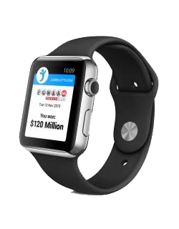
Lotteries want new and innovative products

Slide 4
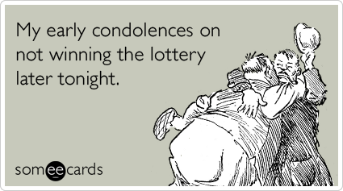
Draw game sales dependent on jackpot size

Slide 5
Lottery sales targets consistently increasing

Slide 6
Limitations on just how innovative you can be

Slide 7
So where’s the Opportunity?
Notes:
This is where I’d like to introduce myself and my company.

Slide 8
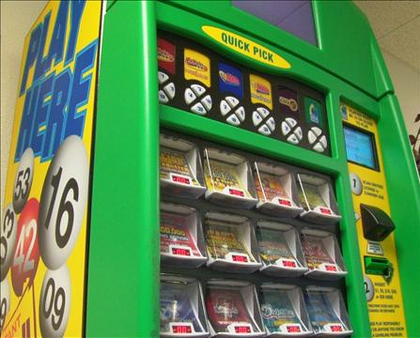

Slide 9
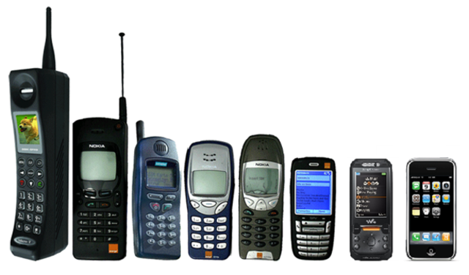
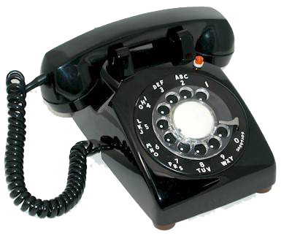

Slide 10
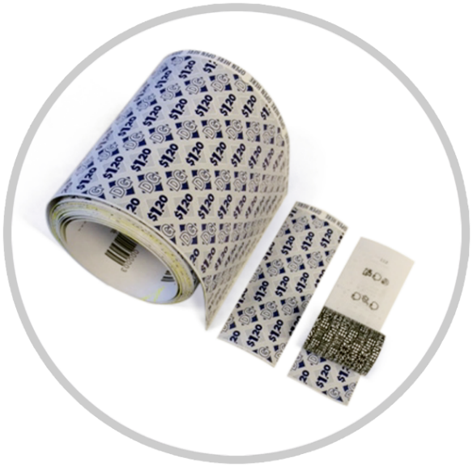

Slide 11
Who can deliver the opportunity?

Slide 13
+
Printing instant tickets
Manufacturing ticket dispensers with video display
Developing unique games and product lines

Slide 14
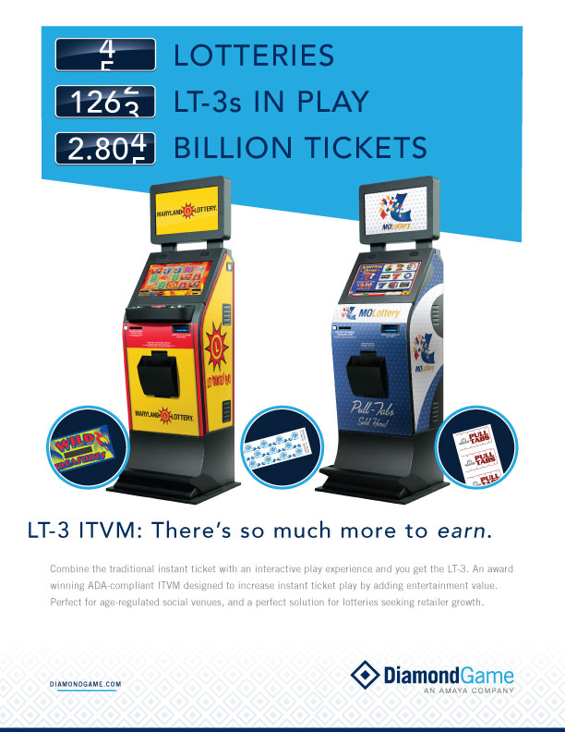

Slide 16
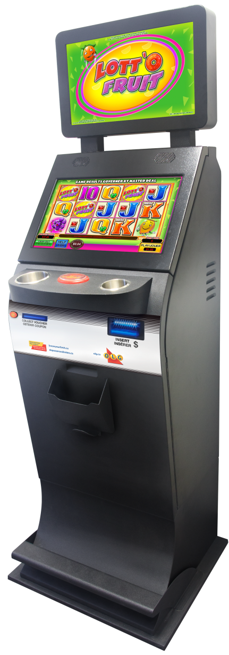
New & innovative, but not really
Consistent sales generation
Incremental sales & retailer expansion

Slide 18
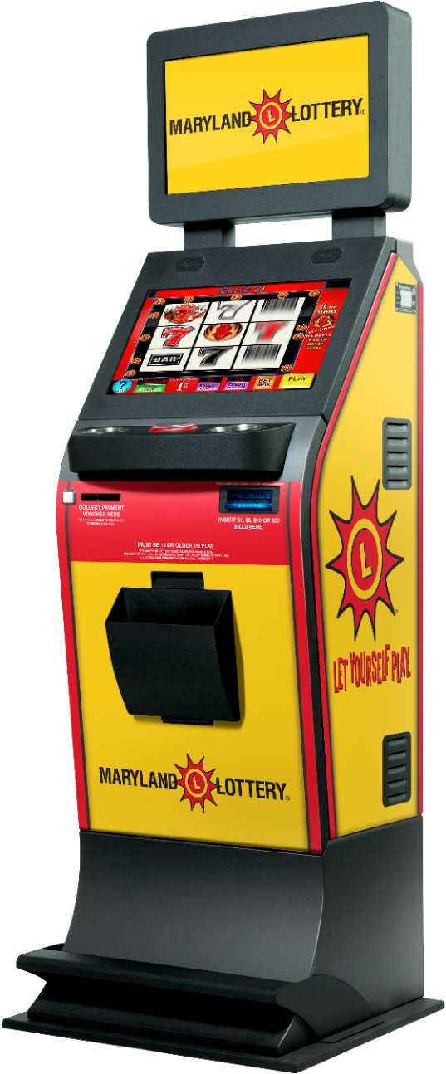
August 2014 deployment
Veteran Halls

Slide 19
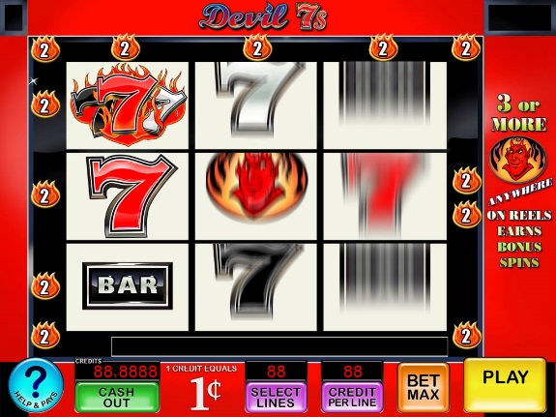
Notes:
Product Configuration

Slide 20
3.8 million tickets/month
Over $22 million in gross sales
$1 million Veteran proceeds

Slide 21
Entertainment value
Higher payout
Longer play experience

Slide 22
