Slide 1
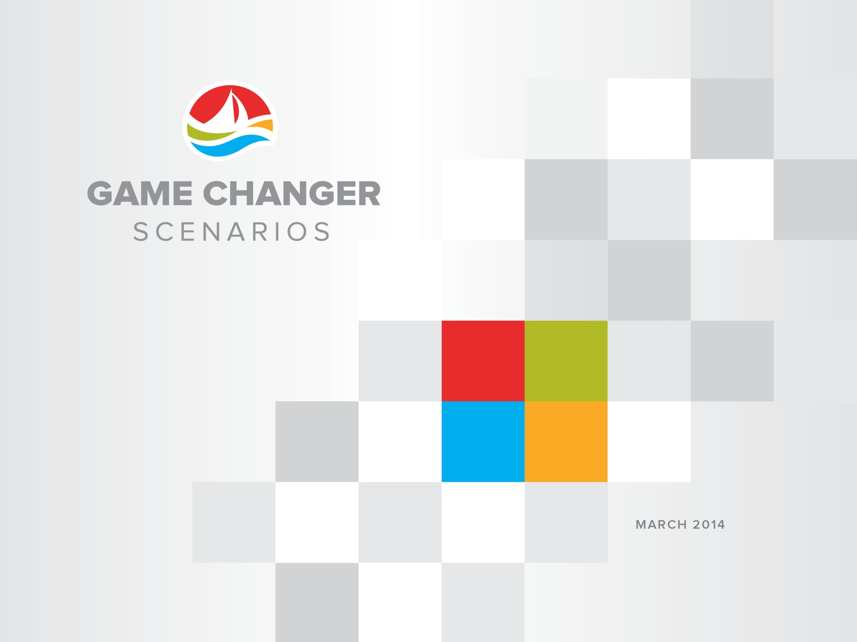
PGRI - Smart Tech – April 2015
Phil Holmes
VP, Strategy & Planning

Slide 2
Transformation to what?
©Atlantic Lottery Corporation 2014

Slide 3
Lottery v2.0
©Atlantic Lottery Corporation 2014

Slide 4

©Atlantic Lottery Corporation 2014

Slide 5
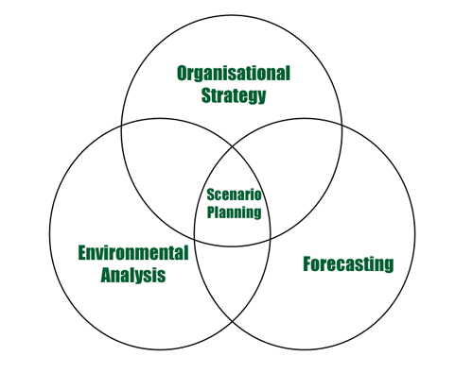
Scenario Planning
©Atlantic Lottery Corporation 2014

Slide 6
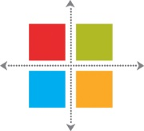
Horizon Mapping
Horizon 1
Horizon 2
Horizon3
Operating Plans
3-5 year Plans
Scenario Planning
Where we are now
Where the industry is going (Trajectory)
Strategic Choices
2030
©Atlantic Lottery Corporation 2014

Slide 7
Scenario Question
What might the Lottery and Gaming industry look like in 2030…
…and how might a gaming company respond to remain relevant?
©Atlantic Lottery Corporation 2014

Slide 8
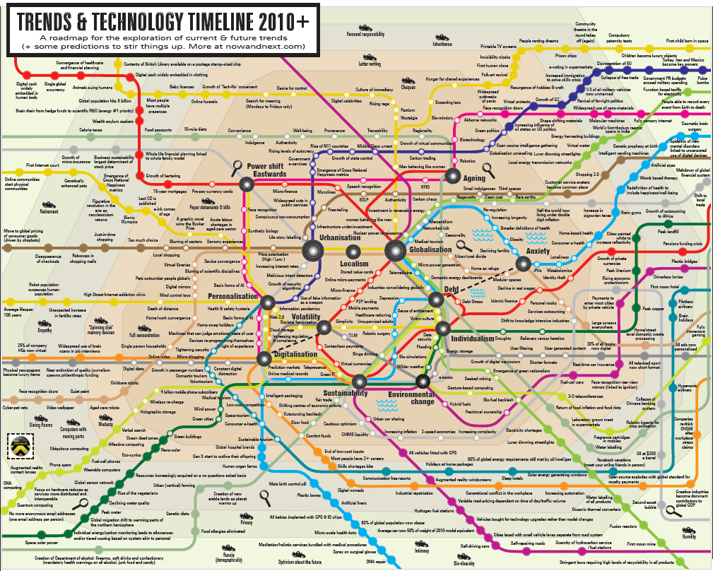
Trends

Slide 9
Trends

Slide 10
Scenario Matrix
High Technology Adoption
CIRCUMVENTION
IMMERSION
Fragmented Market
Unified Market
INTRUSION
COLLABORATION
Low Technology Adoption
©Atlantic Lottery Corporation 2014

Slide 11
Scenario Matrix
High Technology Adoption
CIRCUMVENTION
IMMERSION
Fragmented Market
Unified Market
INTRUSION
COLLABORATION
Low Technology Adoption
©Atlantic Lottery Corporation 2014

Slide 12
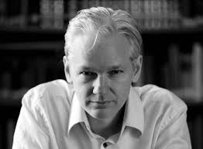
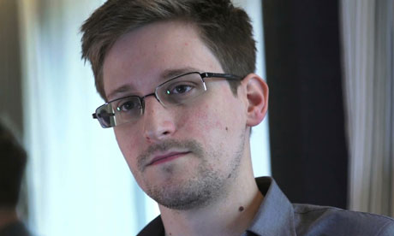




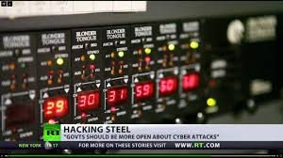

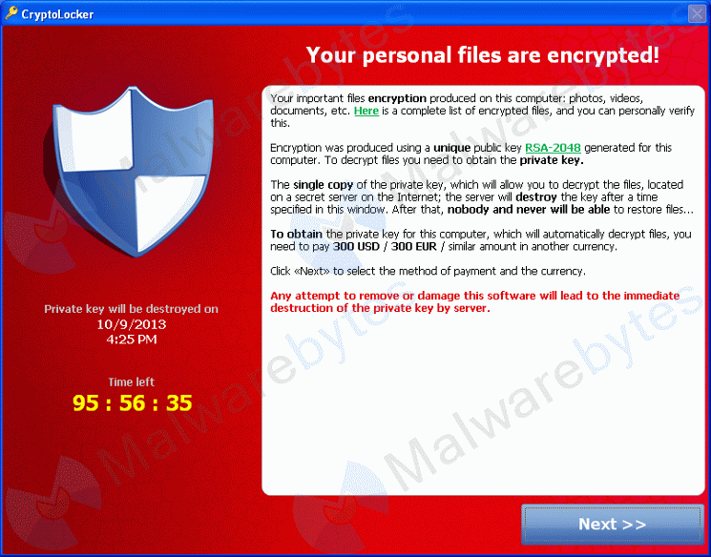
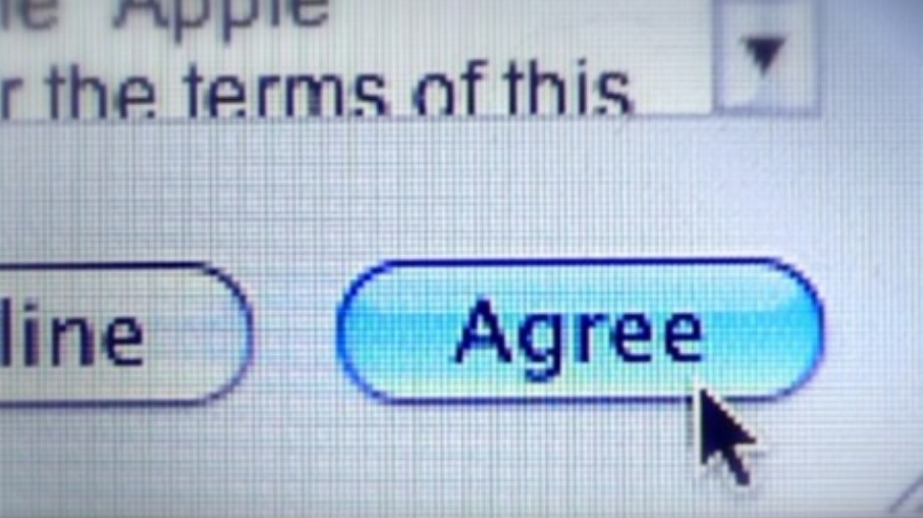
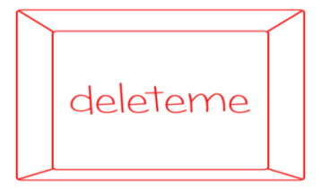

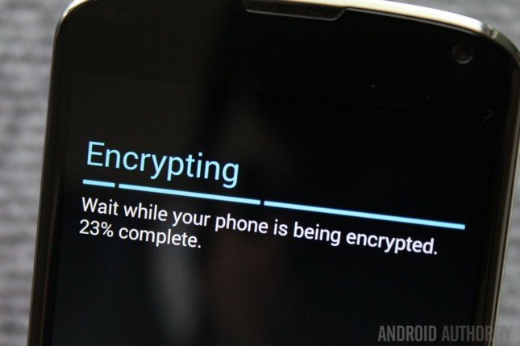

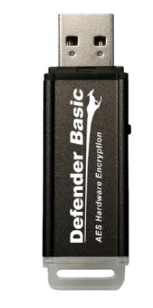

Intrusion
Data
Compromise
Leaky
Apps
CYBER TERRORISM
Digital Simplification
Data
Ransoming
Terms & Conditions
Digital Eject
Organized & Radicalized
Data Amnesty
Zero Day Team
Device Encryption
©Atlantic Lottery Corporation 2014

Slide 13
Scenario Matrix
High Technology Adoption
CIRCUMVENTION
IMMERSION
Fragmented Market
Unified Market
INTRUSION
COLLABORATION
Low Technology Adoption
©Atlantic Lottery Corporation 2014

Slide 14
Scenario Matrix
High Technology Adoption
CIRCUMVENTION
IMMERSION
Fragmented Market
Unified Market
INTRUSION
COLLABORATION
Low Technology Adoption
©Atlantic Lottery Corporation 2014

Slide 15


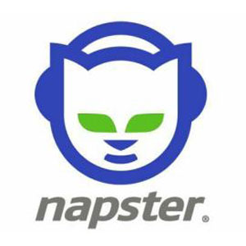










Circumvention
Legislation
Prohibition
Market Speed
Virtual Payments
Spirit of the Law
Social Acceptance
©Atlantic Lottery Corporation 2014

Slide 16
Scenario Matrix
High Technology Adoption
CIRCUMVENTION
IMMERSION
Fragmented Market
Unified Market
INTRUSION
COLLABORATION
Low Technology Adoption
©Atlantic Lottery Corporation 2014

Slide 17
Scenario Matrix
High Technology Adoption
CIRCUMVENTION
IMMERSION
Fragmented Market
Unified Market
INTRUSION
COLLABORATION
Low Technology Adoption
©Atlantic Lottery Corporation 2014

Slide 18
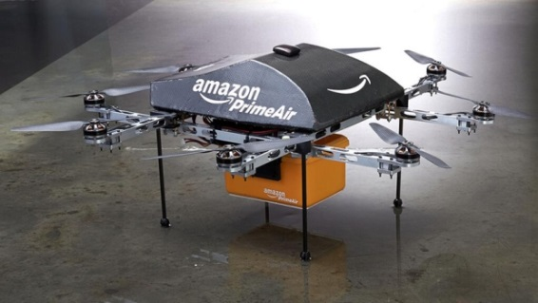
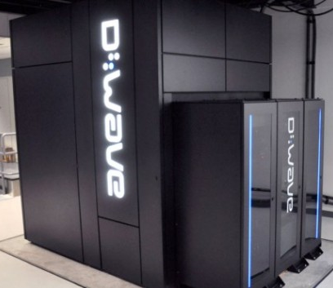
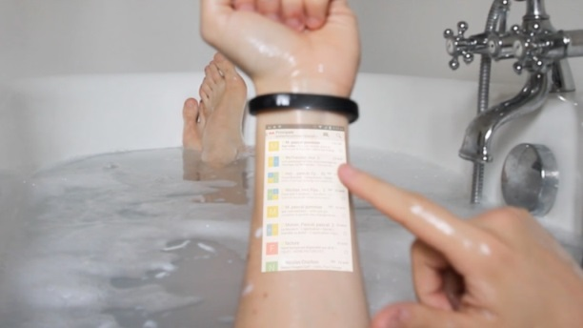

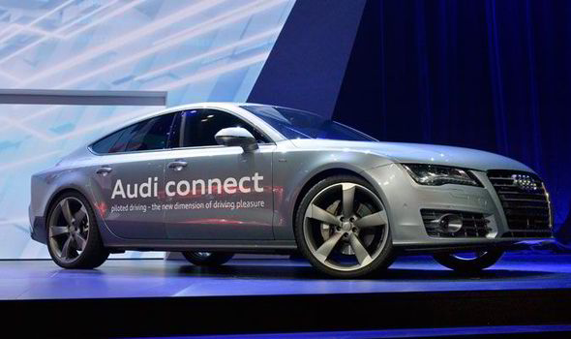

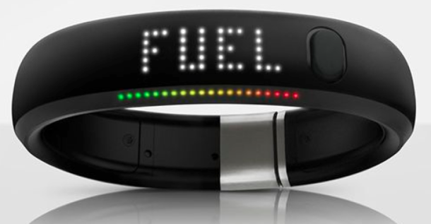
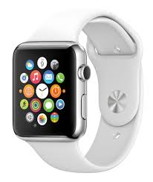
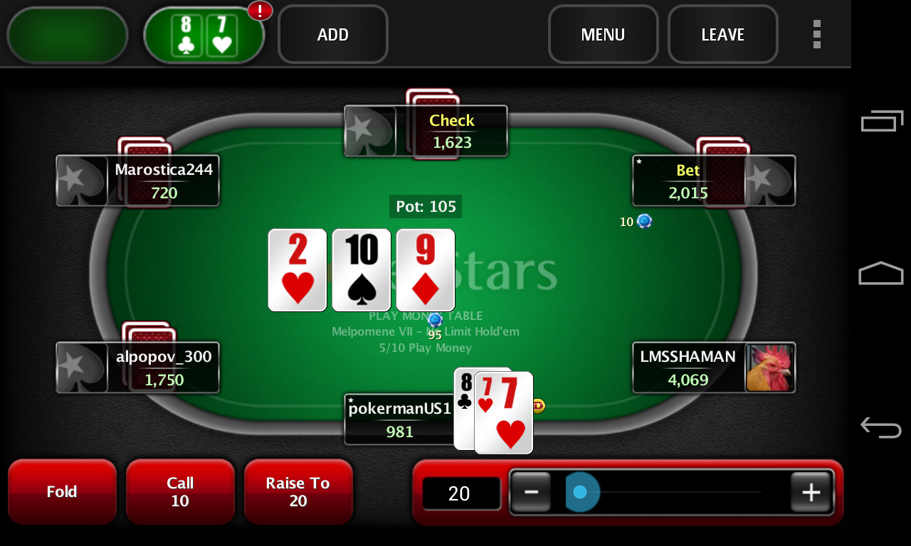

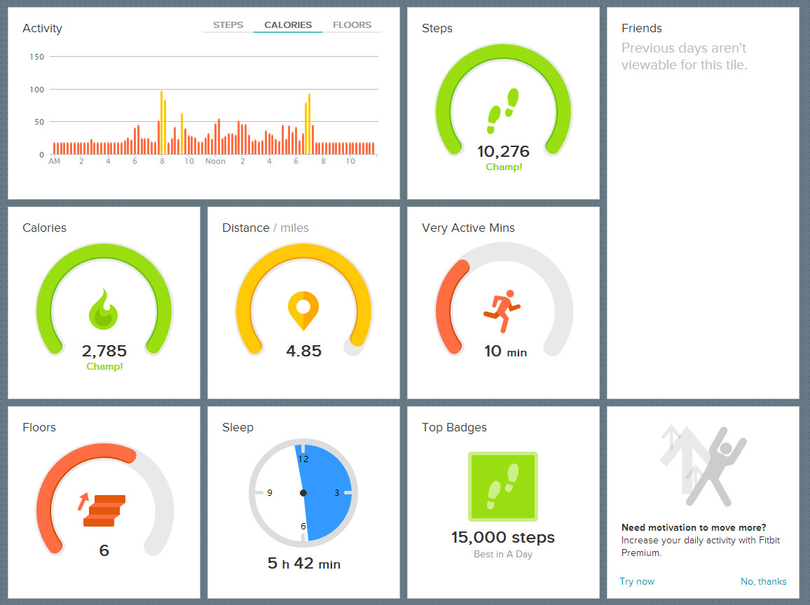

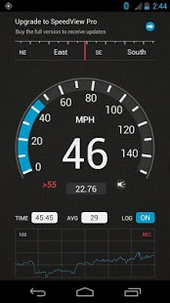
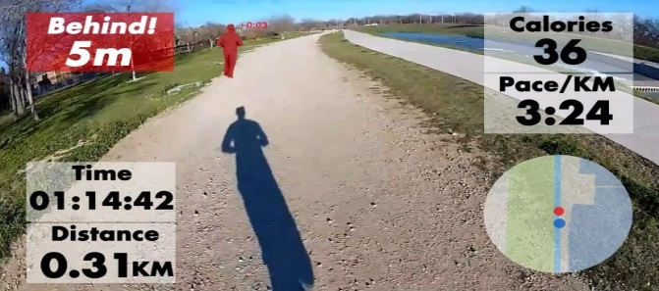


Immersion
Drones
Fully Immersive Gaming
Quantum Platforms
Autonomous Vehicles
Quantified Self
Fully Immersive Gamification
Social Engineering
Big Data
Implicit → Explicit
Disruptive Alliances
Gaming Eco System
©Atlantic Lottery Corporation 2014

Slide 19
Scenario Matrix
High Technology Adoption
CIRCUMVENTION
IMMERSION
Fragmented Market
Unified Market
INTRUSION
COLLABORATION
Low Technology Adoption
©Atlantic Lottery Corporation 2014

Slide 20
Scenario Matrix
High Technology Adoption
CIRCUMVENTION
IMMERSION
Fragmented Market
Unified Market
INTRUSION
COLLABORATION
Low Technology Adoption
©Atlantic Lottery Corporation 2014

Slide 21

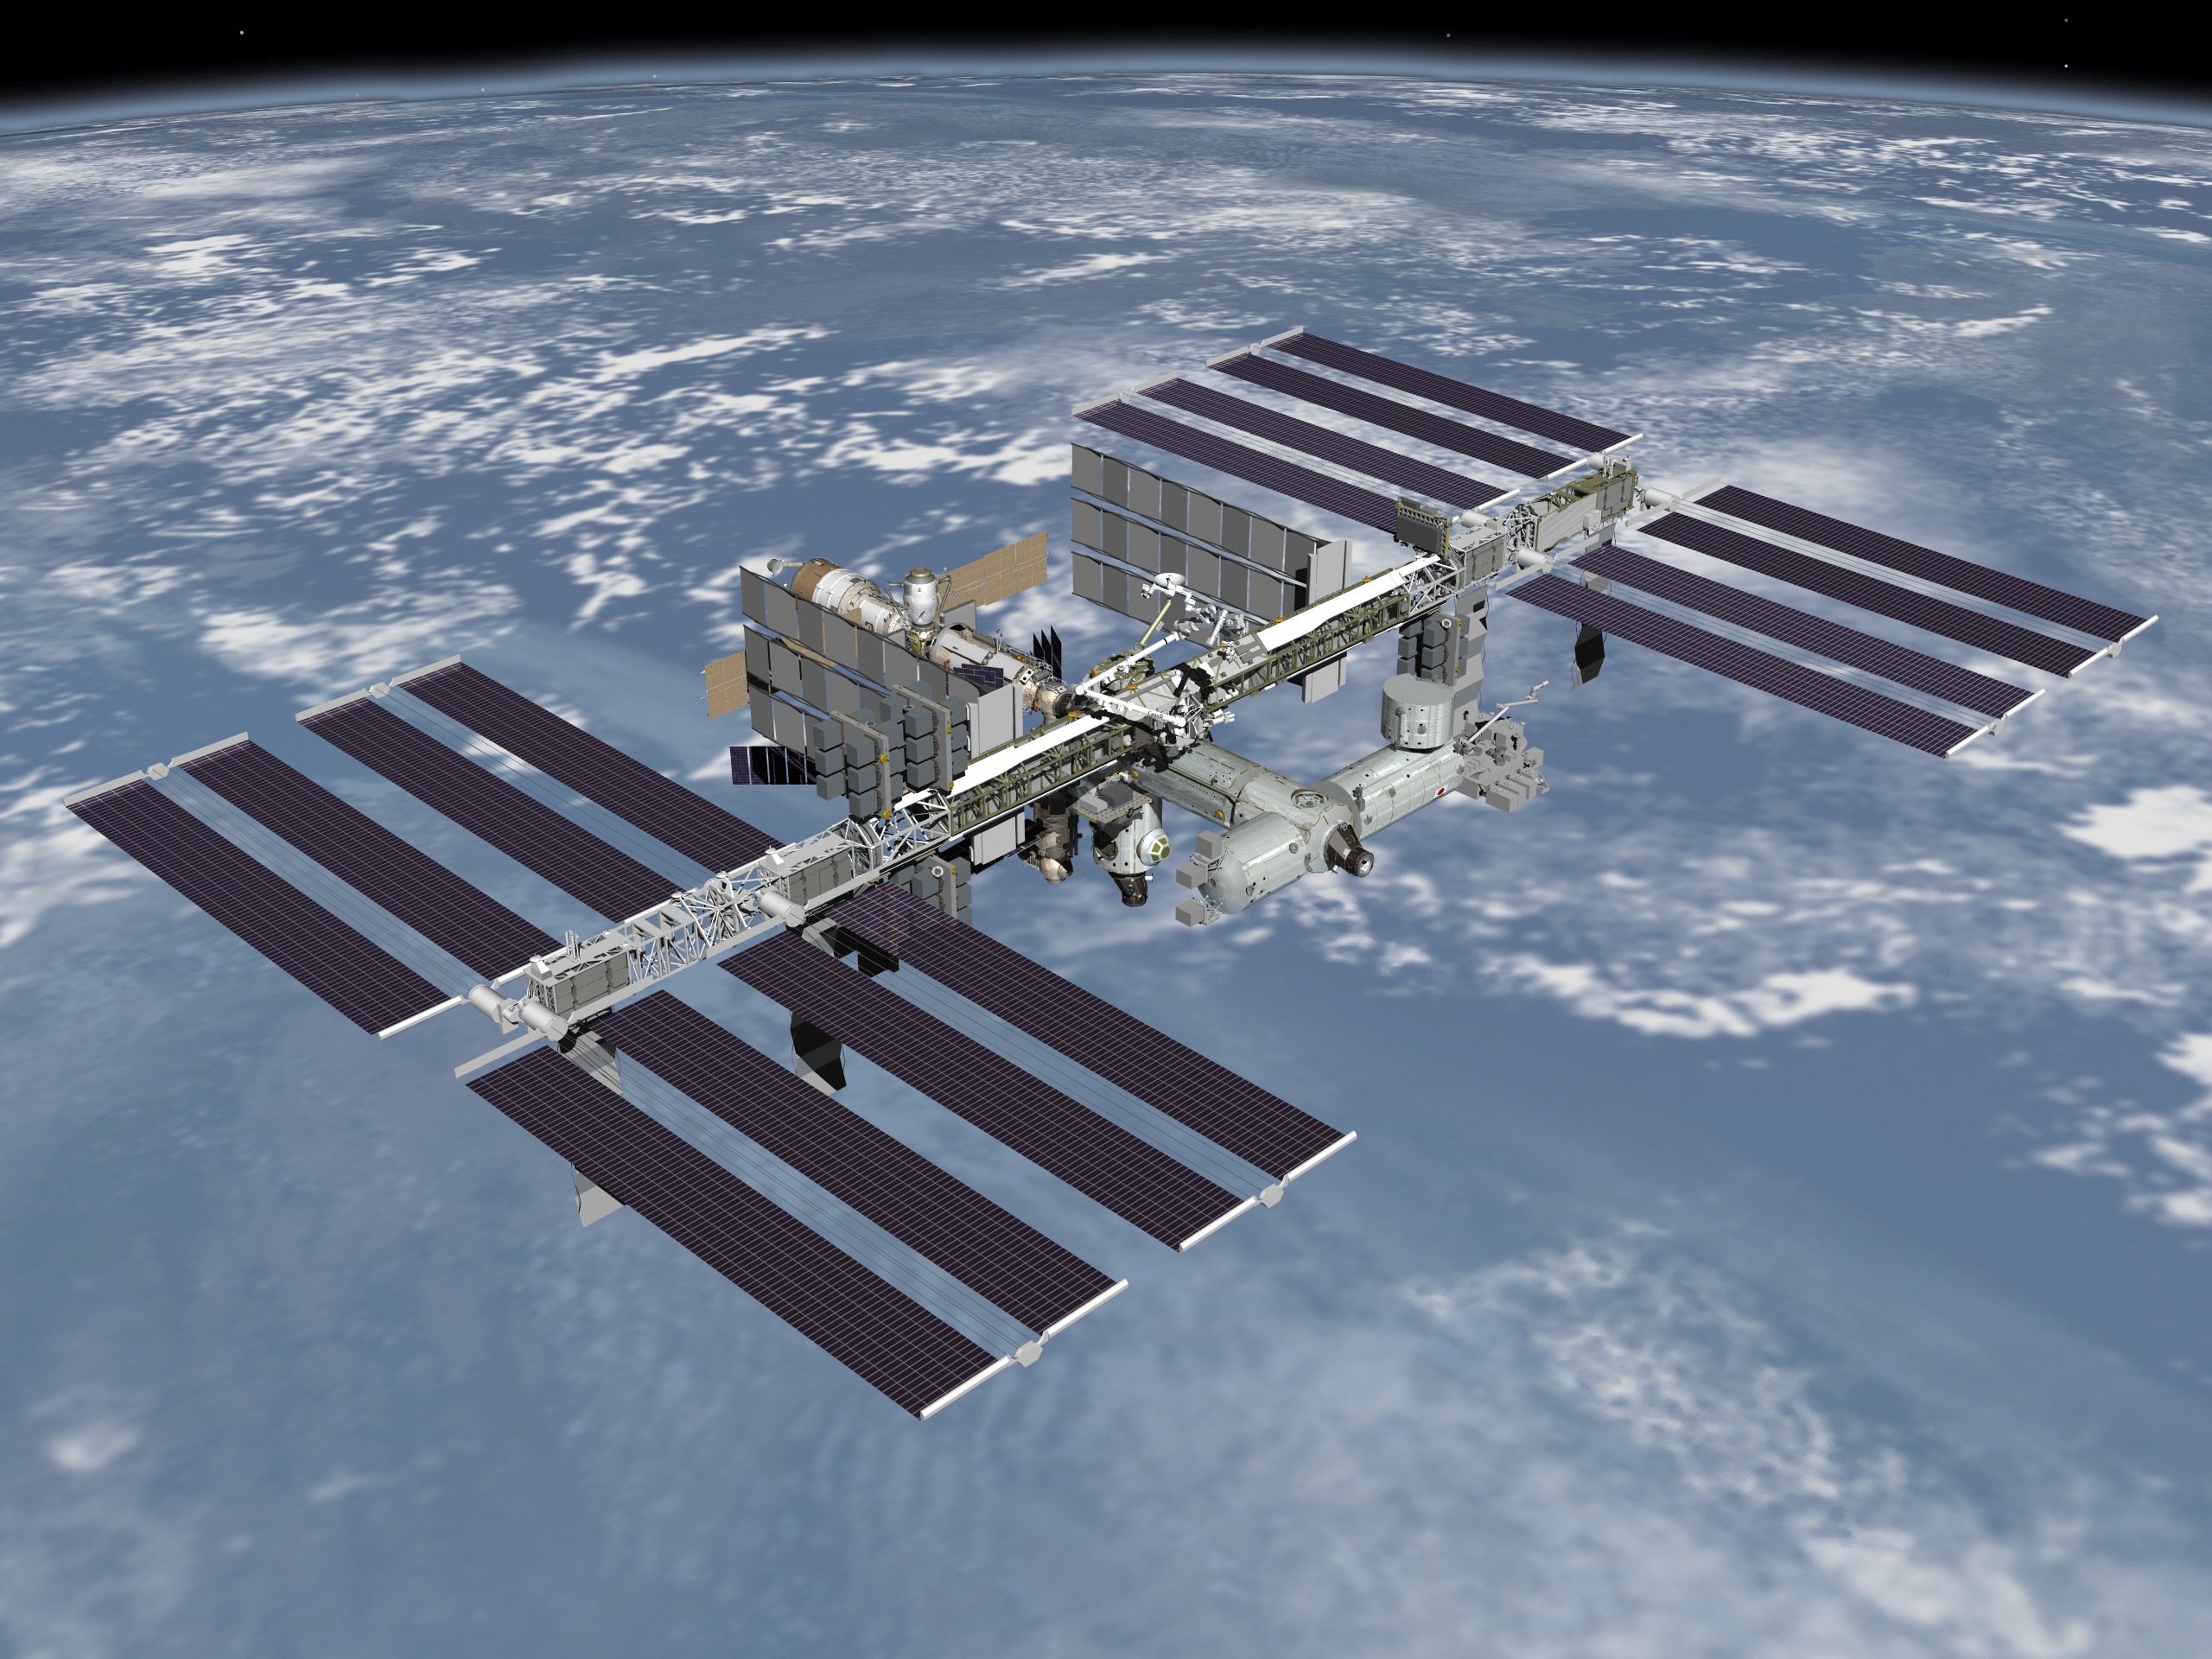
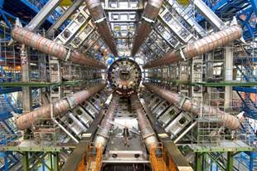




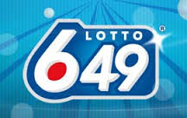


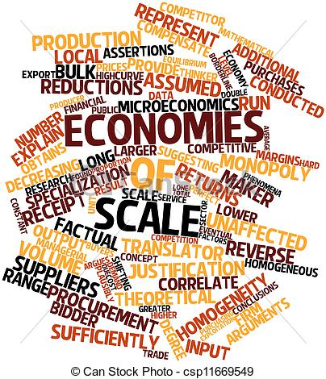



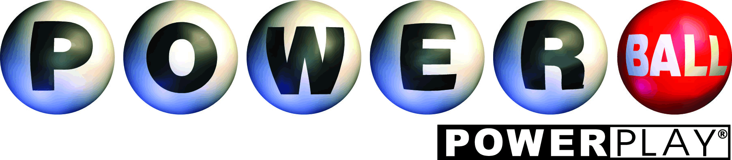


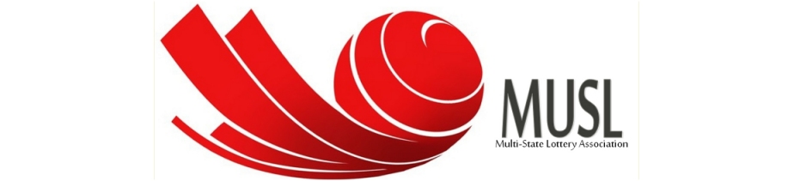





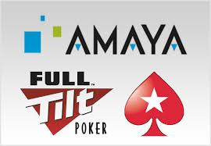




Collaboration
Association
+
Product
Service
Collaboration
Reactive - Defensive
Consolidation
Proactive – M&A
©Atlantic Lottery Corporation 2014

Slide 22
Scenario Matrix
High Technology Adoption
CIRCUMVENTION
IMMERSION
Fragmented Market
Unified Market
INTRUSION
COLLABORATION
Low Technology Adoption
©Atlantic Lottery Corporation 2014

Slide 23
Implications
Horizon 1
Horizon 2
Horizon 3
Circumvention Collaboration Immersion
2030
©Atlantic Lottery Corporation 2014

Slide 24
Conclusions
…no single scenario…
…exponential…
…2030…2015…1915
©Atlantic Lottery Corporation 2014

Slide 25
PGRI - Smart Tech – April 2015
Phil Holmes
VP, Strategy & Planning

