Slide 1
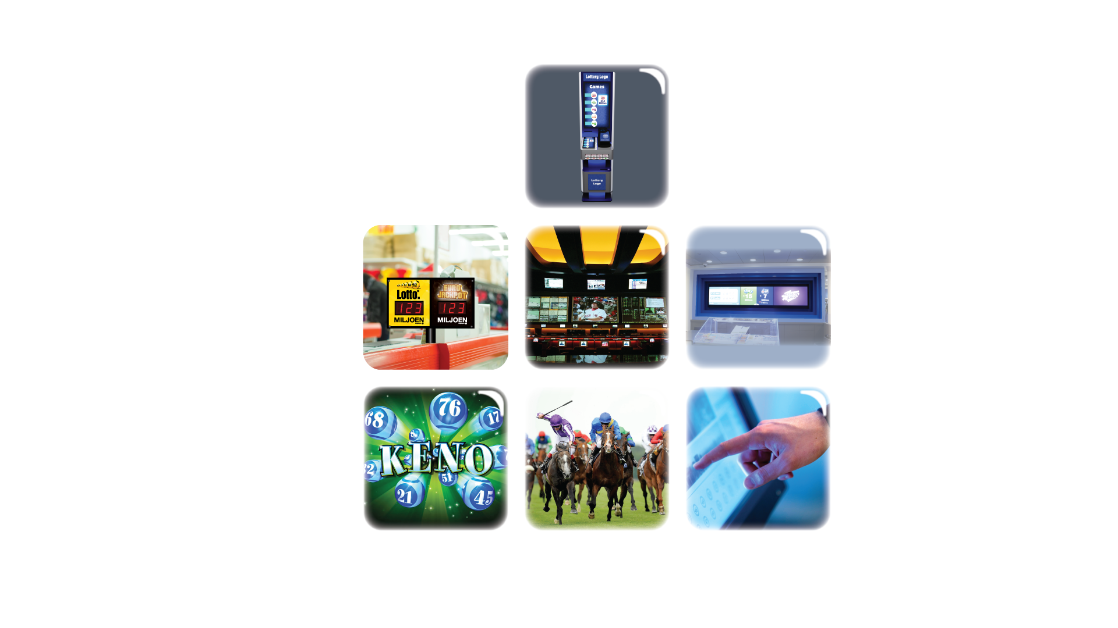
Investing in Technology at Lottery Retail

Slide 2
The need to invest in Digital at Retail
Latest consumer store visit data - Kantar
Latest TV Ad spend data - Wall Street Journal
Examples of large scale digital sign deployments
Examples of Lottery digital signs at retail

Slide 3
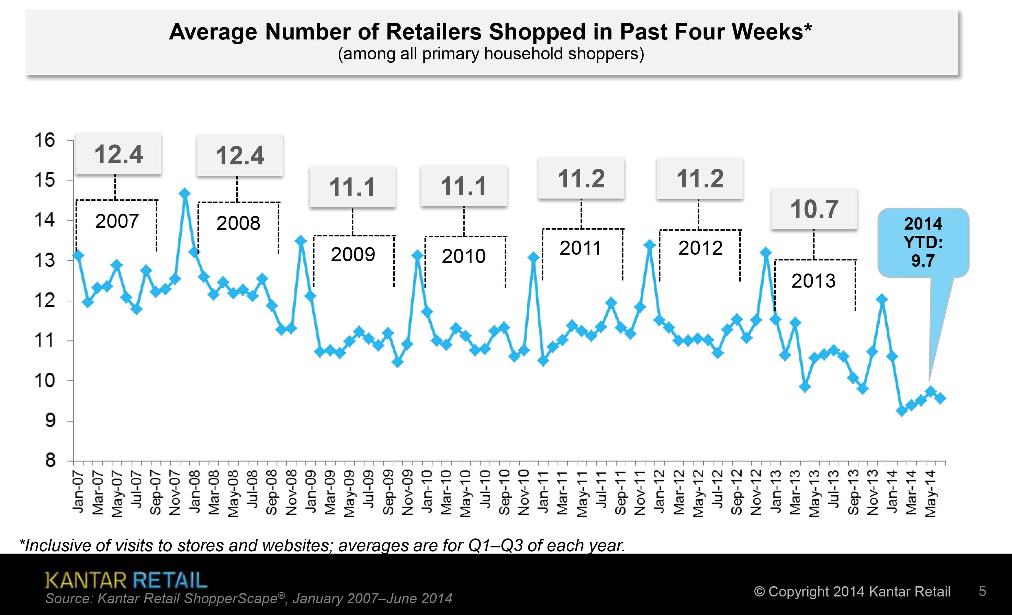
Why is this evolution important?

Slide 4
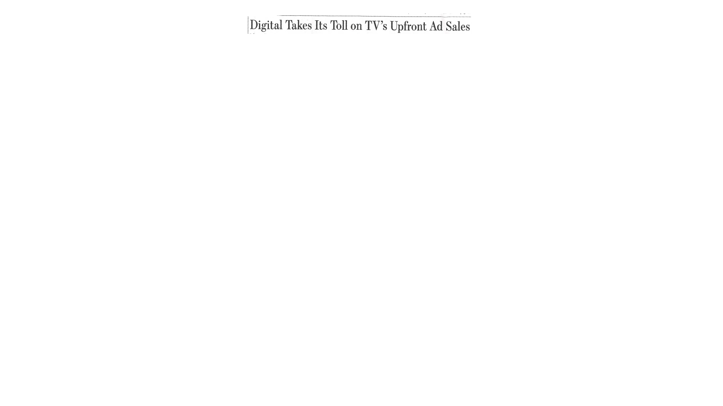
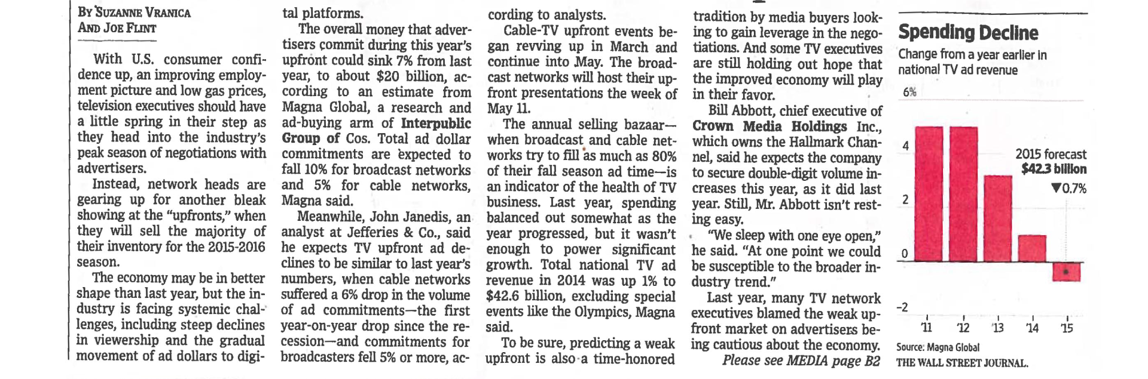
Wall Street Journal, March 26, 2015
“Over the Top” content services are reducing TV ad sales (Netflix, Apple TV, Hulu)
“ Upfronts” could sink 7% from last year
    10% decrease for Broadcast channels
    5% decrease for Cable channels
  (according to Magna Global/Interpublic)
Brands need new ways to influence consumers at retail

Slide 5
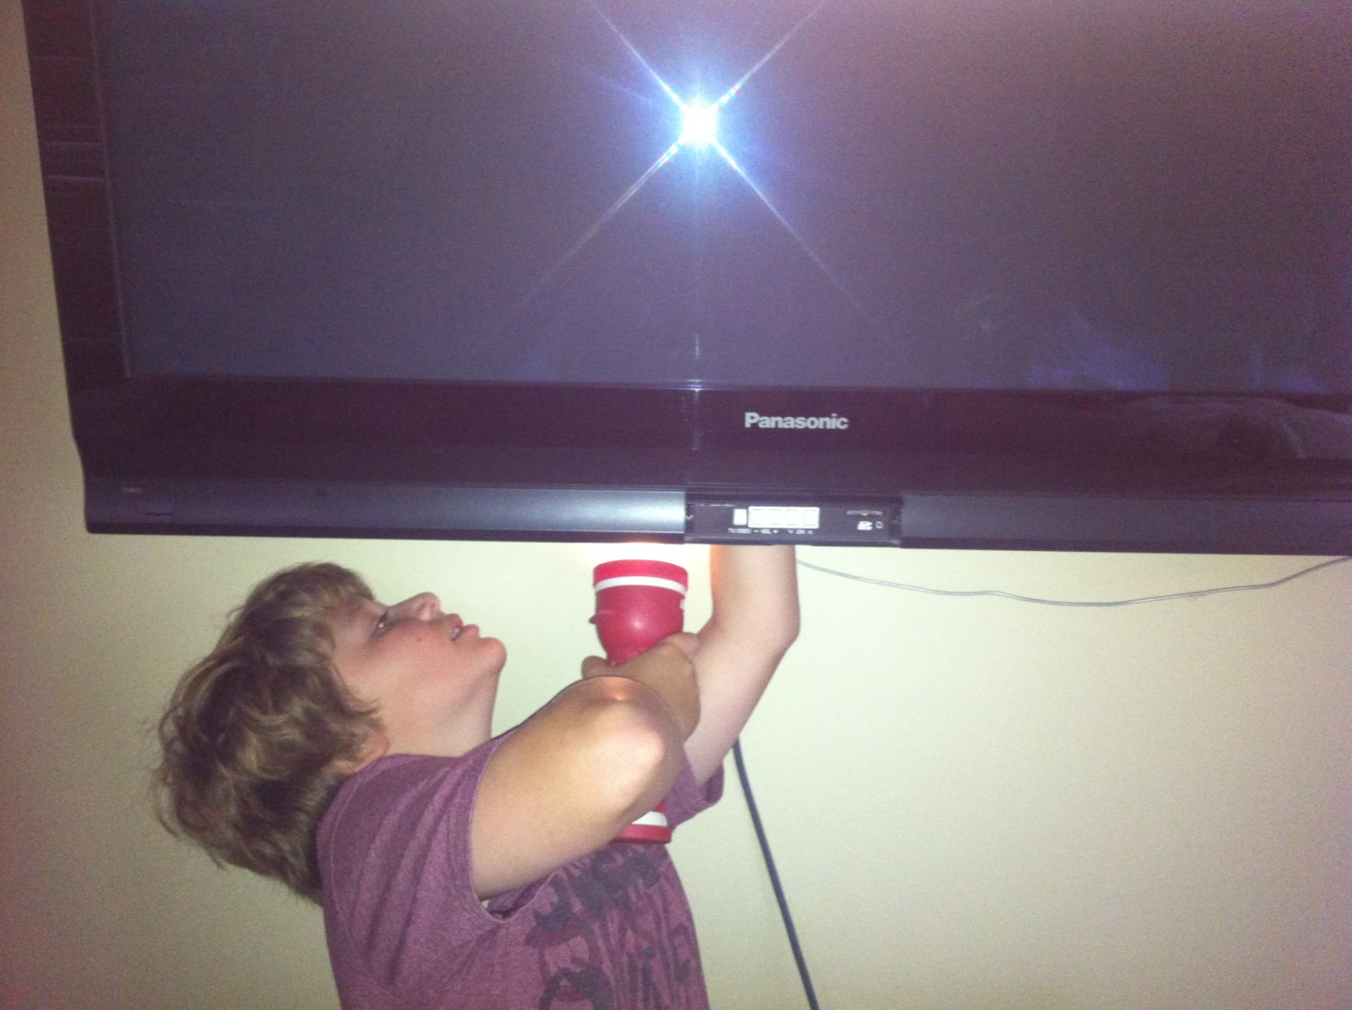
Digital Natives Expect Digital Experience

Slide 6
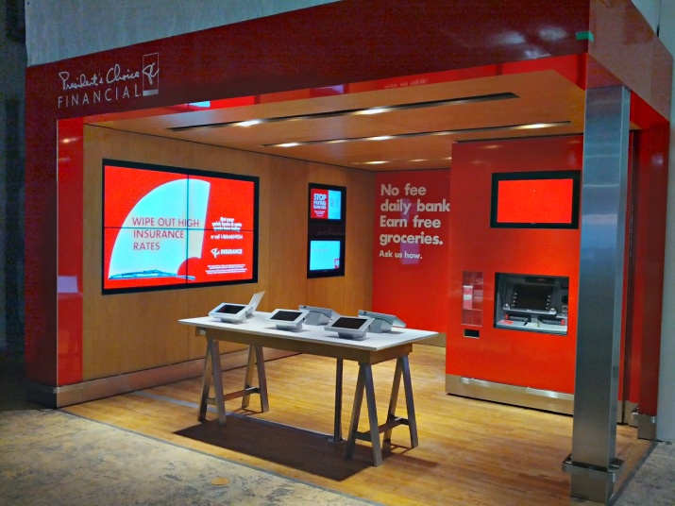
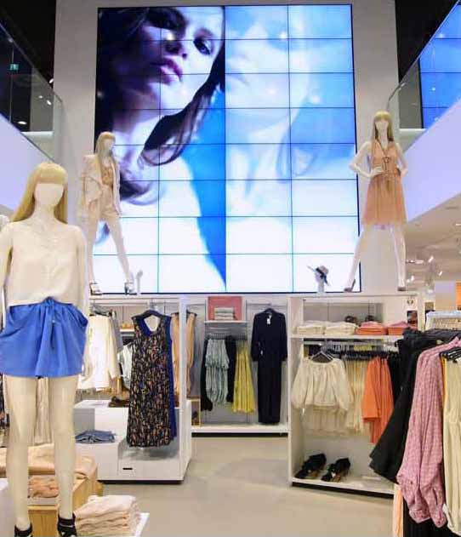
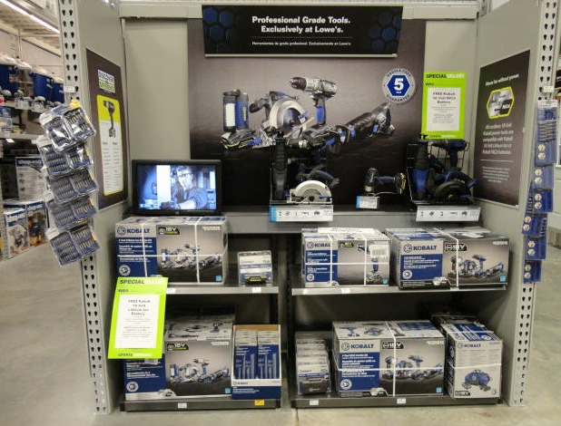
We are all becoming DIGITAL NATIVES
All of the cool new technology you see here is not a luxury - it is expected !

Slide 7
What does digital at retail look like?
Here are some examples of large scale STRATACACHE deployments

Slide 8
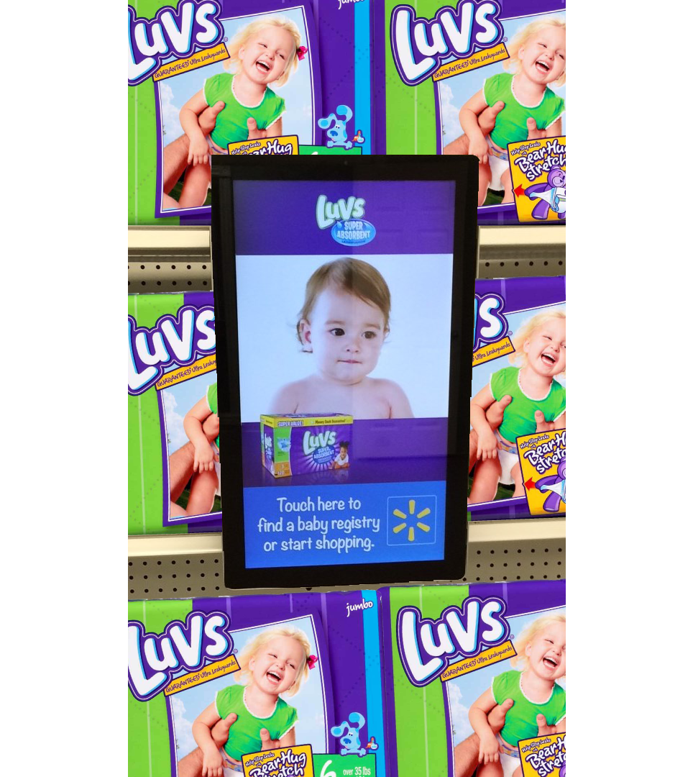
Walmart End-Cap Solution
34,000 Tablets on end caps in 3800 stores
Brand-paid advertising & product information
Touch enabled shopping
Back-facing product verification cameras

Slide 9
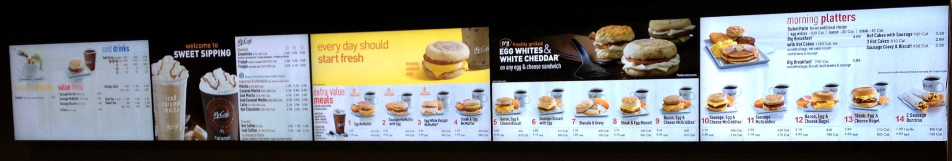
McDonalds Menu Boards
STRATACACHE manages 24,000 digital menu boards, internationally
In-store digital advertising is more than just content being digital
It is a network of connected screens that can be triggered to automatically display relevant content
For example – promote cold drink video on hot day, automatically triggered by RSS weather data feed

Slide 10
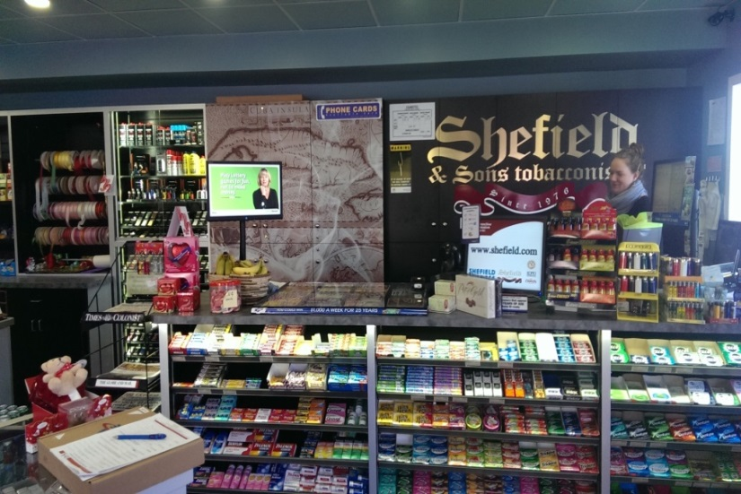
BCLC Retail
STRATACACHE manages an independent digital sign network on behalf of BCLC
Screens at retailers
Video Walls
Interactive experiences

Slide 11
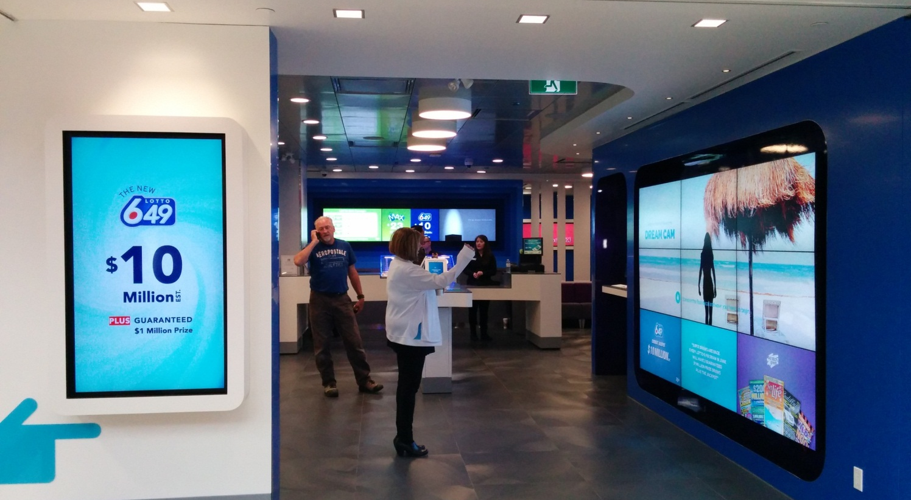
BCLC Signature Store - Gestural Video Wall
Notes:
Retail sales optimization is more important than ever.
New technologies are enabling new retail experiences, and so
Consumers expect brands to raise their game at Bricks & Mortar retail.

Slide 12
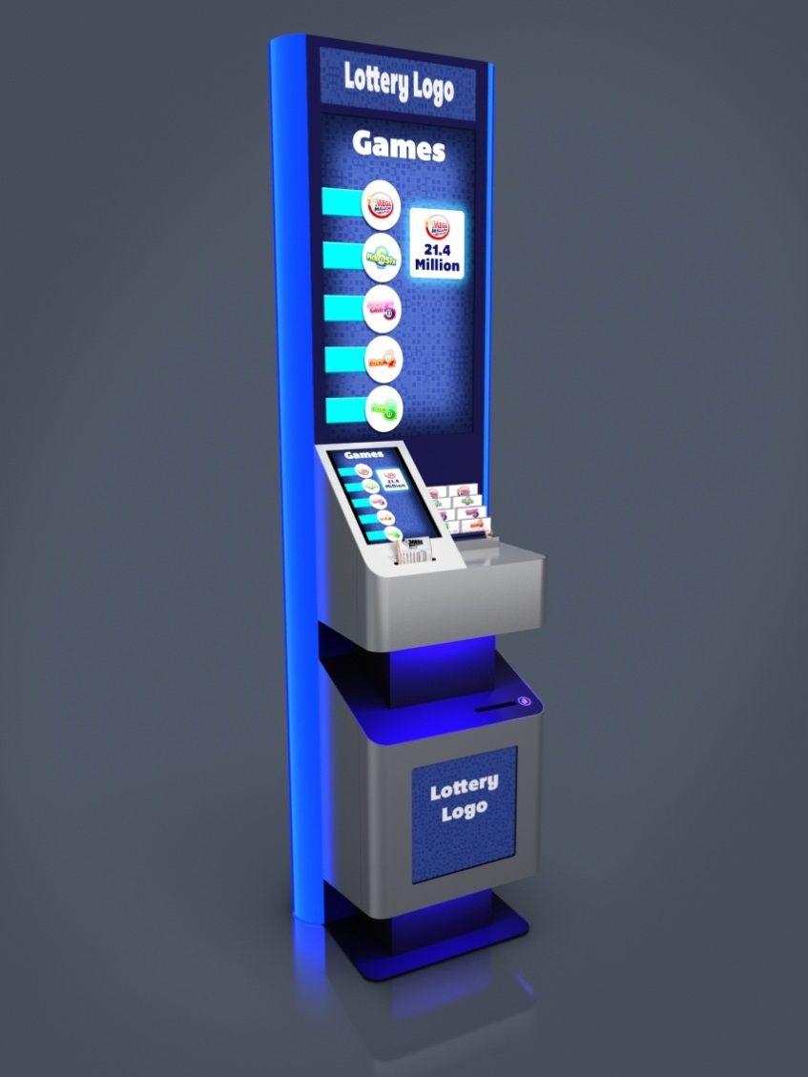
Digital Play Stations
Large LCD display plus touch tablet & ticket checker
CTA & Advertising
Product & play information
Facilitates quick picks & reduces congestion at cash
Come see it at NAPSL!

Slide 13
Summary
Competition for consumers attention is increasing as consumers are making fewer trips to stores
Digital engagement at retail is a necessity to reach your audience where they shop
Locations without dynamic media risk being seen as “stale” or “outdated”

Slide 15


