Slide 1

The Numbers Game

Slide 2









Slide 3

76% of purchase decisions are being made in store.

Slide 4
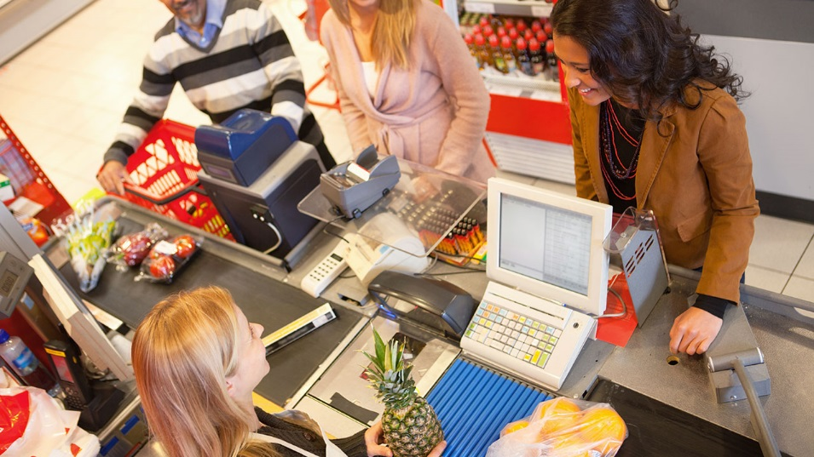
21 SECONDS

Slide 5





POS Strategy: Signage Placement
3
Point of purchase
2
Store entry
1
Outside store

Slide 6
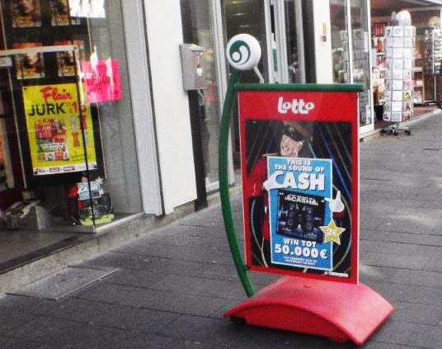
Outside Store

Slide 7
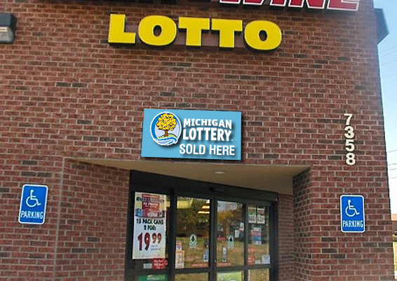
Store Entry

Slide 8
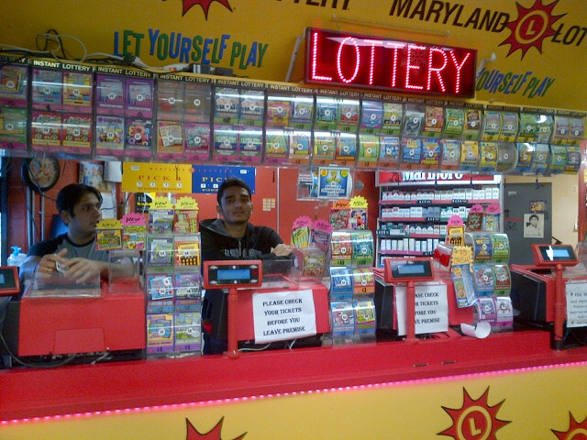
Point of Purchase

Slide 9

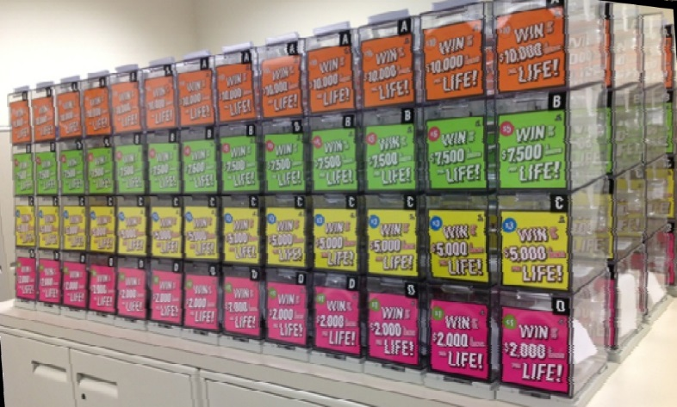
Innovative Solutions…

Slide 10
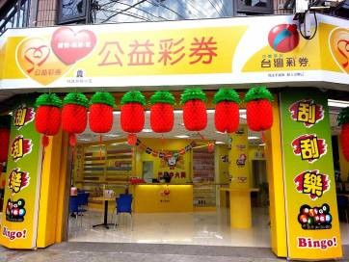
Innovative Solutions…

Slide 11
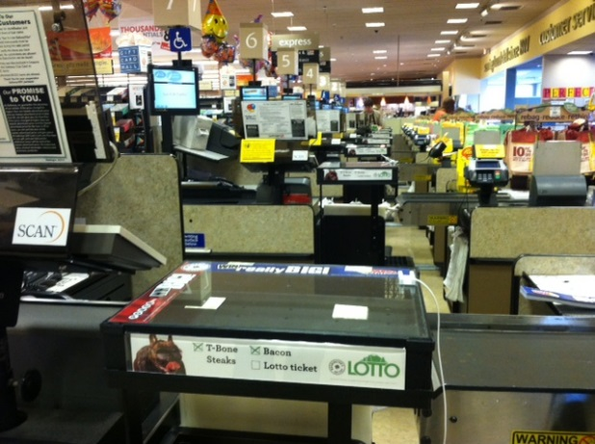
Innovative Solutions…

Slide 12
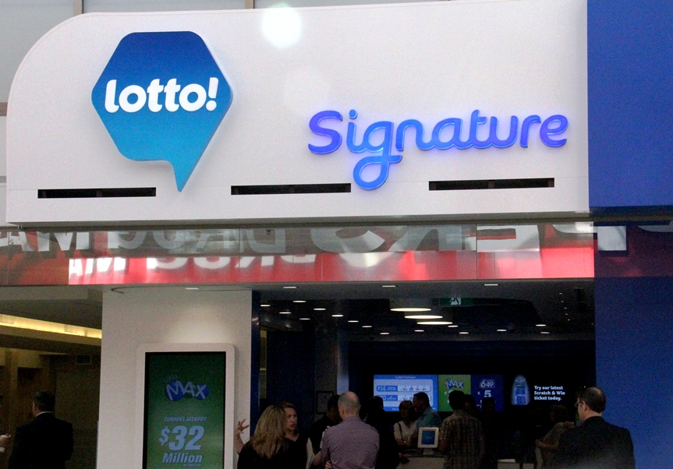
Innovative Solutions…

Slide 13

Endcaps meet the Lottery world….
Special displays at end of isle
Sample instant tickets in display

Slide 14
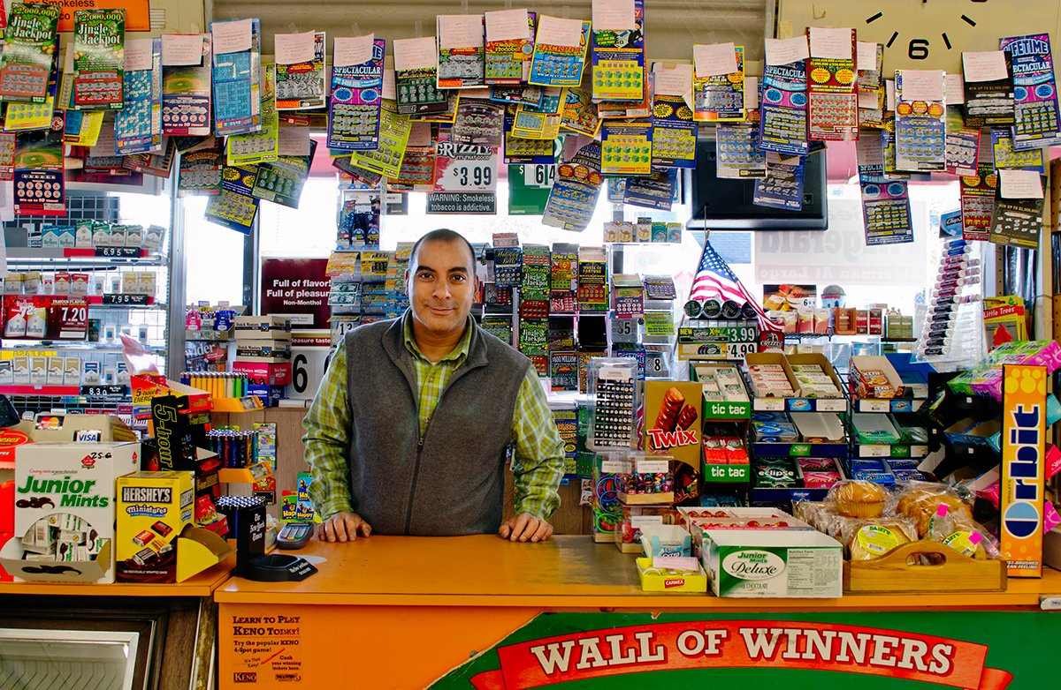
Winner Awareness

Slide 15

Winner Awareness

Slide 16

3 WEEKS

Slide 17



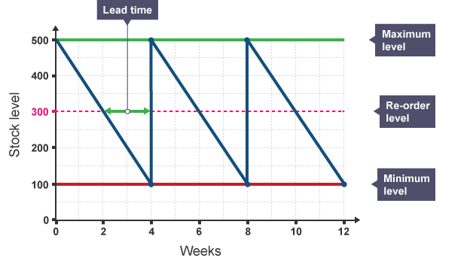
LOTTERY
MANAGEMENT SYSTEM

Slide 18


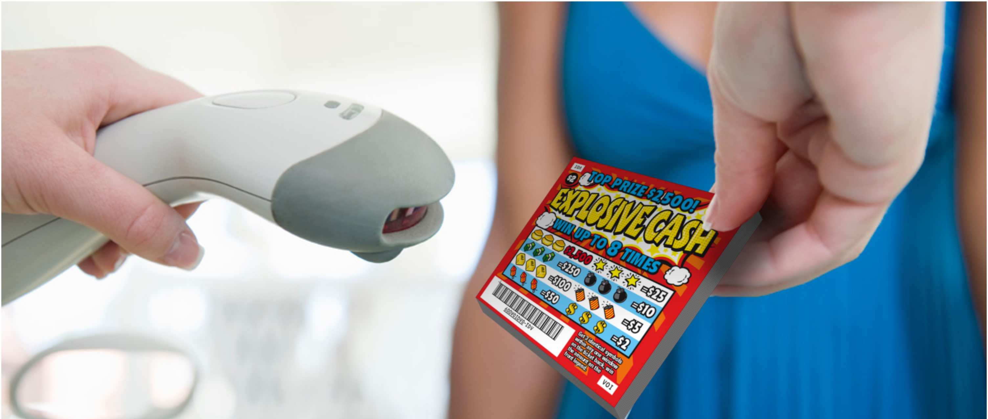

Slide 19



Slide 20

Retailer Relationships
1
:
120
Retailers
Field Service Staff

Slide 21


Slide 22



Slide 23



Slide 24
Contact Me
Matt Isaac
Director, Retail Development
ph: 813.957.0755
Email: misaac@pbl.ca

