Slide 1

Speed Date Your Customers
Customers
Leigh-Ann Goad
Market Research & Consumer Strategist
Notes:
Introduction
Clever way to say that with technology, we have so much opportunity to learn more about our customers, our players. And it can be faster and more enriching then ever before.

Slide 2
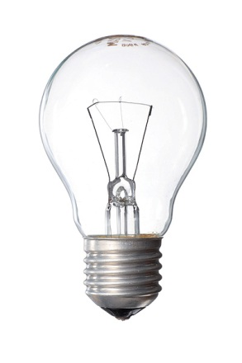
#findthetruth
Taking Data to Insights
Notes:
passionate about taking research or data and turning into great customer insights. We have so much data - it can comes from our surveys, interviews, observations but also digital from what people are doing on our websites, mobile apps, e-commerce platforms, etc…
Find the Truth– Data doesn’t lie - but it’s important to uncover the truth. Once you uncover the truths, you have insights
Insights are what you can carry forward
Customer centric research builds on and on with each project you do
Ex: three concepts, players like A, sense of control, challenge, required me to think, etc…
Now we can take our insights and apply them to future games, promotions, etc…

Slide 3

#whatisnext?
Technology Enabled Research
Enrich your research w/ insights
Outside the comfort zone

Slide 4
#abbreviatedworld
LOL
K
brb
Notes:
Ok – so we live in a world with abbreviations: LOL (laugh out loud), BRB (be right back), K (ok), so it is harder to get quality open ends from our surveys – especially web-based.

Slide 5
#novagueopenends
Better than other concepts
Value
Appealing
Get at the Truth!

Slide 6

#iChat
Enrich your survey data
Allows for a conversation
Show pictures or video
Notes:
Let me introduce you to iChat. It’s a great way to enrich your quantitative studies - How iChat works – you identify a set of criteria (people who like Concept A), at end of survey, we would like to you more about Concept A, do you have a few minutes to enter a live chat? Yes – get more e-rewards, go into a chat session with a moderator who has a discussion guide.

Slide 7
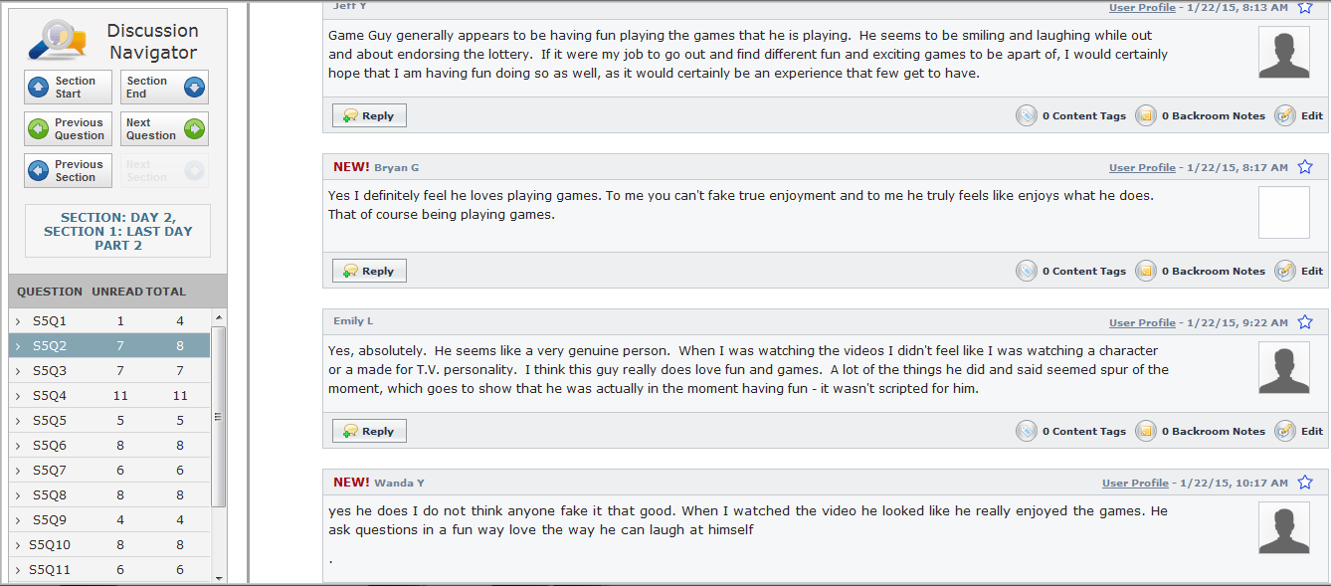
Discussion Board

Slide 8
#momentintruth
Capturing consumers in the moment
Not relying on memory

Slide 9
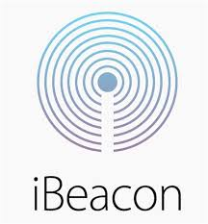
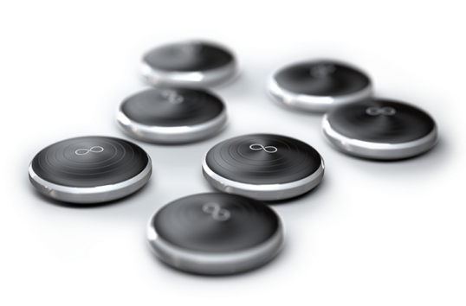
#iBeacon
Notes:
One of the newer technologies are ibeacons. I first heard about ibeacons last year at a Market Research Association conference. It utilizes micro-locations. A little bigger than a quarter, ibeacons can be placed anywhere, they broadcast out a signal that communicates with Apple and Android phones.

Slide 10
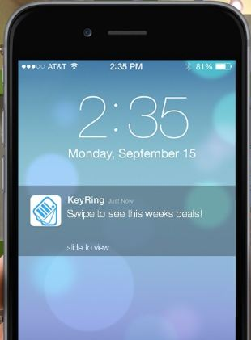
#iBeacon
Notes:
Several ways ibeacons can work – but the basic is that it broadcasts out a signal that is recognized by Apple and Android phones – sends a notification. Best way is to utilize a mobile app that a person has already downloaded (explain example using lottery app)
Incentives (Yes and no)
Pros (get moment in truth data)
Cons (is it an intrusion? Privacy concerns)

Slide 11

#ontothepanelist
Be inspired
Find the truths
Notes:
Wrap-up

