Slide 1
LOTTERY SOFTWARE
SOLUTIONS
for true believers

Slide 2
3
Decisions

Slide 3
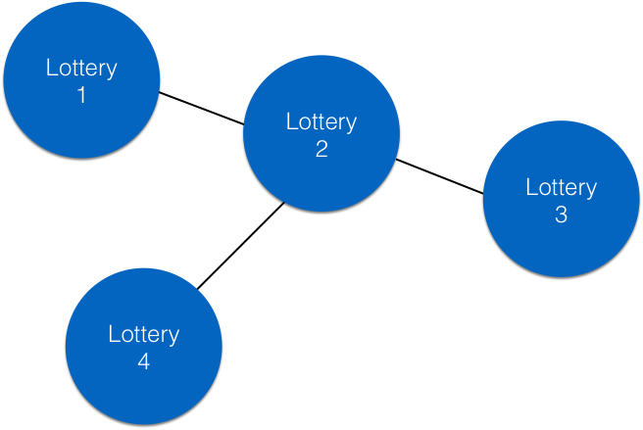

Slide 4
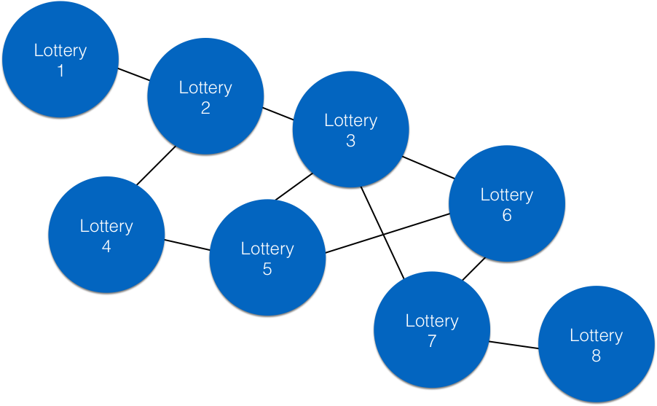

Slide 5
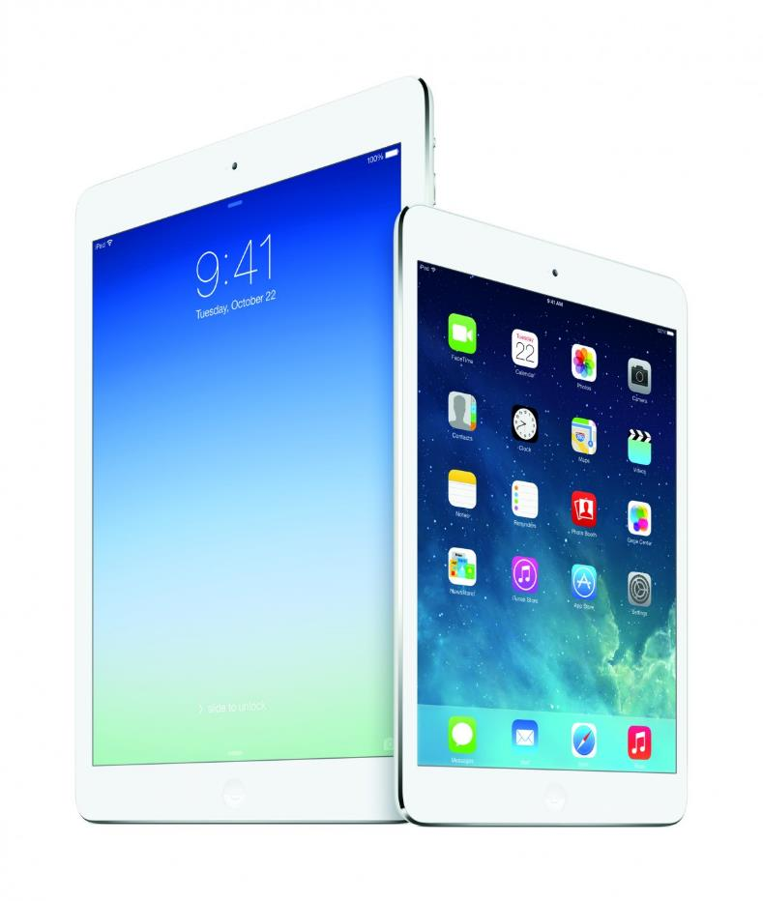

Slide 6
1
Go native.

Slide 7
2
Start with a blank
screen.

Slide 8
3
Configuration trumps
customization.

Slide 9
100%
Features immediately
available to all lotteries.

Slide 10
90%
Reduction in
implementation costs.

