Slide 1




Slide 2

EDUCATE & EXPAND
PRODUCT ENHANCEMENT
DRIVE to RETAIL

Slide 3
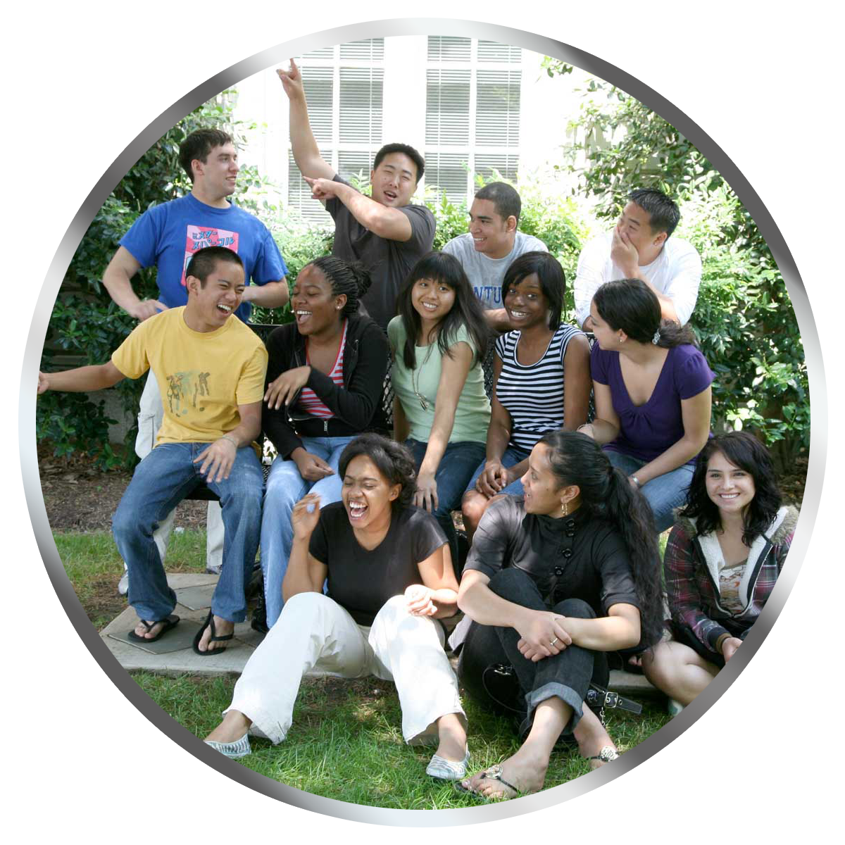
The New Customer

Slide 4
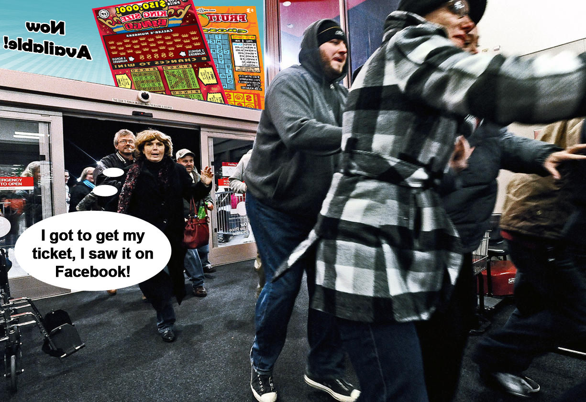

Slide 5


Slide 6




Slide 7



Slide 8

RETAIL

Slide 9


Slide 10

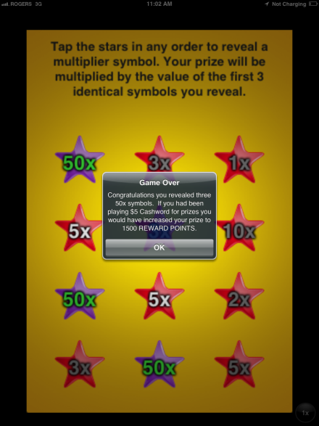
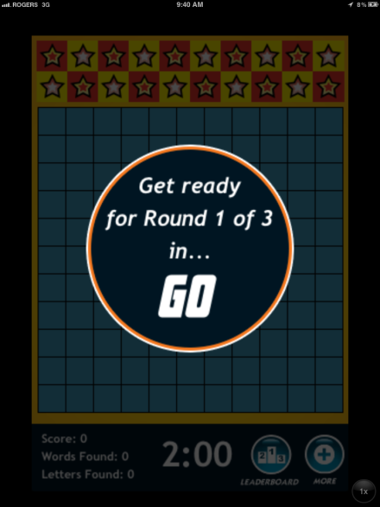
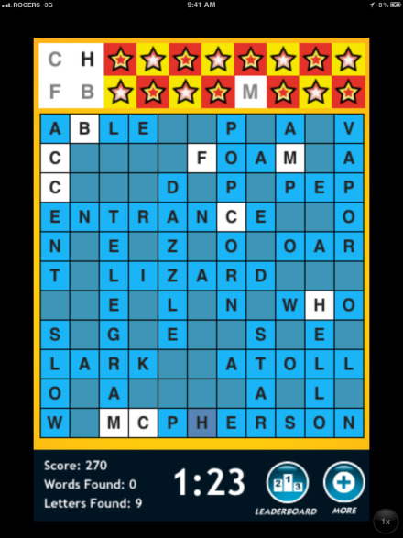
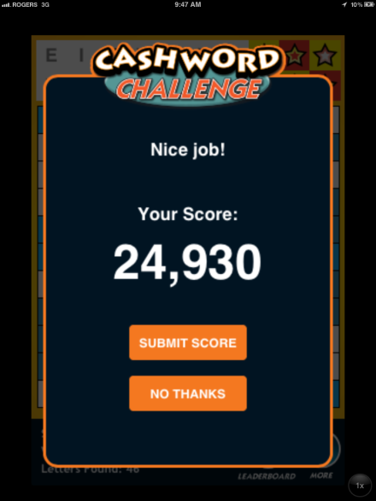
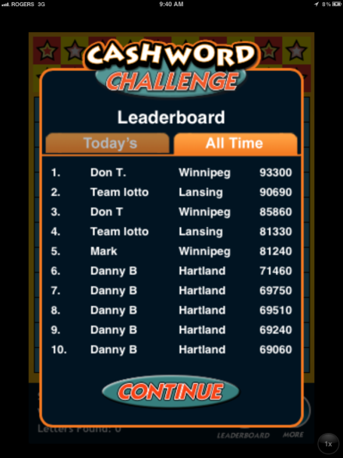

Michigan Cashword App
Powered by Pollard Banknote

Slide 11
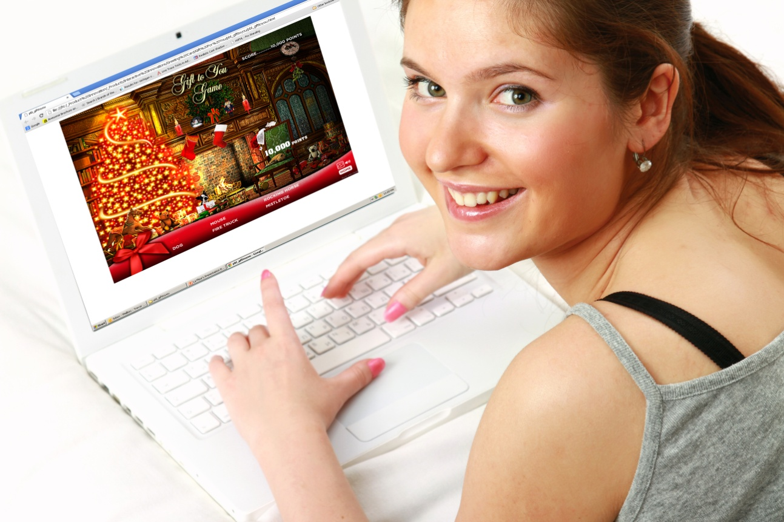
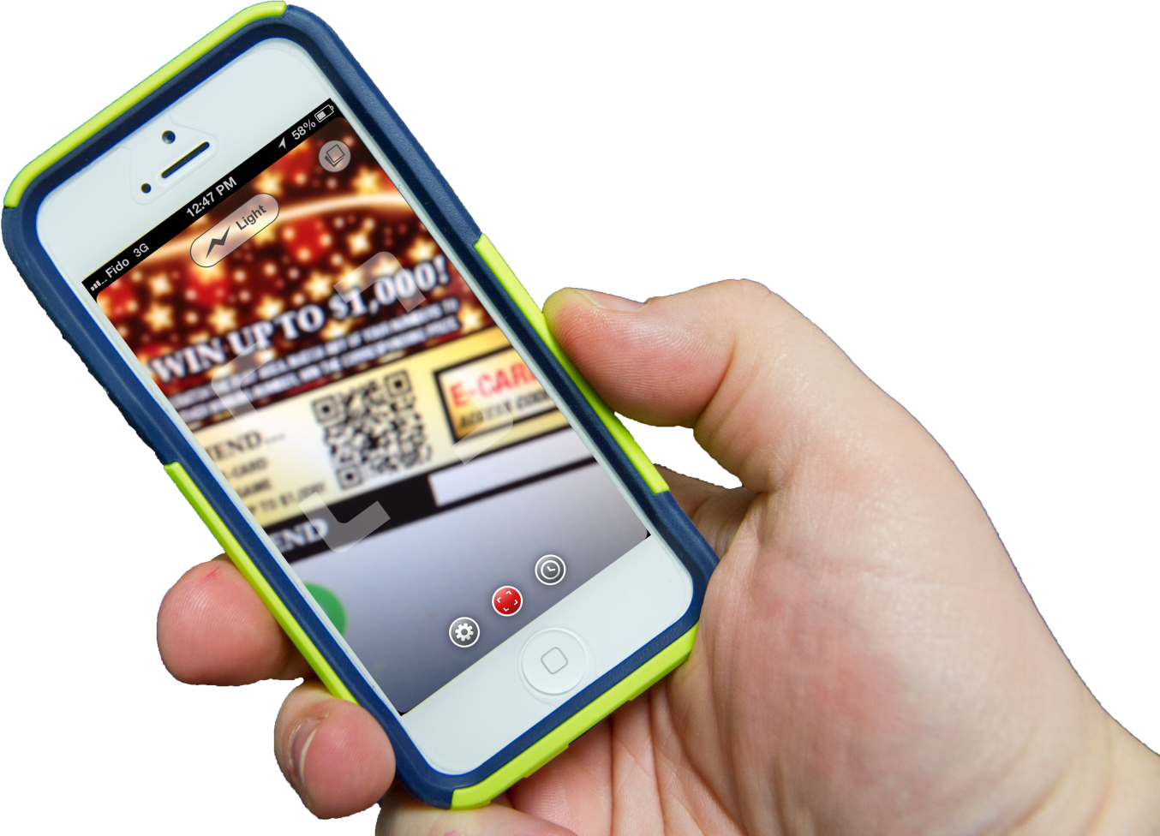
E-Greeting Card
Send to a friend!
Notes:
11
11

Slide 12

Margaret DeFrancisco
Email Me
mdefrancisco@pbl.ca

