Slide 1
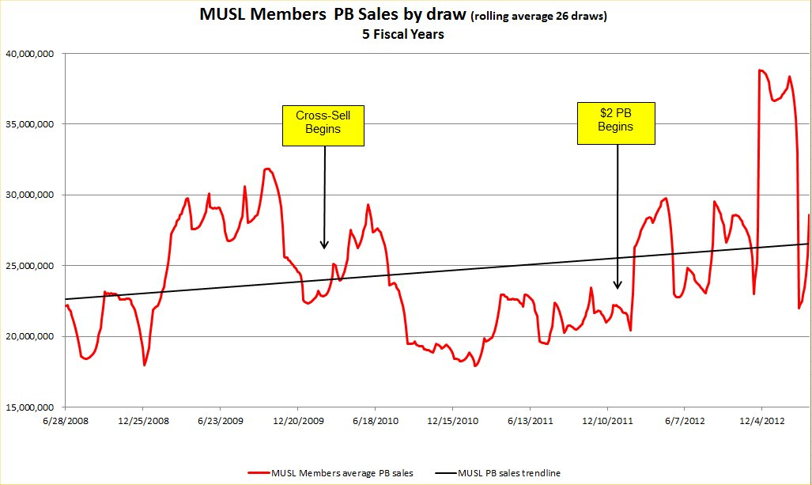

Slide 2
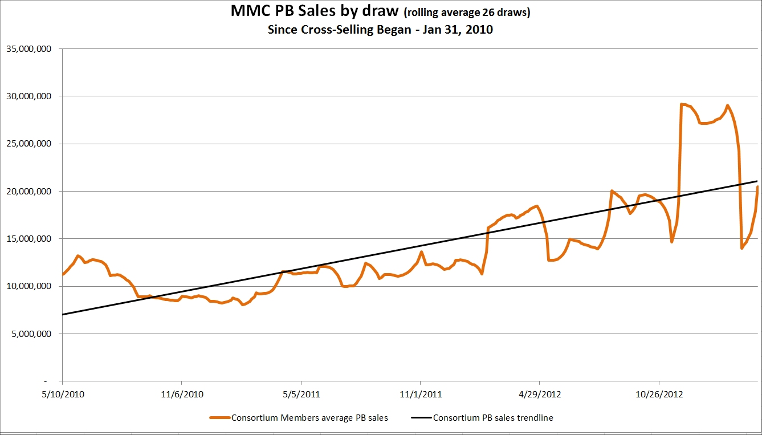

Slide 3
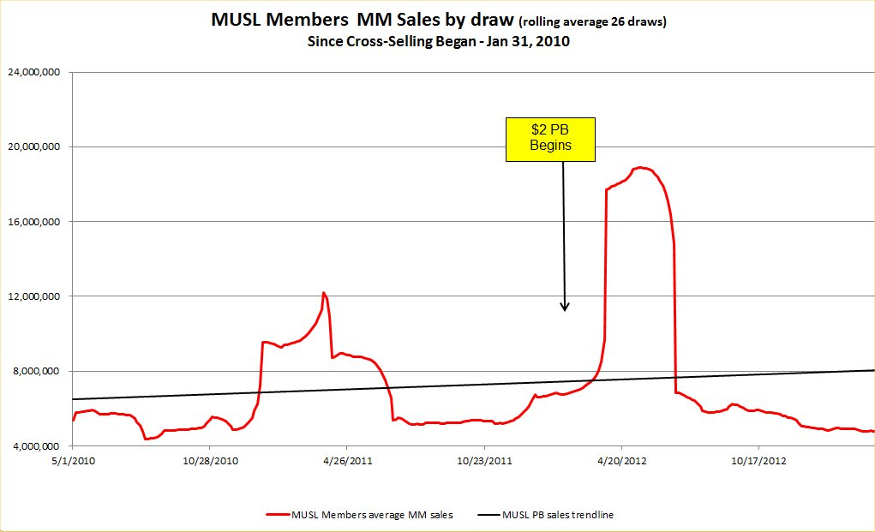

Slide 4
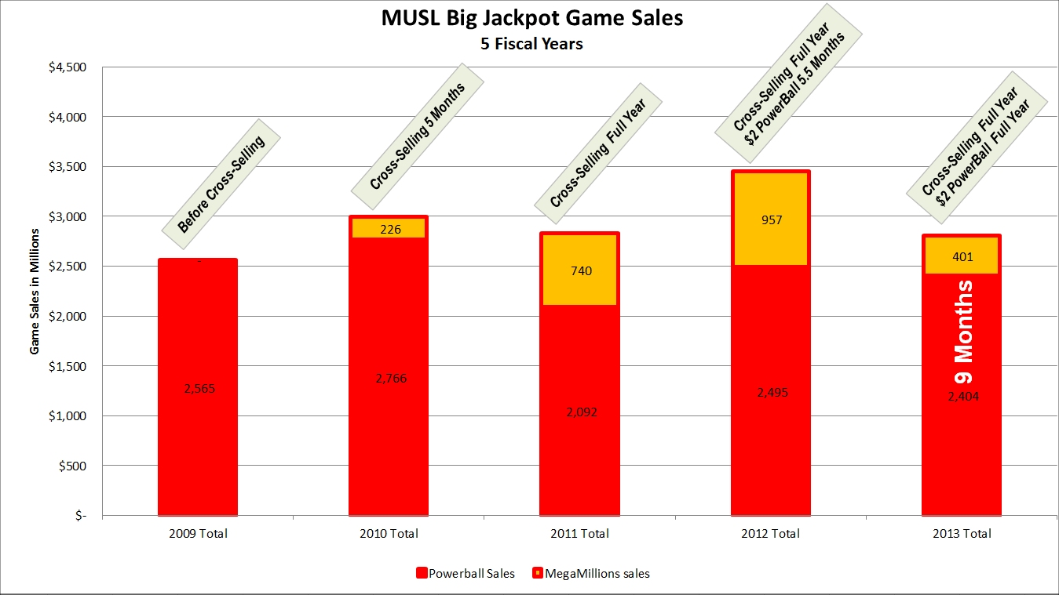

Slide 5
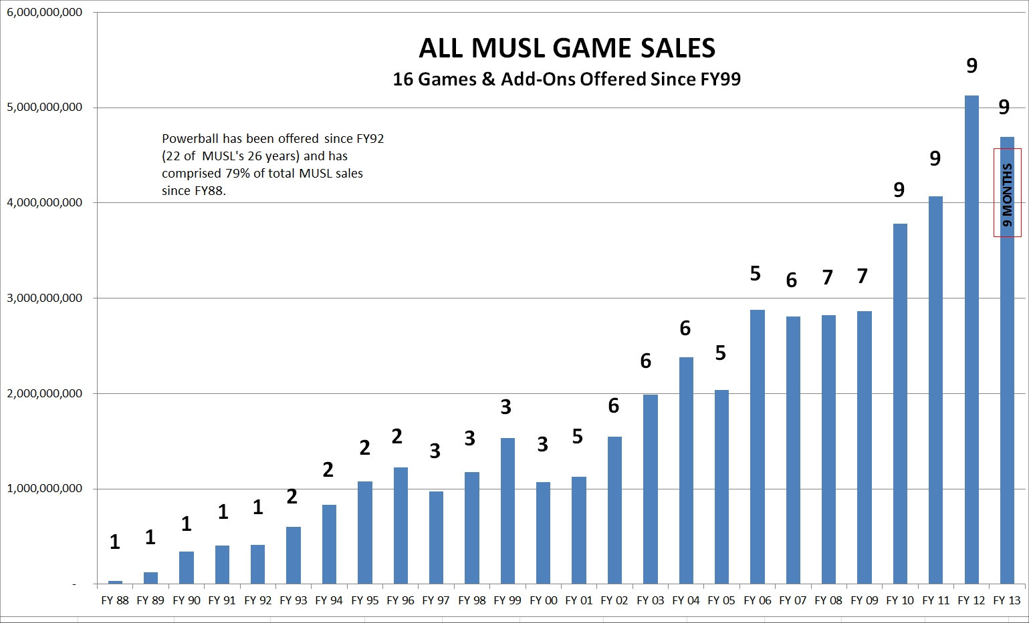

Slide 6
Future Plans for MUSL Games
PB: Reduce Risk at Guaranteed Jackpot Levels.
PB: Expand Demographics to Mobile Users.
PB: Add Value by Extending Play of the Game.
PB: Add Promotional Power through Partnerships with National Firms.
HL: Matrix Change May 15; “True Cash” Jackpot.
WC: Matrix Changed FY13.
2by2.
MegaHits.
New Games.

