Slide 1
The final countdown
Friedrich Stickler, President, The European Lotteries

Slide 2
Overview
The global market
Two different models: state lotteries vs. private operators
The fight against illegal operators

Slide 3
The gaming market

Slide 4
GGR online worldwide ($bn)
$ bn
Notes:
Quelle: H2_eGaming_Sum_27-02-13

Slide 5
GGR State Lotteries online worldwide ($bn)
$ bn
Notes:
Quelle: H2_eGaming_Sum_27-02-13

Slide 6
GGR landbased worldwide ($bn)
Notes:
Quelle: H2_Global_Summary_12-11-12-1352725672

Slide 7
GGR landbased North America ($bn)
Notes:
Quelle: H2_Global_Summary_12-11-12-1352725672

Slide 8
GGR Offshore Online Gambling US ($bn)
Notes:
Quelle streng vertraulich: The Land of e-Gaming Opportunity – March 2012
For the first decade of Internet gambling, the US market dominated and was by far the largest in terms of absolute revenues and player yields. Even by 2006, the year of UIGEA, the US market still accounted for just over 26% of the global interactive market as the absolute value of its offshore market peaked at US$ 5.20bn in gross win.

Slide 9
European gaming market online and landbased 2011
Notes:
Quelle: H2_Global_Summary_12-11-12-1352725672

Slide 10
Consumer policies

Slide 11
% of „legal GGR

Slide 12
% of operators checking Identity, Age, Bank accounts

Slide 13
Playing with multiple playing accounts
93% Yes

Slide 14
Monthly deposit limits
2/3 of commercial operators allow deposits over €1m

Slide 15
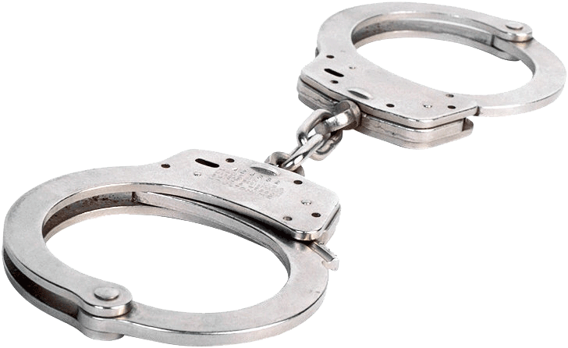
Fight against illegal operators

Slide 16
Defending the classic lottery model
Fight against illegal operators
Consumer protection
Money for society (fiscal arguments and good causes)

Slide 17
Threats
Offshore operators without license offer a wide range of products:
Lottery, Casino, Poker, Sportsbetting
No limits for wagers and age
Higher payout percentage
No taxes
Offshore operators acquire customers without licence

Slide 18
Growing competitive disadvantage for authorised providers
authorised provider
comercial operator

Slide 19
Fight against illegal operators
15.000 existing websites Annual revenues exceeding €12 billion in 2013
12.500 without a license = unauthorised
illegal
500 licensed operators in Malta
5 times more operators without a license than licensed operators
Source: greenpaper on online gambling, european commission 2011

Slide 20
Fight against illegal operators
Combined measures – UIGEA as role model:
Strong legal framework and severe sanctions
IP/DNS blocking together with payment blocking
Banning illegal advertising
Setting up black lists (white lists)
Public information about illegal gambling and operators
Coordination between national authorities

Slide 21
Fiscal arguments
Comercial online operators
European Lotteries
average tax total revenues
0,5% – 1%
25%
average tax from GGR
20%
(offshore 1%-2%)
65%

Slide 22
Online Regulation in Europe
Some states without regulation
Subsidiarity principle: states hold primary competence to regulate gambling
No mutual recognition
Responsibility for consumer protection lies with the member state
Internal consistency of a Member States gambling policy is a national duty

Slide 23
Online Regulation Systems
Monopolies
State monopolies – Germany, Portugal
Private monopoly (concessions) – Austria, Great Britain
Liberalized markets with licences
limitated or unlimited number of licences
Free license Systems
e.g. Malta (for international market except Malta)
Prohibition

Slide 24
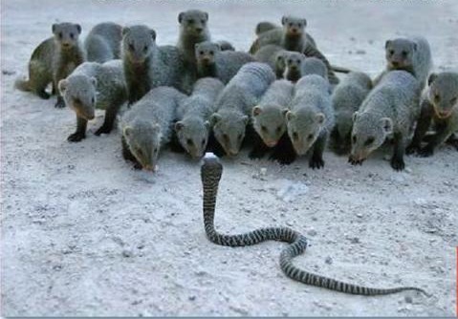
How to forge a united front

Slide 25
Common aim
!! Guarantee a sustainable future for lotteries !!

Slide 26
How to forge a united front
Enter partnerships and strategic alliances with stakeholders
The role of politics
Communication and lobbying

