Slide 1





Revitalizing the Retail Network Through Digital Channels
Brian J. Roberts
April 9, 2013
A Proud Member and Sponsor of:
Notes:
Good Morning
I want to talk to you this morning about how the Internet can not only generate incremental revenues, but how it can be used to re-engage and revitalize your traditional brick and mortar retailers.

Slide 2
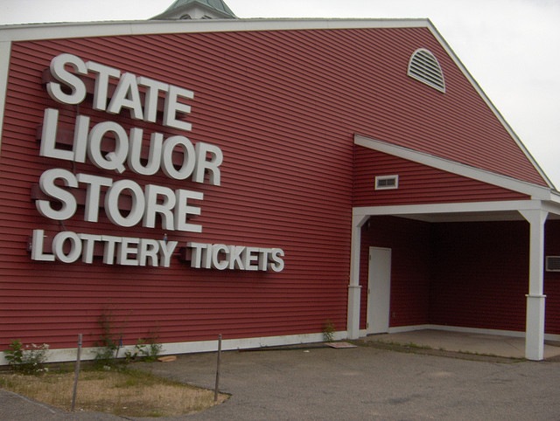

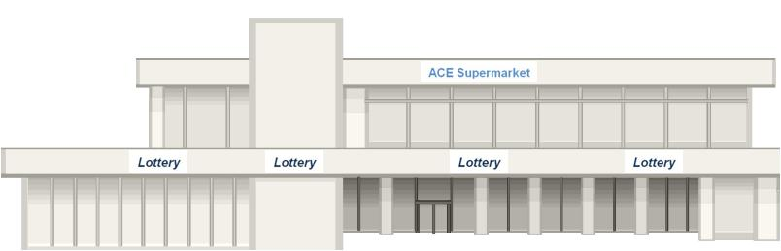
The Evolution of the Retail Network
Off-Line Agent
Instant Only Retailer
On-Line Agent
e-Retailer
Notes:
Since the first lottery ticket was sold at a New Hampshire State Liquor store in 1964 the retail network has been in constant change. From state liquor stores to Banks, to news agents and tobacconist to supermarkets.
As our daily lives have changed so have our buying habits; and as an industry we have adapted; changing legislation, rules and regulations as necessary to enhance our distribution. We now have a broad spectrum of retailers to provide convenience to our customers. AND I think we all agree that the more retailers we have the more sales are generated.
Along the way we have used many terms to describe our distribution partners, which often related to the lottery products being sold: we’ve had agents, retailers, off-line agents, instant only, on-line only retailers, VLT retailers and Limited VLT retailers and I’m sure there are a few more.
And as we created these new categories of retailers we defined the requirements relative to those retailers.
Well, it’s now time to create the e-Retailer

Slide 3


The Gaming and Consumer Markets
Have Changed
The current practices of selling lottery tickets do not appeal to new consumers who prefer to make purchases online at their convenience.
Notes:
To do so, we need to educate others (commissioners, legislators and retailers) to make them recognize that since the inception of the first U.S. Lottery in 1964 both the gaming market and the consumer market have seen significant changes.
The Internet has become an integral part of everyday life for the majority of our customers, not only in regards to their professional life, but also in regards to personal business and communication; and
The current practices of selling lottery tickets does not appeal to a new consumers who prefer to make purchases online at their own convenience.

Slide 4





Embracing the Existing Retailers
Like it or not the Internet is here to stay.
Notes:
Even though the existing retailers have voiced opposition to selling lottery on-line the prudent retailers recognize that they can sell just about every product in their store over the Internet, except lottery and to think that the Internet is going to go away is far beyond wishful thinking. So why not sell Lottery online and get on the Internet band wagon ?

Slide 5

Jumbo is an e-Retailer
..not a lottery supplier
Jumbo has been a licensed e-Retailer for over a decade complementing the state lotteries’ web-sites.
In the past year Jumbo facilitated the sale of $100 million lotto type game tickets from a population of 14 million; more than 18 U.S. Lotteries.
By comparison this is approximately 17% of the $573 million lotto type tickets purchased by Illinois’ 12.9 million residence
The cost to our Lottery partners is BUDGET NEUTRAL , Jumbo operates on the retailer commission; just like other retailers.
Notes:
Jumbo has been a licensed e-Retailer for over a decade complementing or operating the state lotteries’ web-sites.
[Read 2 and 3 above]
We are not proposing exclusivity; but a way for Lotteries to complement their own web-site and build an effective web presence through multiple e-Retailer touch points to maximize exposure and awareness to capture sales.
Jumbo provides the assurance to the Lottery that all the rules and regulations (age, location and problem gambling controls) are adhered to, and that advertising standards are maintained.
And our retail services are BUDGET NEUTRAL; we operate on the retail commission.

Slide 6
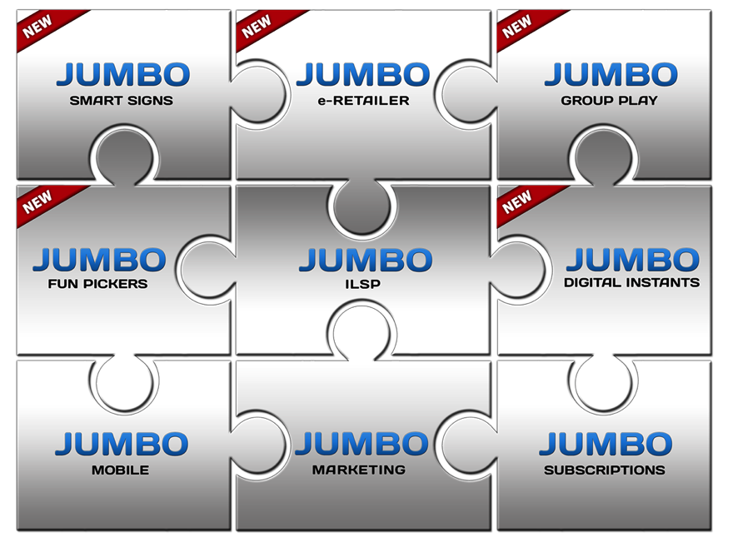
Delivering More
In fact Jumbo delivers much, much more….
Jumbo has developed solutions and tools to create a diverse network of e-retailers that can embrace and revitalize the traditional retail to drive incremental commissions.
Jumbo invests heavily to market and advertise the digital channels.
Notes:
BUT, in fact Jumbo delivers much, much more….
Jumbo has developed solutions and tools to create a diverse network of e-retailers that can embrace and revitalize the brick and mortar retail network.
Jumbo invests heavily to market and advertise the digital channels, which is a significant value add to a lottery’s marketing budget.
Besides creating opposition from the existing retailer; if a lottery runs everything though their own site with their own marketing team how does it know how efficient and effective it is if there is nothing to compare to? Competition will breed success for all stakeholders.
So, How Do We Engage the Traditional Retailers?

Slide 7
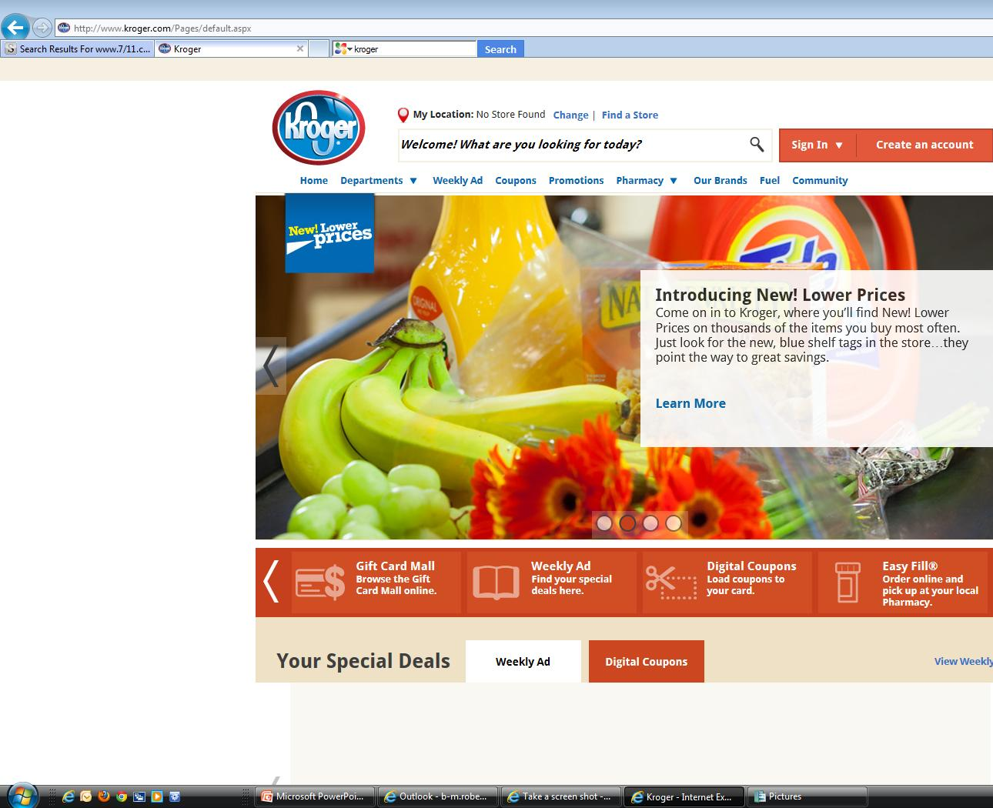
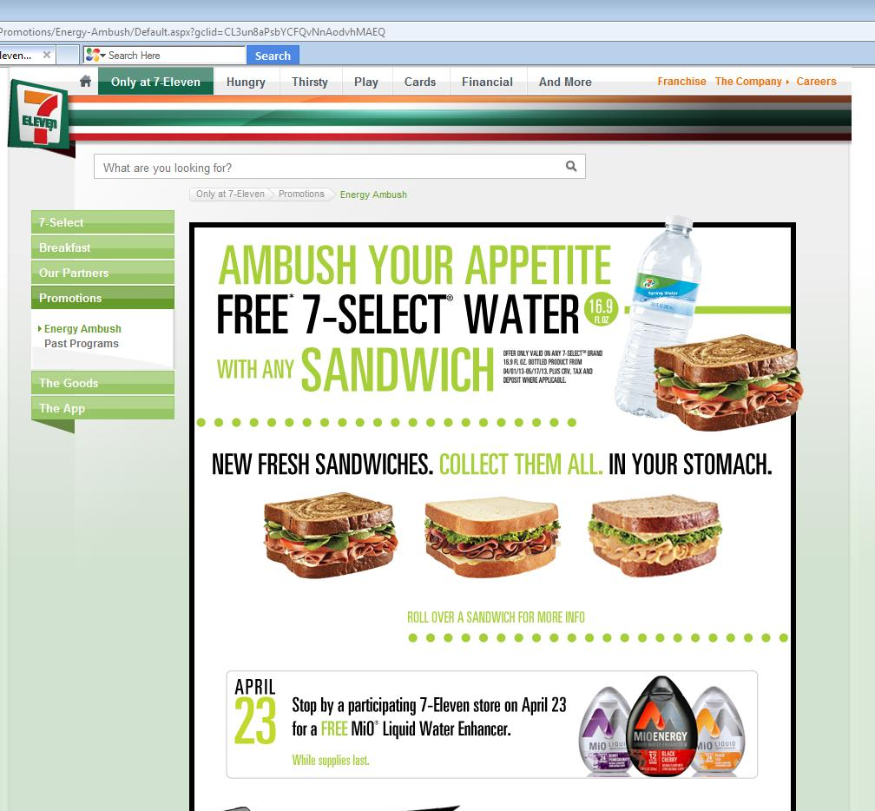
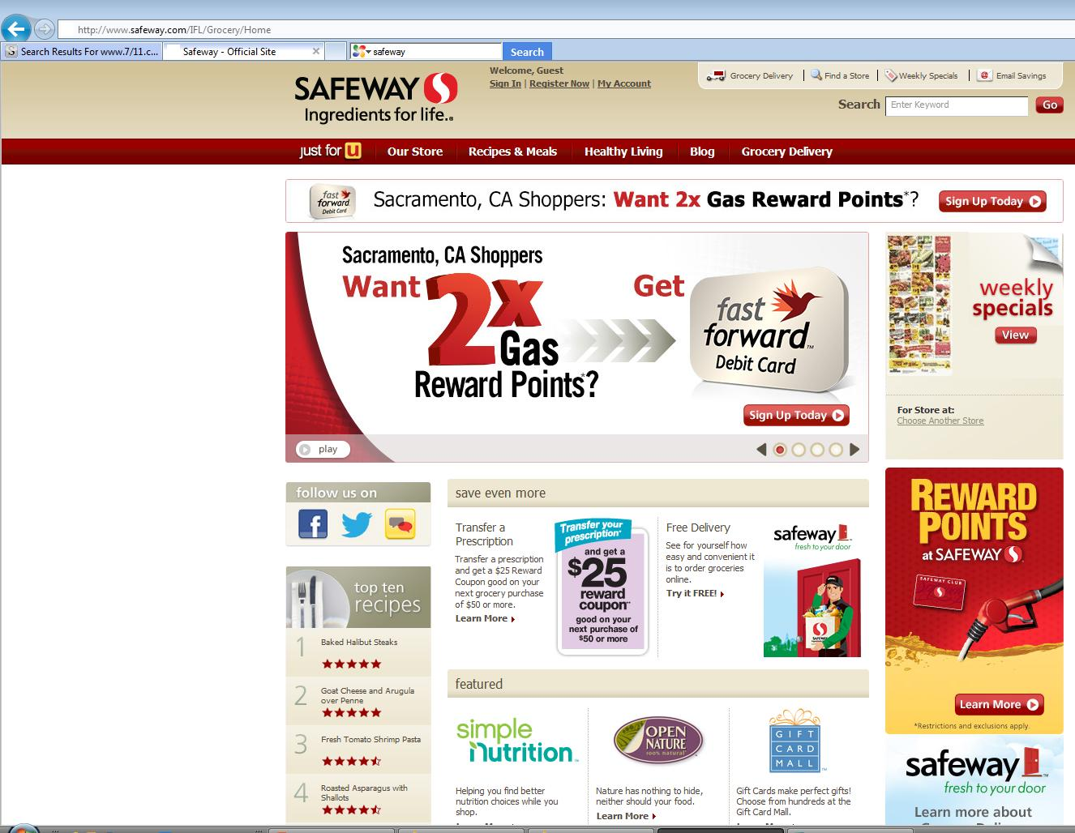
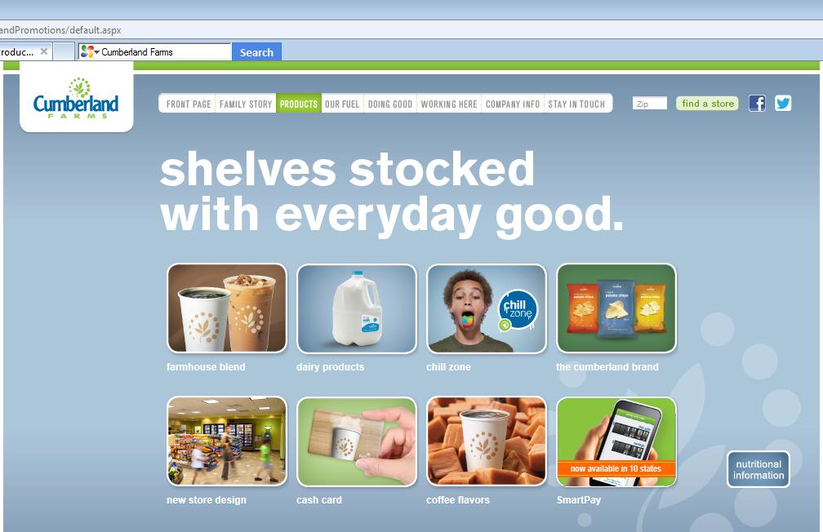
Retailers Know the Power of the Internet
Hundreds of offers to drive Customers to their Stores
Do retailers really think selling lottery over the Internet will minimize their foot traffic and sales?
Notes:
Retailers already know the power of the Internet, as most major chains whether they be convenience or supermarkets already have web-site to promo their good and services.
With all of these wonderful and higher margin offers to drive customers to their stores;
Do they really think that selling lottery over the Internet will minimize their foot traffic and sales?
NO, they just want a piece of the action and Jumbo can help them and turn an opponent into a proponent.

Slide 8
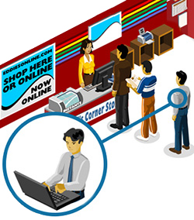

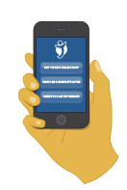
It’s all about bringing together
the Traditional and Digital Channels…
..into a single harmonious system
Notes:
No it’s all about bringing the Traditional and the Digital channels together.
The worldwide data shows that the Internet does not effective sales at the traditional retail.
We can demonstrate that a Jumbo web-site will capture new players and new revenues. An existing retailer’s web-site will provide convenience to the retailer’s customers and generate incremental commissions for the retailer; we know that players spend more online than they do in the store.

Slide 9

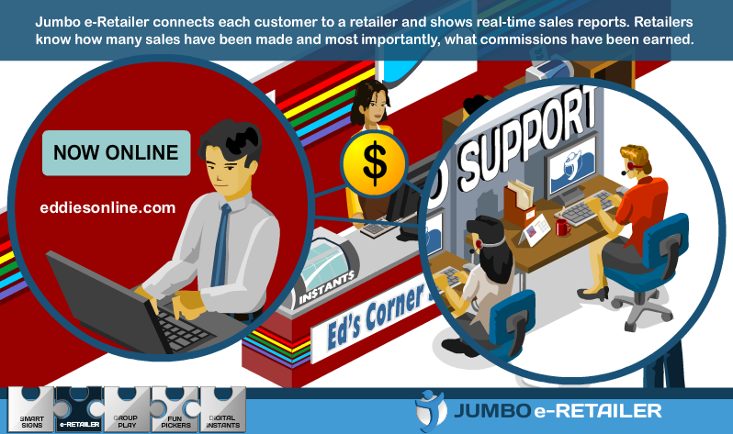
Empowering Retailers
to Satisfy Customer Needs
Notes:
There are many reasons why the airlines, as an example, have embraced third party web-sites to sell their tickets and they are the same reasons why the online gaming industry has embraced affiliates.
Simply put the more sites on the web promoting and advertising our products, the more eyes are on our products; if we can capture that lottery sale right now we eliminate the possibility of a lost sale, but the customer will still visit the brick and mortar store to buy a good cup of coffee or a sandwich; we can’t deliver them over the Internet yet! But I’m told Al Gore is working on it!

Slide 10

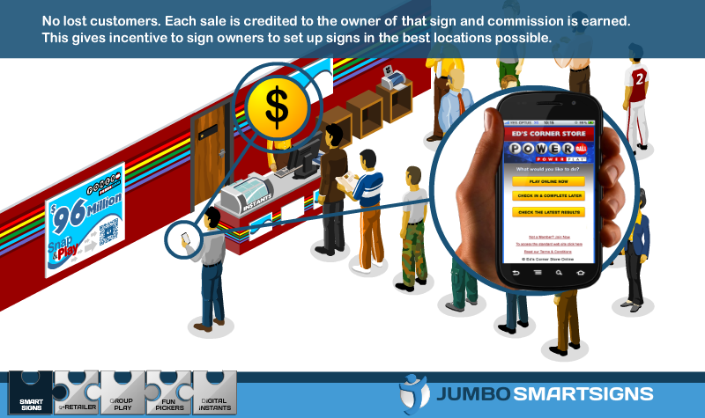
Retailer Tools to Drive Sales through Customer Convenience
Notes:
So what are the tools that Jumbo can provide the retailer to increase sales?
A COUPLE OF EXAMPLES:
First, Jumbo has developed Smart Signs that allow the player to have immediate access to purchase online and the sign provides the retailer’s identity for commission recognition regardless of the signs location, either in the stores or outside.

Slide 11
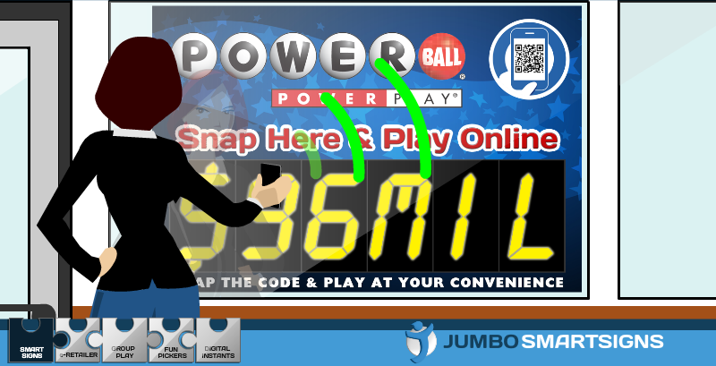
Using Smart Signs to Drive Immediate Sales
Notes:
An example of on out door smart sign

Slide 12

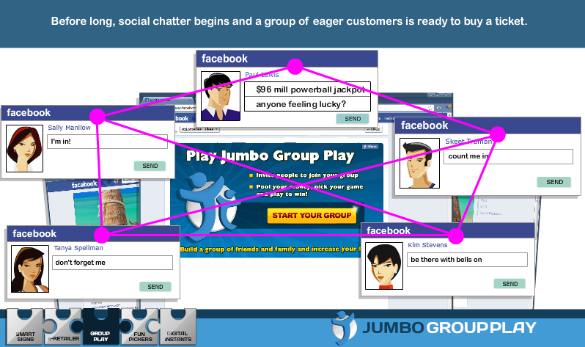
Using Social Media to Enhance Group Play
Notes:
Second, Jumbo tools allow the retailers’ online customers to play in many more ways like combinations and Group Play.
Group Play engages the retailers’ customers with their friends via social media; another powerful tool to drive sales.

Slide 13
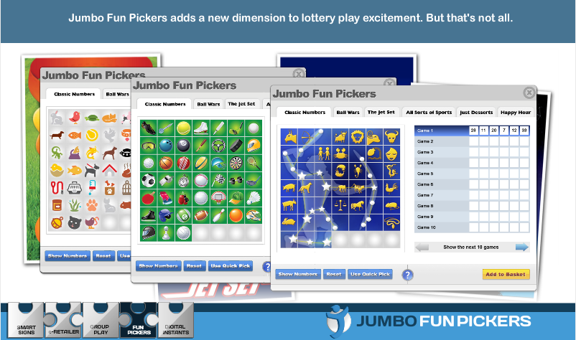
Using Digital Media to Add Play Value
Notes:
Retailers can provide their online customers with added play value when choosing they numbers.

Slide 14
Creating Loyal Players
Jumbo manages a powerful Loyalty Program for all e-Retailers
Customer spend = Points = Loyalty promotions = More sales
Average spend is double traditional ticket spend
Notes:
And, the Smart Retailers can maximize the benefits of Jumbo’s Lotto Points loyalty program, which can stand alone or be incorporated into the retailer’s own loyalty program.

Slide 15

Benefits to the Lottery
Budget-Neutral-Plus Offering
Jumbo creates an extensive network of e-retailers that creates many more touch point to engage the customer and capture the sale.
Jumbo’s solutions enable the engagement of new retailers who have previously rejected Lottery.
Jumbo handles the affiliate arrangements.
Jumbo provides a complete turnkey operation, including a commitment to an extensive marketing at its own cost.
Jumbo has a proven track record…
….let’s work together and make this happen!
Notes:
To Summarize

Slide 16
We Would like to be
Your e-Retailer Partner
THANK YOU
brianr@jumbointeractive.com

