Slide 1

Notes:
Announce name change. Same company, same people, new name to reflect multi-product company. Expanding, etc.

Slide 2
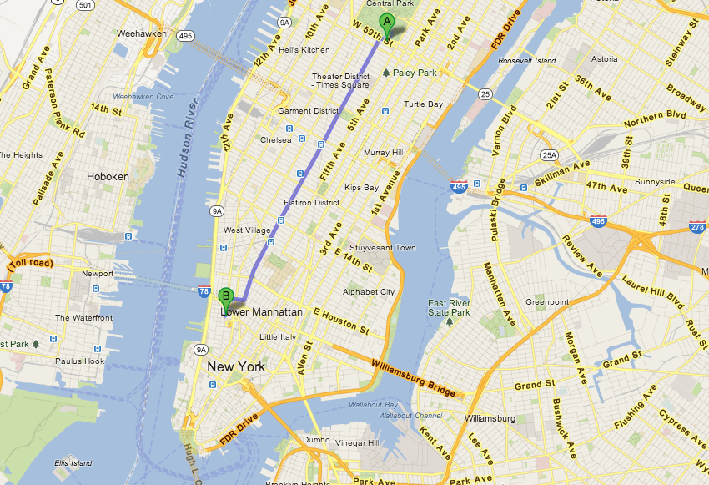
Notes:
Show them where our office is in location to where they are now. Talk about how Chelsea and Tribeca are known as Silicon Alley, but its spread to other areas of NYC – particularly DUMBO.

Slide 3
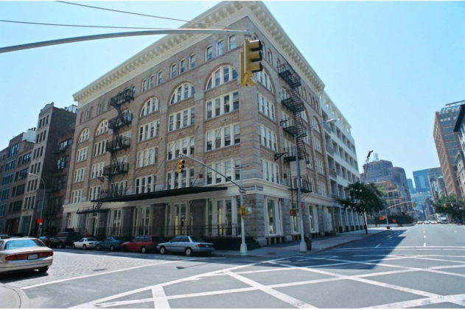
Notes:
Hudson Alley world-wide headquarters. This is where the magic happens.

Slide 4

Notes:
Talk about oneplace momentum. Shipped last year and by the beginning of summer we will have 3 jurisdictions live. More by end of summer.

Slide 5
Notes:
State what bacon is. (look it up on wikipedia)

Slide 6
Bacn
“…better than spam, but not as good as a personal email.”
-- Wikipedia
Notes:
Wikipedia definition is outdated…mobile changed the playing field. Email is only part of the equation.

Slide 7
Notes:
Nobody comes to our blog until we send out these emails, then a large % of mailing list come to look at the new stories and commericals.

Slide 8
Notes:
Even a better example of bacon. Nobody comes to Lottery Answers until somebody does something on the site and emails go out to users.

Slide 9
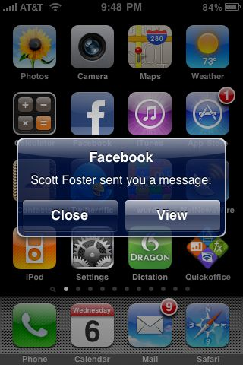
Notes:
An example of mobile bacon. Another example is OnePlace where we use push notifications like this to alert users that they have a pending task for a retailer as they pull up – using a technology called geo-fencing.

Slide 10
Bacn is to retailer marketing as POS and billboards are to player marketing.
Notes:
Importance of POS to players buying tickets. It reminds them to execute a certain behavior (buy tickets). Bacon can remind retailers to execute certain behaviors like activating new books, pushing a certain game, etc. The player is reminded that they might win big. The retailer is reminded that they might get some extra money or get some entries into drawings

