Slide 1

ABS and APPS
Notes:
What I am actually going to discuss is the importance of keeping your core strong, how can we enhance core games and engagement with players and retailers.
Building a strong core whether it’s our own body or lottery products are important to overall health and well being.

Slide 2
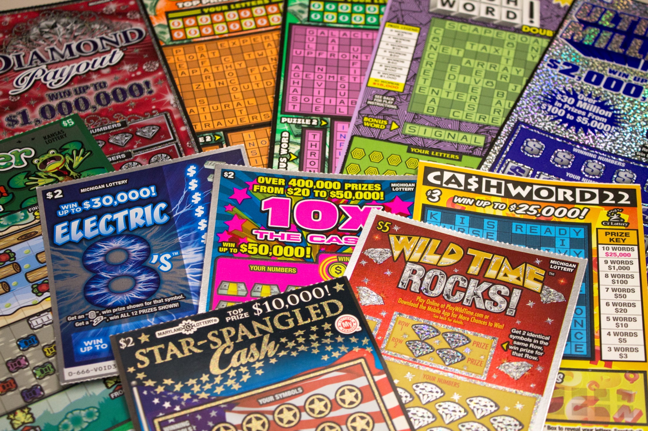

$45 Billion in Instant sales
Notes:
LP notes: we work hard to understand whole lottery ecosystem, others have branched out into casinos, we explore other areas but fundamentally our success is underpinned by success in our core business

Slide 3

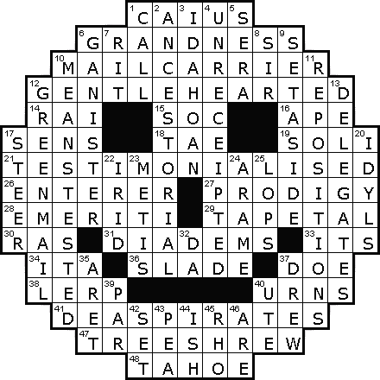
B
I
N
G
O
5.5
+
Billion
12.4%
Total instant sales

Slide 4
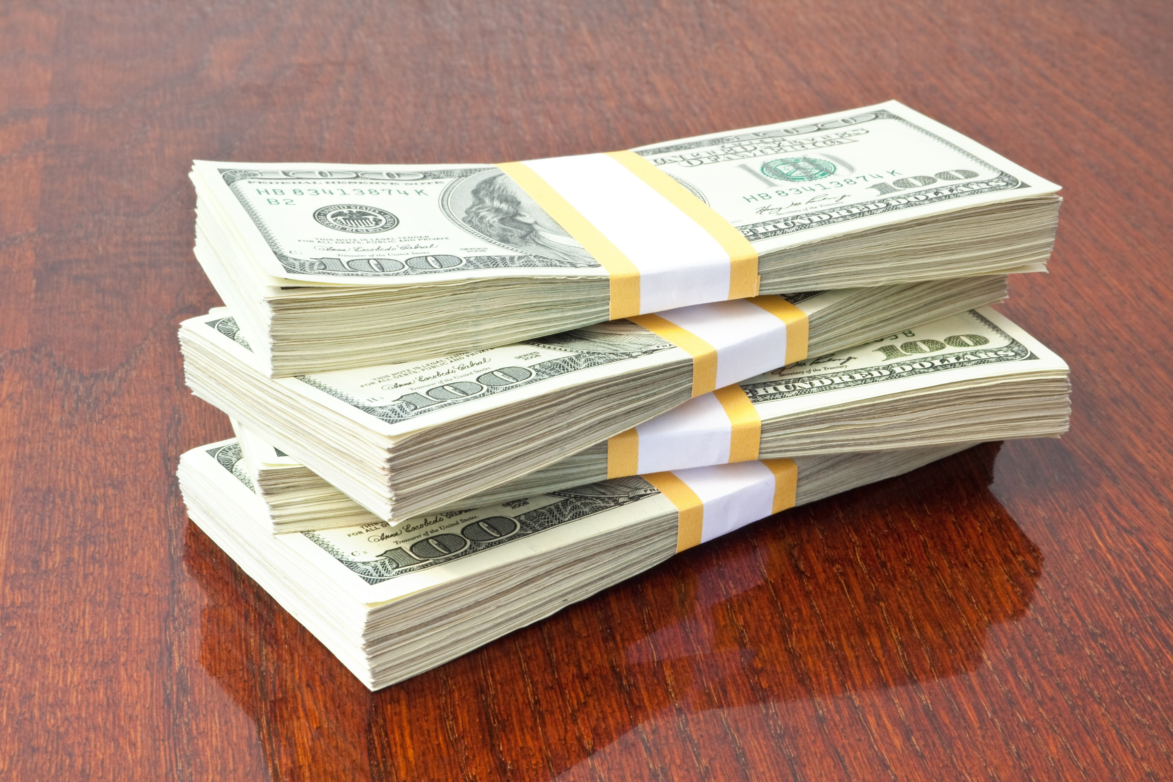
Notes:
US average Crossword sales account for over 13% of total instant sales: so if your lottery is below 13% you could be leaving money on the table.
Many states have lower payouts which leads to increased profitability.

Slide 5
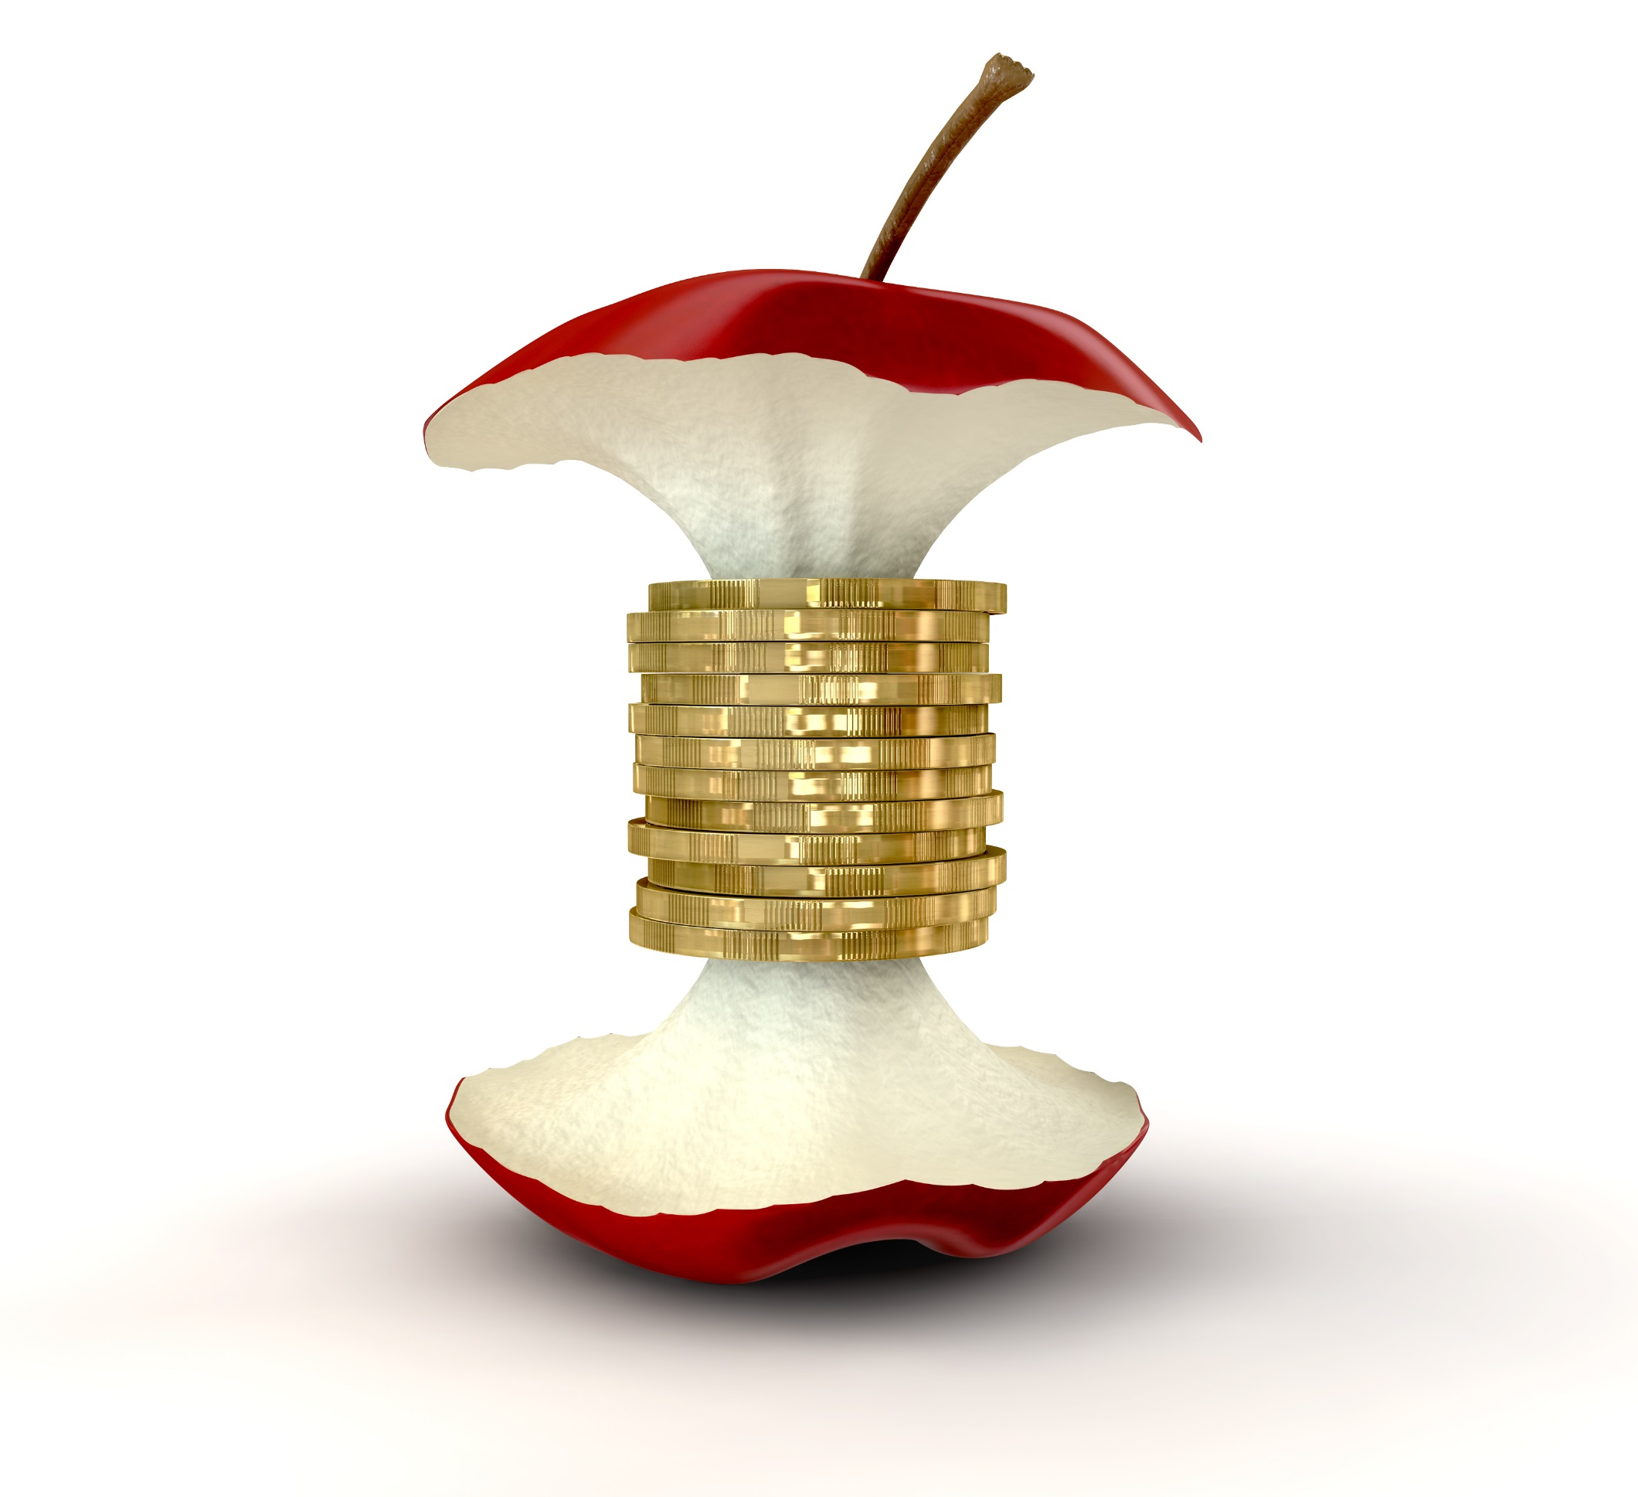
Profits are core to any business.
Notes:
Profits are Core to any successful business
Profits to good causes – are the only reason
our industry exists
Pressure for profits is growing fast
Pressure builds a strong core

Slide 6

How to keep your core strong?

Slide 7
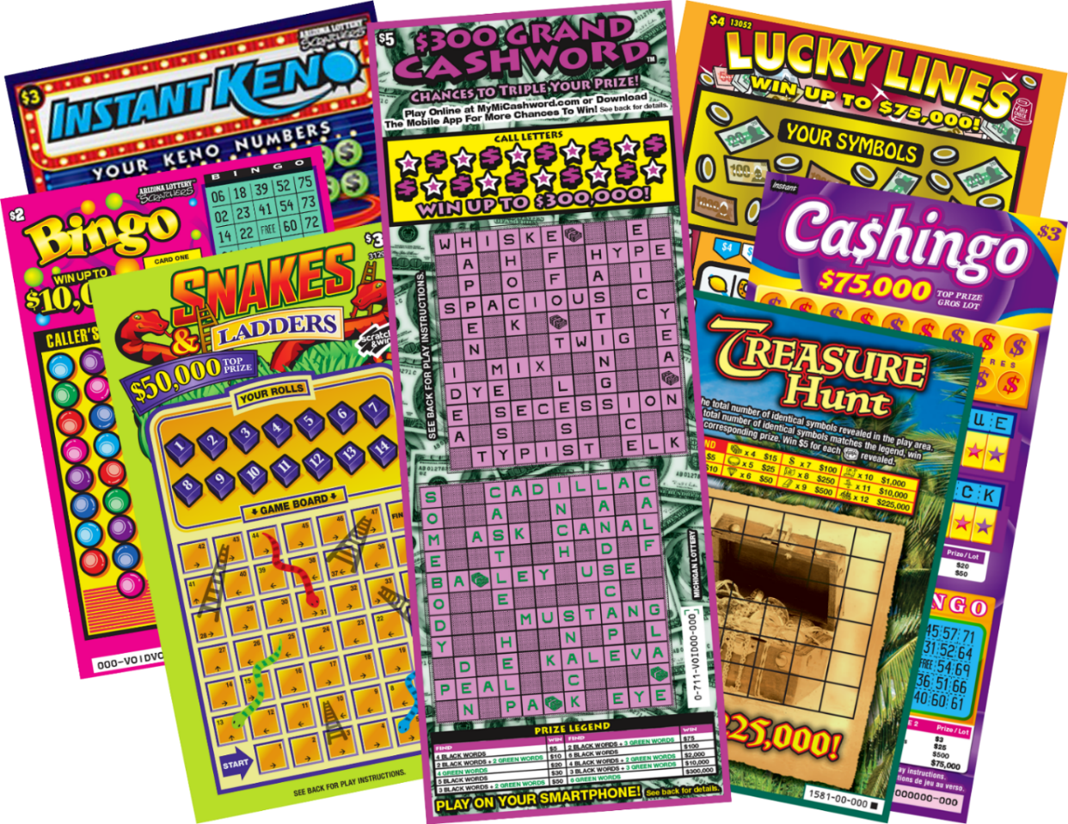
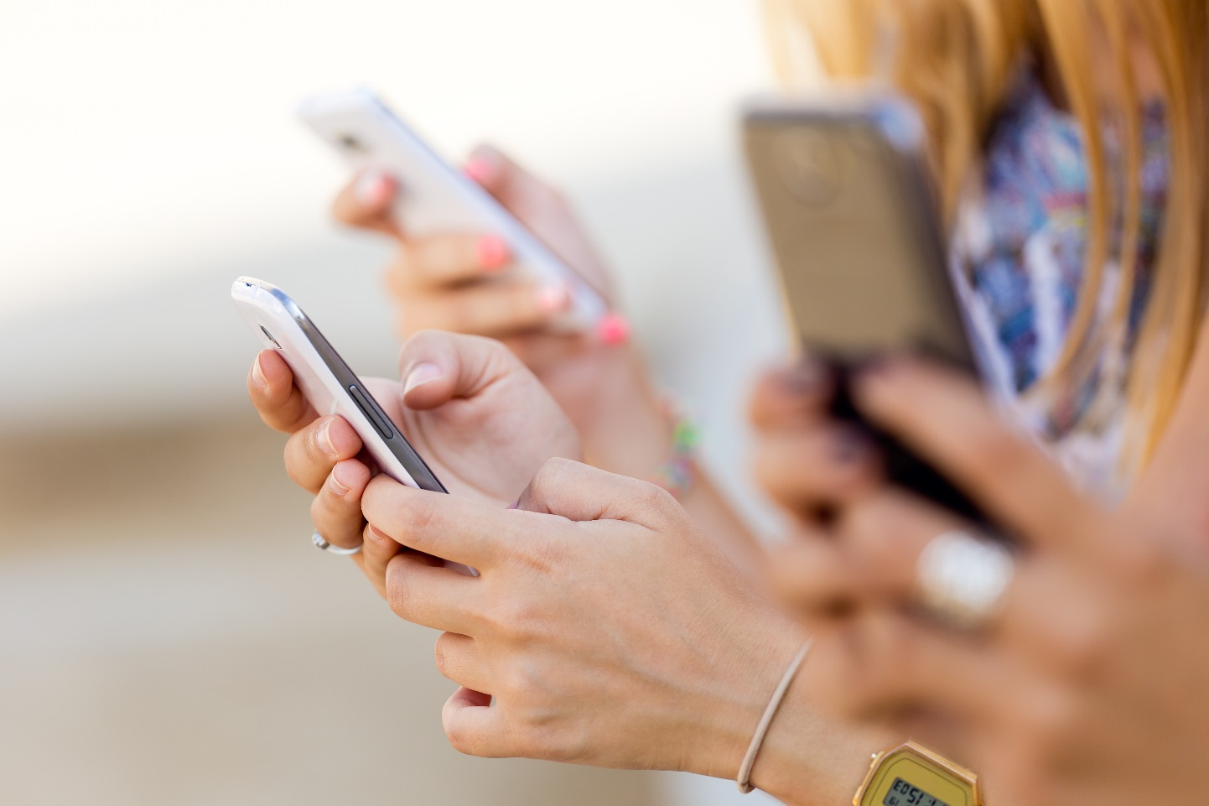
1. Exercise
2. Evolve core products
=
3. Engage with people

Slide 8


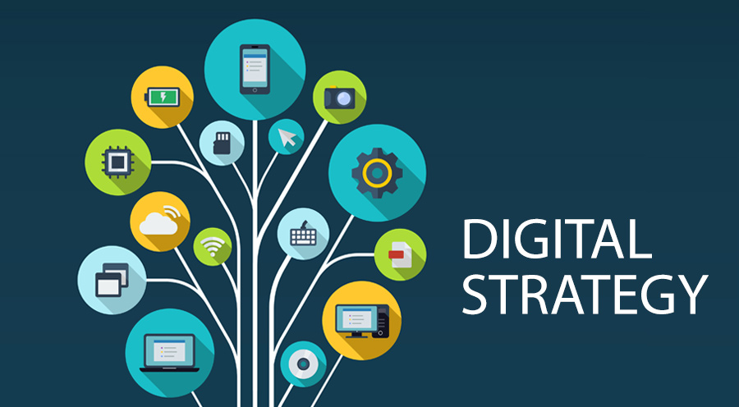


loyalty
2nd chance
the
space between
eSubscriptions
Apps

Slide 9
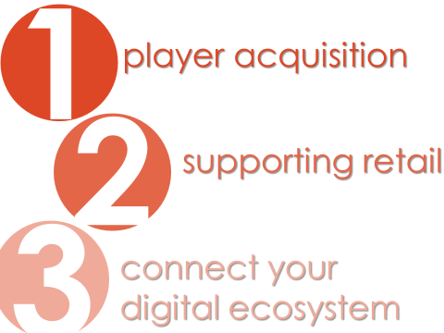
BETWEEN
SPACE

Slide 10
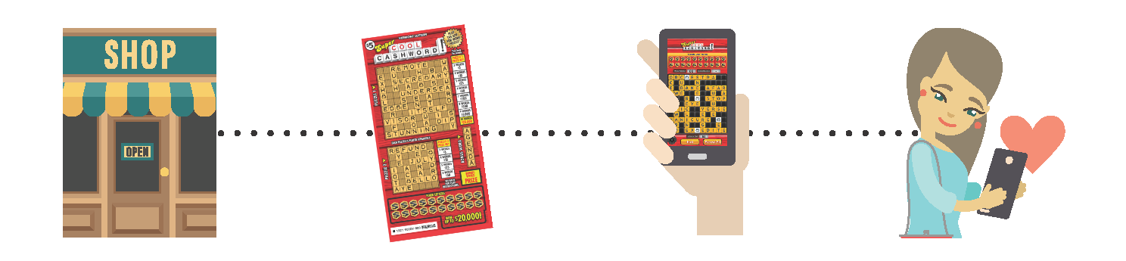
How it Works
BUY TICKET
PLAY
VISIT SITE OR OPEN APP
PLAY AGAIN
(CAN PLAY FOR FUN WITHOUT PURCHASING TICKET)
Notes:
Initial ticket purchase takes place at retail
Play the instant game …if win on the ticket go to retail to claim their prize.
If don’t win on the ticket players can experience some additional Crossword game play(which we know they love) by going to the App store or Google play, download the app and play a game for fun or enter the code from their non-winning ticket to play for prizes on their smartphone (second chance draw entries) . They could also go to the Kansas Lottery website and play directly on there.
Play for prizes players can win entries into a second chance draw in which they win cash coupons which players can redeem at retail.

Slide 11
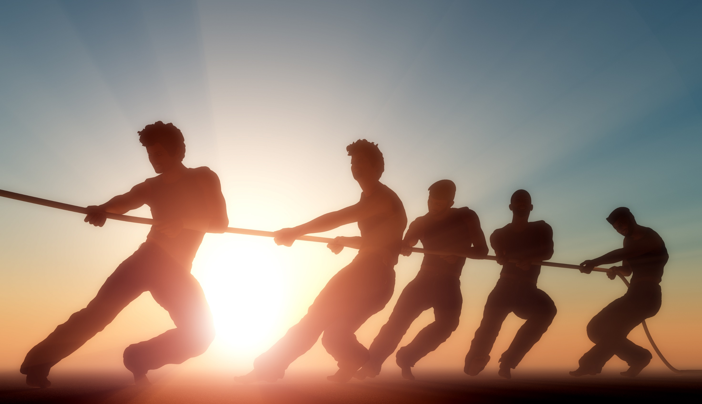
Notes:
PBL has done the work – turn key products with little effort from lottery team to launch apps.

Slide 12
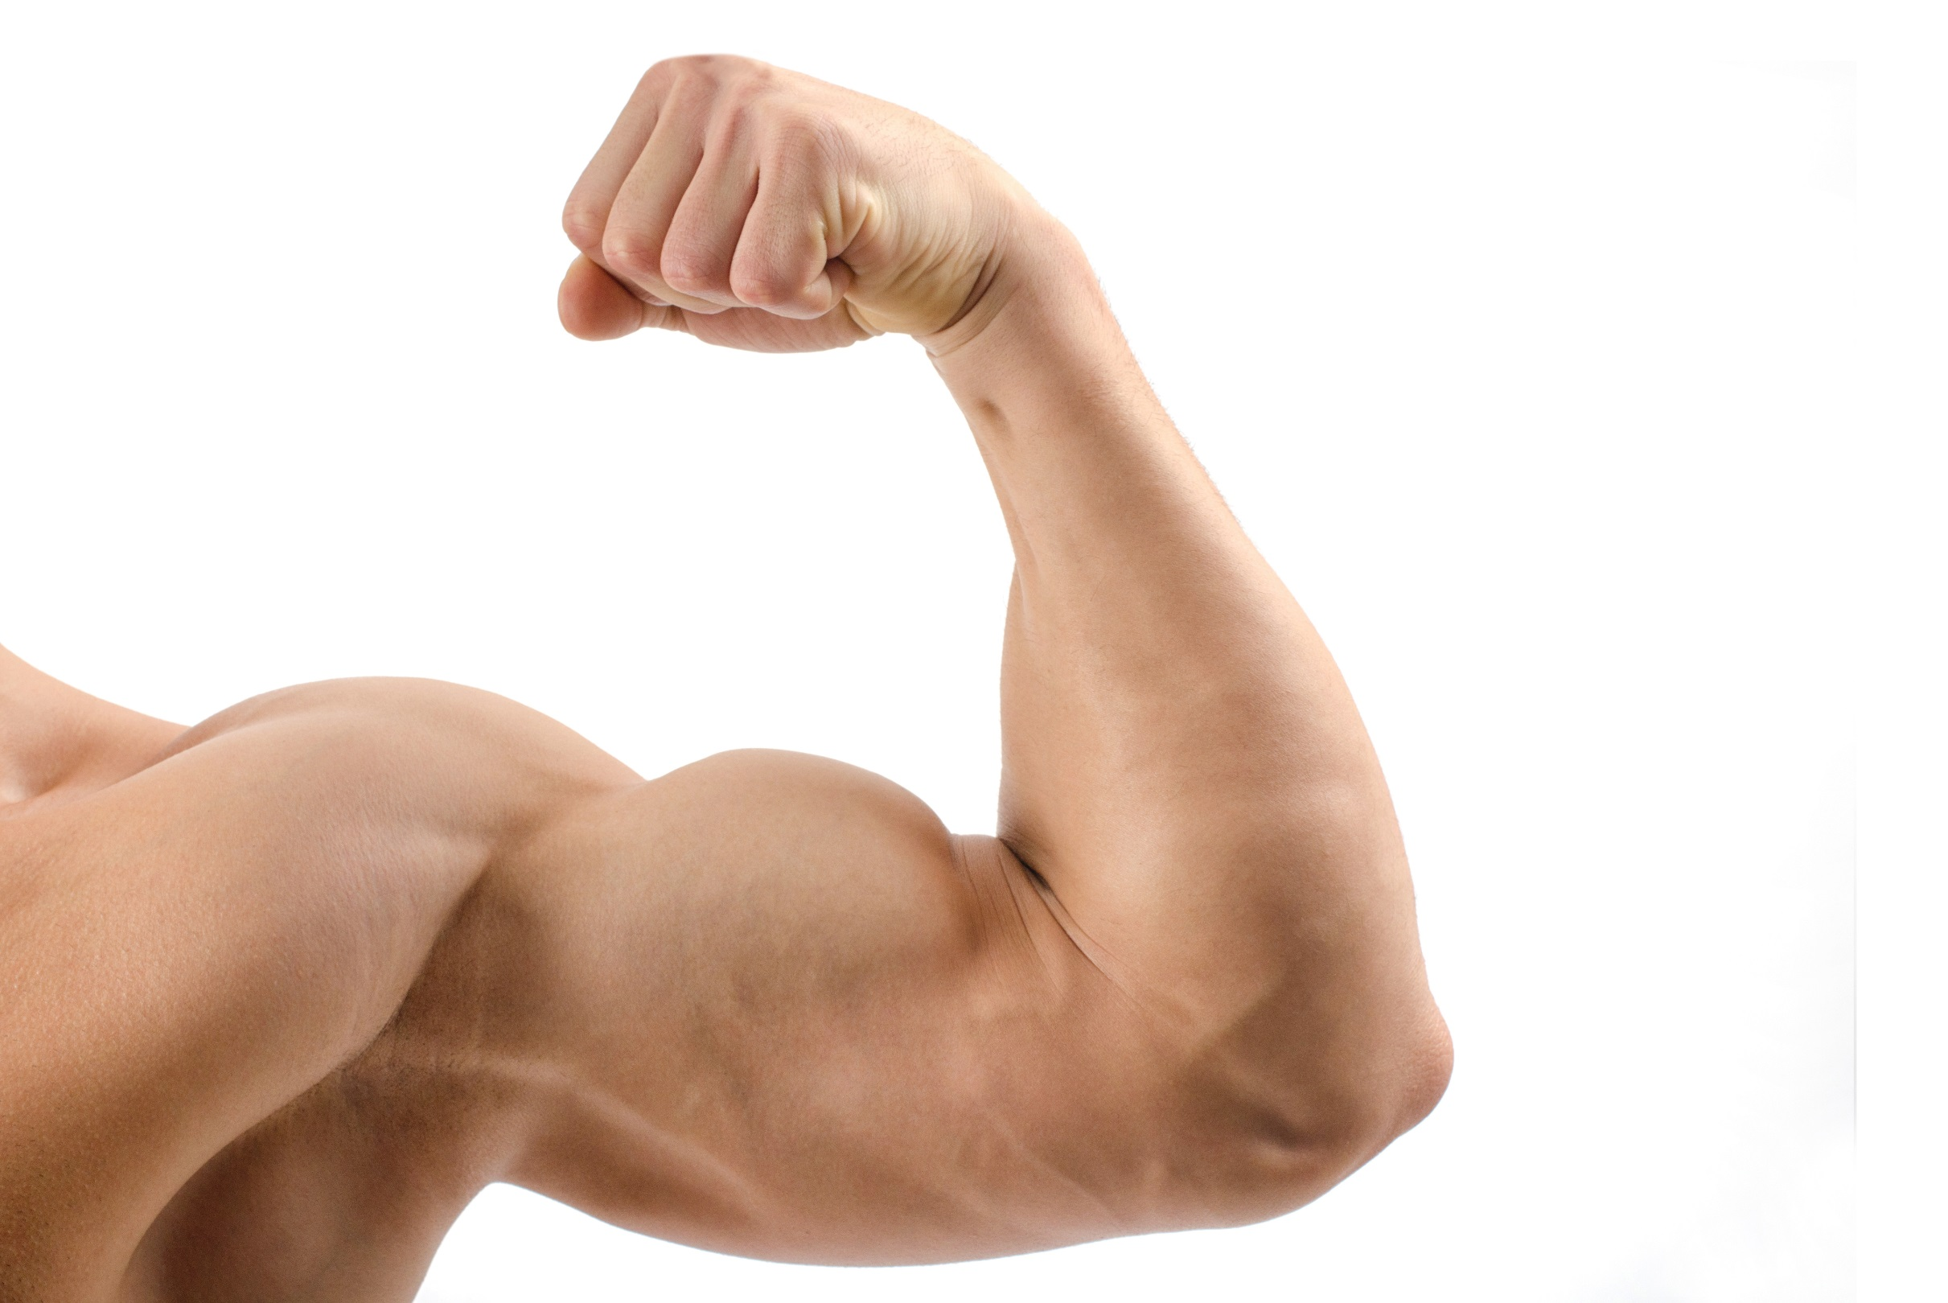
Powerful
Results
Notes:
Results show spike in loyalty club membership and attracting, new, younger players.

Slide 13
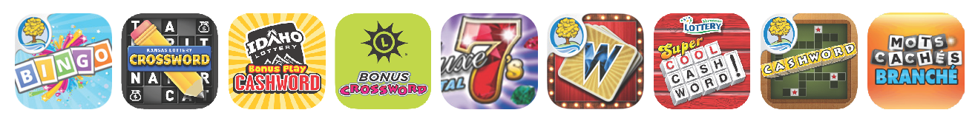
9 Space Between apps have been launched in 7 jurisdictions…

Slide 14
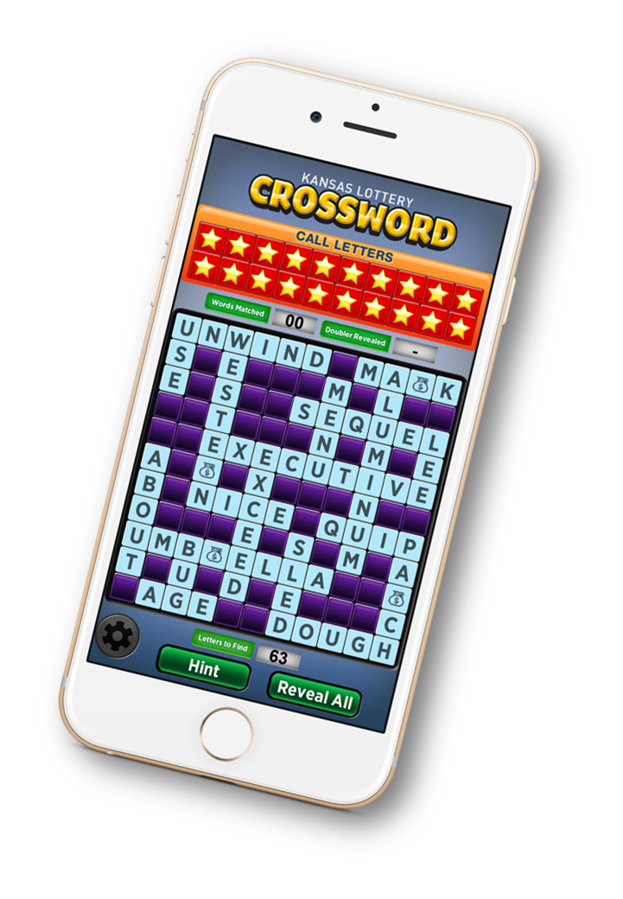
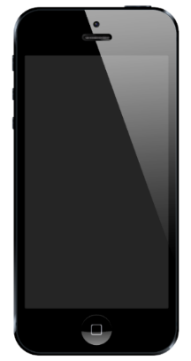
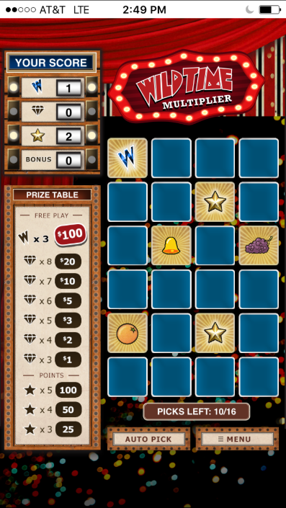
…with over 34 million games played for fun and prizes!
Notes:
Why go with Pollard for your interactive game choices….we are the expert in interactive game play associated with instant tickets.
Total number of Pollard games to played to date…app designed by Pollard and managed by Pollard
30.8 million games have been played.
That’s 13.3 million mobile games and 17.5 million desktop games.
Sliced another way, 12.3 million games were played for fun and 18.5 million games started with a ticket purchase and were played for prizes.

Slide 15
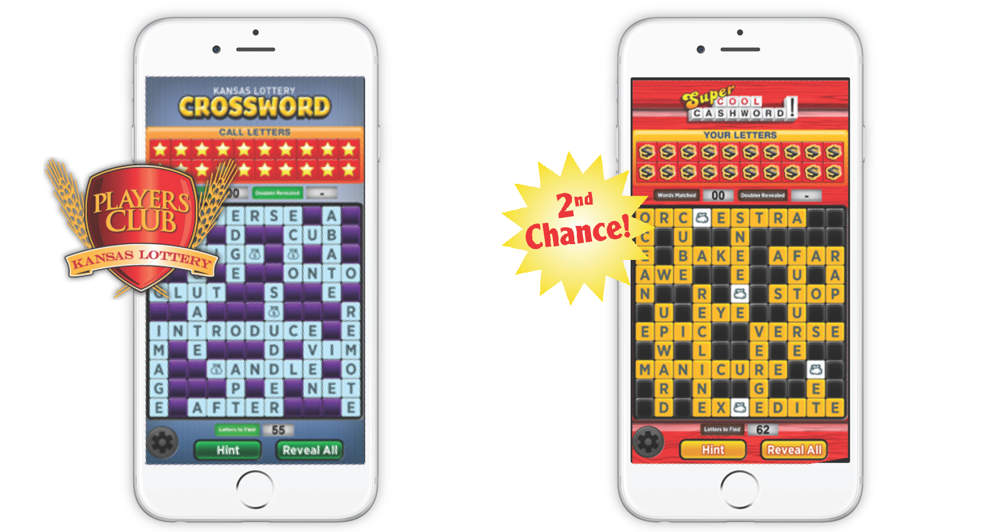
1. Player acquisition: Spike in Loyalty Club Memberships
140%
TWICE as many
Notes:
In first two months of launching $100,000 Crossword – new player registrations increased 140%!
Super Cool Crossword in Vermont, saw twice as many entrants into the second chance draw compared to all other tickets in fact almost 15% of all tickets entered in May and June were Super Cool Crossword tickets.

Slide 16
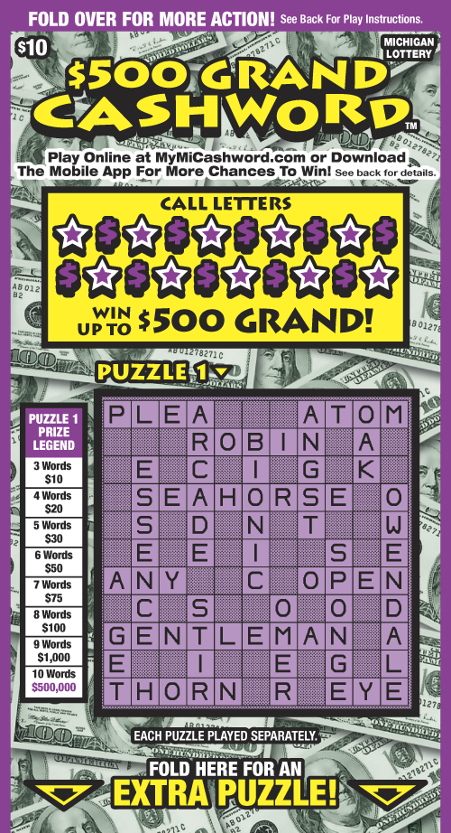
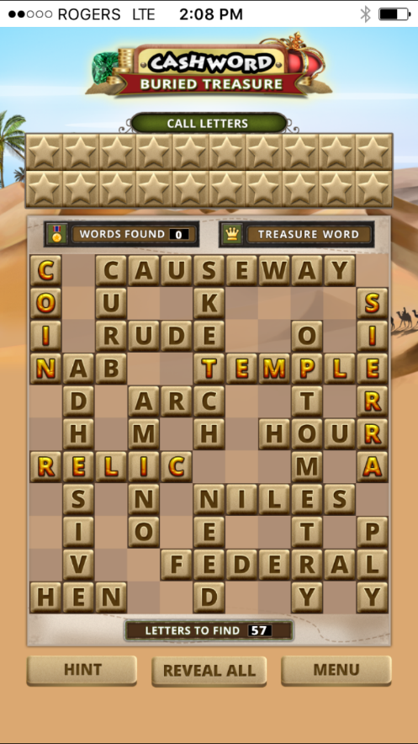
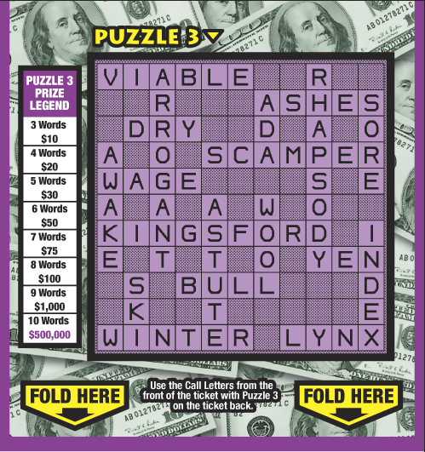
MI Cashword Survey Results
3/4 of 18-25 year old consumers who
played for fun
said they were
more likely to buy
tickets as a result

Slide 17





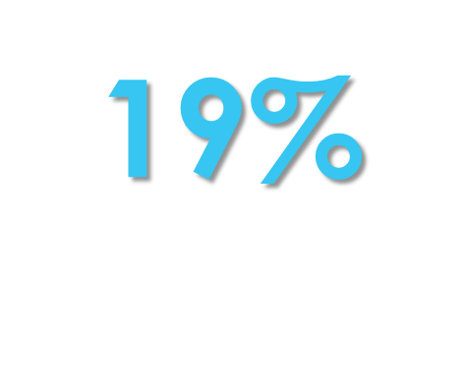



57%
2. Supporting retail
28%
65%
24%
23%
Notes:
From our WebPlay launches, we have seen an average of 36% increase in comparable ticket sales when doing a 12-week comparison.
MI Cashword 28% Cashword category
ID Cashword 57% $3 and $5 Cashword tickets
MD Crossword 23% $3 Crossword tickets
LQ Mots Cache 19% $3 Mots tickets
MI Wild Time 105% $5 Wild Time tickets
CA Deluxe 7’s 36% $20 tickets
MI Bingo -5% Bingo category
KS Crossword 24% $10 Crossword tickets
Note that Vermont sales increase is only for 6 weeks pre and post.

Slide 18




Cashword Sales Increase
36%
Notes:
From our WebPlay launches, we have seen an average of 36% increase in comparable ticket sales when doing a 12-week comparison.
MI Cashword 28% Cashword category
ID Cashword 57% $3 and $5 Cashword tickets
MD Crossword 23% $3 Crossword tickets
LQ Mots Cache 19% $3 Mots tickets
MI Wild Time 105% $5 Wild Time tickets
CA Deluxe 7’s 36% $20 tickets
MI Bingo -5% Bingo category
KS Crossword 24% $10 Crossword tickets
Note that Vermont sales increase is only for 6 weeks pre and post.

Slide 19

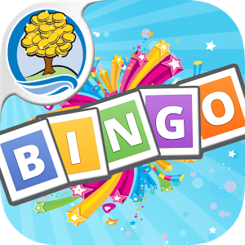
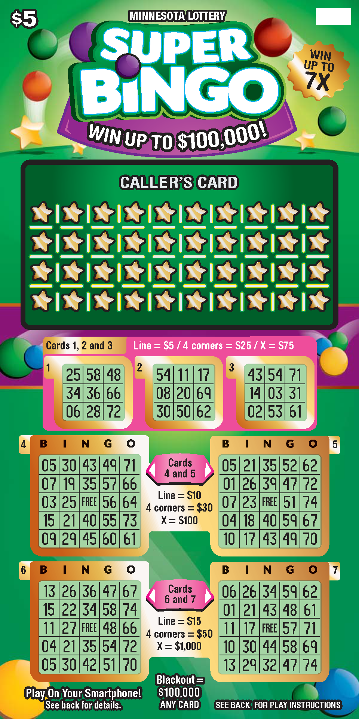

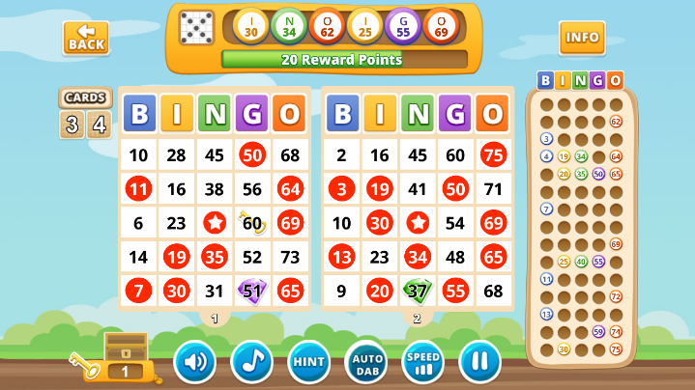
$5 Super Bingo with App
Ten Week Sales Results
74%
HIGHER
than average ten-week sales of all other
$5 Bingo games
launched since 2009
Notes:
We recommend this interactive game not only for the overall look and feel and play value but for the strong results the game is generating.
When compared to the ten week average sales of all other $5 Bingo games launched since 2009, Super Bingo in Michigan outperformed the average sales by 74%.

Slide 20
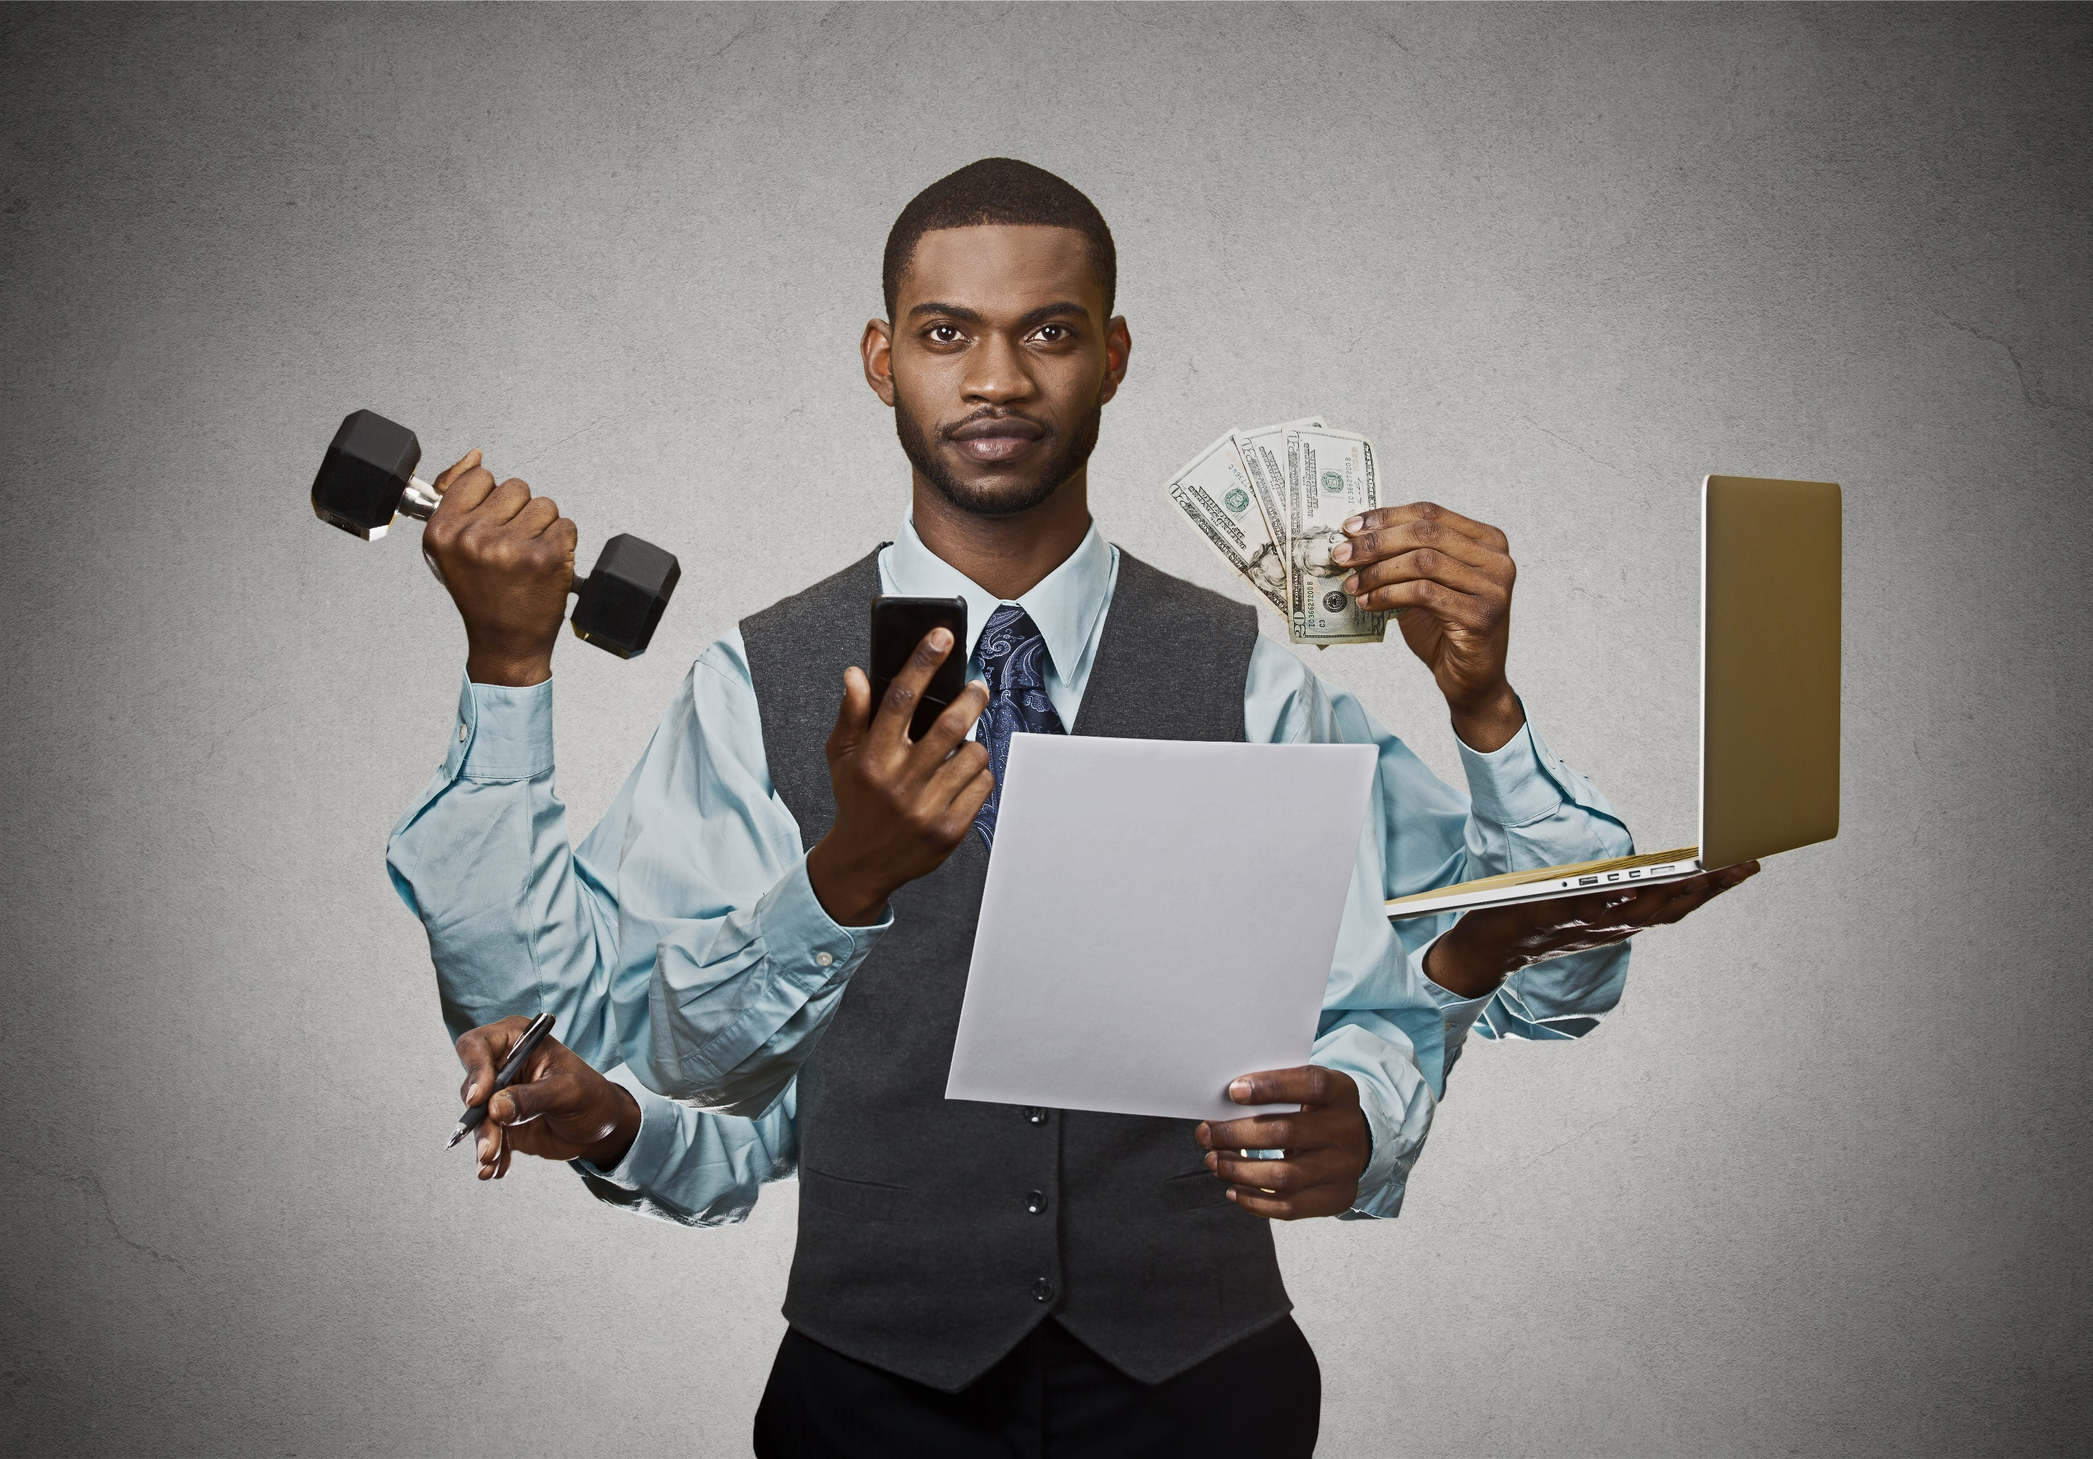

3. Connecting Digital eco-system
Notes:
Everyone is busy today and is forced into multitasking like no other generation. We utilize technology to help make our lives easier… and more fun! We may have different apps on our phones and tablets that are personal to us: social media, sports, news, stocks, gaming and lottery. Let’s make sure we are maximizing our apps today to the fullest and continue to develop new ones that will keep our cores strong.

Slide 21

Keep
Your Core
Strong

