Slide 1
Simon Butler CEO,
ABACUS Solutions International Group
September 2016, Lottery Expo, Miami PGRI Conference

Slide 2
THE PROMISE OF API TECHNOLOGIES A view from the other side, an alternative approach

Slide 3
THE PROMISE OF API TECHNOLOGIES
The NASPL retail initiative stated from the start-
“…that the industry should establish a standard lottery API for multilane sales that retailers can incorporate into their solutions to enable lottery sales to take place within a multi-lane environment.”

Slide 4
PROBLEMS AND CHALLENGES AS SEEN BY ABACUS
A complete system rather than a common API
Significant development, management and operational control by ONE entity
Costly to run and operate
Imposes a solution on a retailer
Retailers are told how to do it rather than how they want to do it
Retailers don’t need lottery…they may want it, but not at any cost

Slide 5
SO IS THERE ANOTHER WAY OF LOOKING AT THIS?
Lotteries need to grow sales
In-lane is completely underdeveloped
So we need to make it easy for the retailers
That doesn’t mean asking them to develop to our API – even if it’s a standard one – in fact it means the opposite
We need common API’s which are fully supported by ALL vendors
But allows the retailer to choose how they wish to implement their solution
All within NASPL guidelines

Slide 6
THE ALTERNATIVE POSSIBILITY FOR LOTTERIES
Is to consider a vendor independent alternative that is more open
Solutions that take into account existing retailer capabilities and infrastructure
Implement a common industry API on all vendor hosts
But allow third party suppliers to compete for the business of transaction processing & routing
Working with the retailers, not imposing upon the retailers
Allow retailer choice as to how they connect either directly or through their preferred third party gateway/vendors

Slide 7
COMPARISONS WITH THE
BANKING WORLD
Key Requirements/Drivers | Banking | Lottery
High level of security | ✓ | ✓
Resilient | ✓ | ✓
Quick response time | ✓ | ✓
Easy & cost effective to implement | ✓ | ✗
Existing retailers’ requirements and infrastructure | ✓ | ✗
Flexibility | ✓ | ✗
Openness | ✓ | ✗
Vendor Independence | ✓ | ✗

Slide 8
HOW THE BANKING
SERVICE EVOLVED
EPoS
Payment Terminal
Bank
EPoS
Common
API
`
Payment Terminal
Open
Network
3rd Party
Dedicated
Network
Bank
Bank
Common
API
EPoS

Slide 9
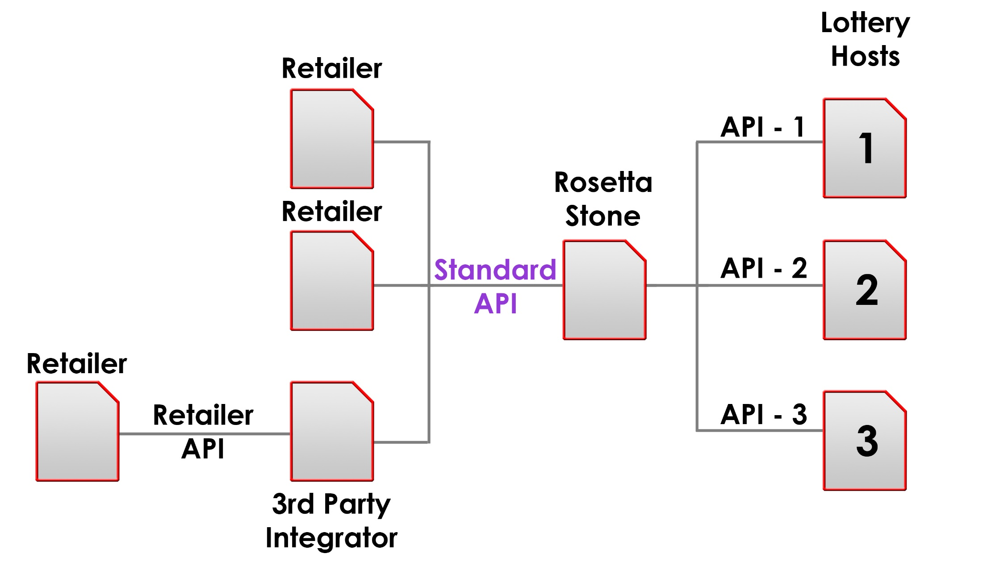
NOT A SYSTEMS SOLUTION

Slide 10
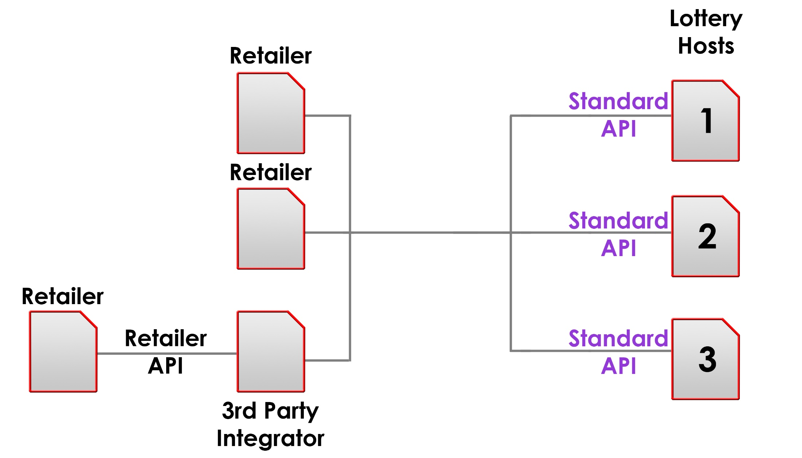
AN OPEN API

Slide 11
A PROPOSAL – AN OPPORTUNITY TO CHANGE
An open API not a “Systems Solution”
A more open architecture
Define the Interface definition/ standards
Define security requirements
Define business rules & operating framework
Create Industry body to manage standards going forward
Create accreditation process
Create open process for gaining accreditation
Create open environment to enable vendor competition
Enable Vendor independence
Define the what not the how

Slide 12
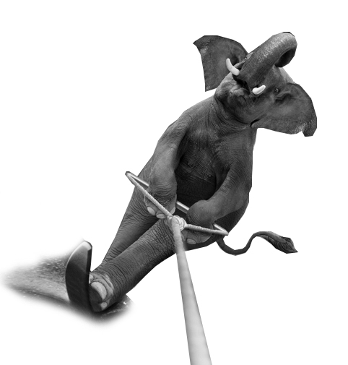
THIS IS HOW ABACUS HAS DONE IT IN THE NETHERLANDS
We went live in November last year
Our approach was to make it easy and cost effective for retailers partnering with their existing retail service providers (i.e. gift card, mobile phone top up etc).
Integrated to existing lottery vendor interface
Abacus managed the whole service implementation on behalf of the lottery operator and retailer
Integrated to four major retailers enabling more than 8,500 cash tills (12,500+ by end of year)
Implemented the second largest supermarket chain from project initiation to going live in less than 6 weeks, enabling 3,500 cash tills

Slide 13
COMING BACK TO MY OPENING STATEMENT
A view from the other side- an alternative approach

Slide 14
DID ANYONE NOTICE AN ELEPHANT?

