Slide 1

things
good
happen
iLOTTERY ONE YEAR LATER
Notes:
- Introductions
- Scott to review business performance after 1 year
- Danny to review operations and insights

Slide 2
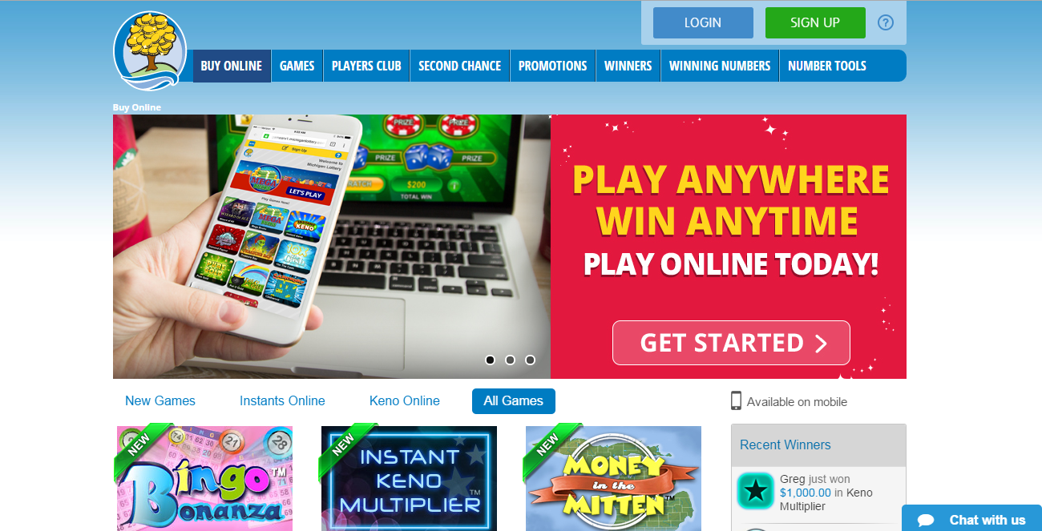
iLOTTERY
LAUNCH
AUGUST
2014
Notes:
iLottery launched in August of last year
No marketing until December (8 months with marketing support in year)

Slide 3






SALES
COMPARISON
IN MILLIONS
$126
$120
$108
$59
$56
iLOTTERY SALES
iLOTTERY SALES
Notes:
Note: August 11, 2014 to August 10, 2015
Sold over $120 million in the first 12 months
On pace for nearly $150 million this fiscal year
Next year we are projecting $250 to $300 million
Possible mention: Comparing sales from the last week in August, iLottery sales were greater than Mega Millions and Power Ball combined ($4 million in iLottery bets vs. $3.3 million in Mega + Power)

Slide 4

iLOTTERY
AS A PERCENT
VS RETAIL
8%
OF RETAIL SALES
RETAIL
Notes:
iLottery sales over the first year represent an 8% share of same-game retail sales (Instants & Keno)
With the addition of Draw Games later this year, we expect an even larger share next year for iLottery

Slide 5




things
good
happen
10%
5%
RETAIL
RETAIL
RETAIL
Notes:
Retail sales have been up in parallel with iLottery sales
Instants up roughly 10% and Keno is up 5% year over year
Possible Mention: Keno To Go is up 14% year over year, which is one step away from playing Online Keno, demonstrating these are different players

Slide 6
REVENUE
CONTRIBUTIONS
TO GOOD CAUSES
things
good
$10 MILLION
SCHOOL AID FUND
happen
Notes:
Roughly $10 million will be given to Schools as a result of iLottery in the first year, after all expenses
If we adjust that for the first 12 months (projected) with marketing support, the number will surpass $14 million

Slide 7

BRAND
NEW
PLAYERS
36%
Notes:
- 36% of depositors were new players (not from Player’s Club)
- Marketing efforts will be utilized to cross these players into retail play in the coming year

Slide 8
YOUNGER PLAYERS
1/3
BETWEEN 18-35
Notes:
Evidence shows that we are attracting younger players with iLottery
Roughly 1/3 of players are between the ages of 18-35

Slide 9
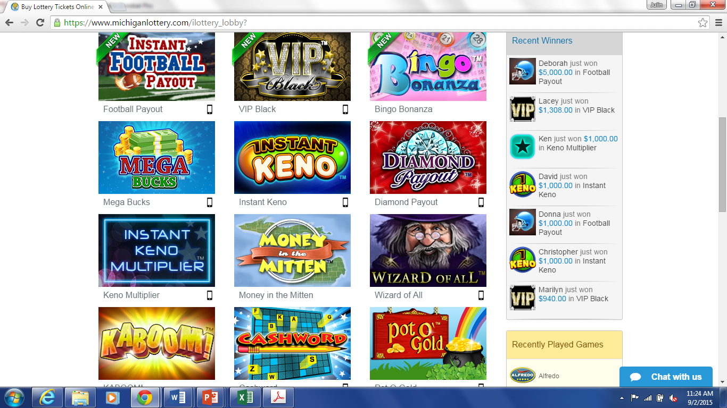
72,000,000
MICHIGAN
iLOTTERY
ATTRACTS
YOUNGER
PLAYERS
GAMES
PLAYED
Notes:
Over 72 million games were played in the first year
With more games being added, and lower price points, this figure will steadily rise in the coming year

Slide 10

RISE
OF
MOBILE
41%
SALES
53%
PLAYERS
Notes:
Mobile players and sales has been on a steady increase since launch
In the first year they represented 41% of sales, and 53% of players

Slide 11

RUNNING THE BUSINESS
payments
marketing
games
analysis
user experience
Notes:
Introduction to Danny
Danny: take some time to illustrate our operations and a key insight from each department

Slide 12

GAMES
Notes:
Games Department
Primary Purpose
To maximize sales by ensuring we have the correct content, pricing and prizing strategies to reach and retain our target audiences

Slide 13


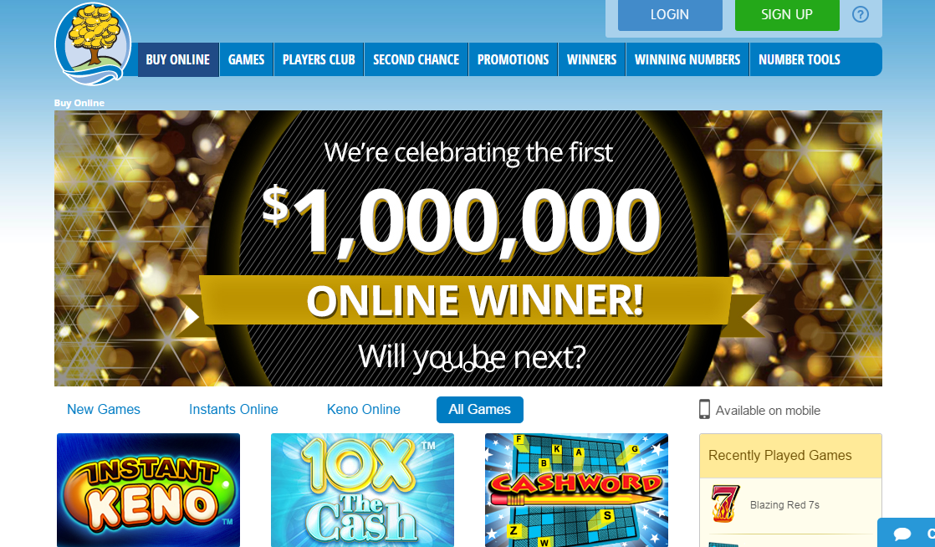

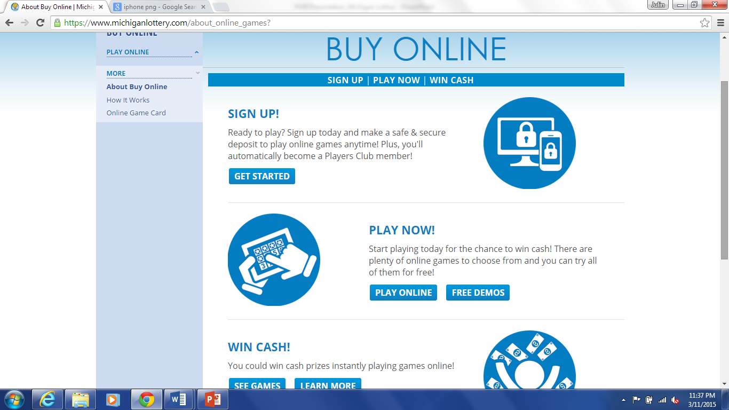
CHANNEL OF PLAY
Notes:
Key Insight
We started with an approach that some games make more sense for mobile and some make sense for desktop.
We quickly realized that this approach complicated marketing efforts too much (e.g. we can’t control if an email campaign or social media post is opened on a mobile device)

Slide 14


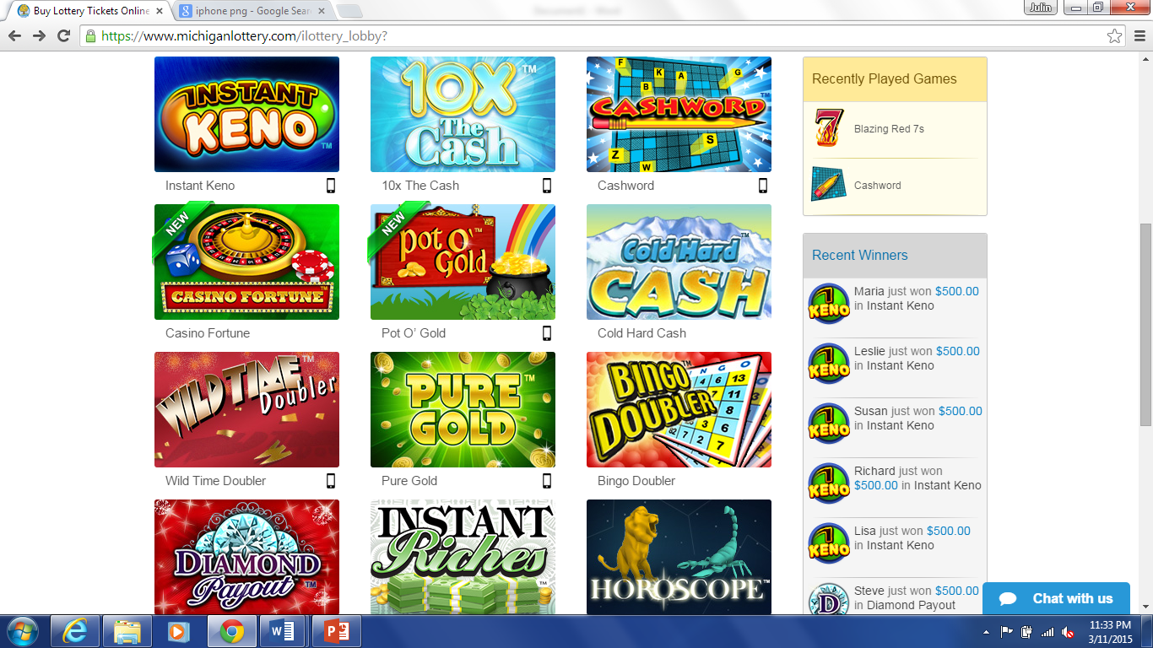
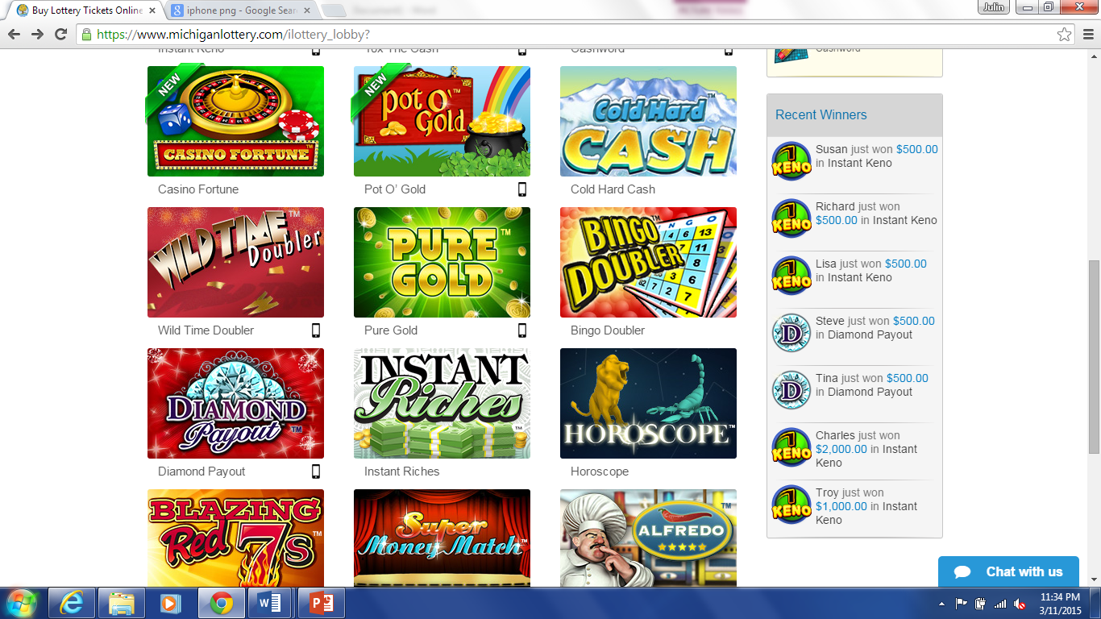
single
channel
multi
channel
5-10X
Notes:
Games that are offered across all channels vs. a single channel perform 5 to 10X better in terms of average sales.
Logic would suggest it would in the range of 2X better given the 50/50 split between desktop/mobile sales
Recent focus groups show that players don’t understand the limitations of a game only being on 1 channel, they expect it everywhere
Needless to say, we have formalized an approach moving forward where all new games are launched with desktop, tablet and mobile variations. Old single-channel games will likely be the first to be eliminated from the portfolio.

Slide 15

USER EXPERIENCE
maximize
Notes:
User Experience Department
Primary Purpose
To maximize traffic and registrations to Michigan Lottery’s digital properties.

Slide 16
online visitor traffic – 5 years
Notes:
- Chart represents monthly sessions to all digital properties over the past 5 years
We’ve been making investments for years to boost our online traffic, which helped fuel our iLottery launch
The team A/B tests constantly on our sites to maximize traffic, and clicks towards iLottery registration

Slide 17
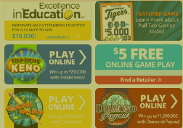
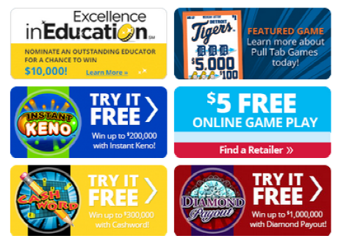
play online
A
B
testing
try it free
Notes:
We observed that many iLottery jurisdictions were using “Play Now” and “Buy Online” buttons on their site banners.
So we tested both of these and didn’t see a huge difference between the two.
But then we ran a split test on a “Try for Free” and linked players to our free game demos and the results were significantly better
On these banner ads, found on our home page, it drove 80% better results during the test period

Slide 18
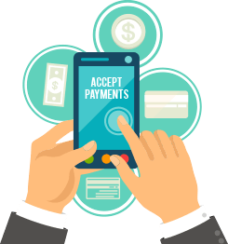
PAYMENTS
ALL
OF THE ABOVE
STRATEGY
Notes:
Payments Department
Primary Purpose
To maximize consumer payment options for both offline and online lottery purchases.
We view payments as an “all of the above” strategy, it’s just a question of how to best prioritize them

Slide 19
SHARE
OF
PAYMENTS
Notes:
This chart illustrates payments by source since our launch
Not so surprising, is the 2/3 share that credit and debit produce
But where we were surprised, is that the Online Game Card sold at retail stores beat out ACH funding

Slide 20
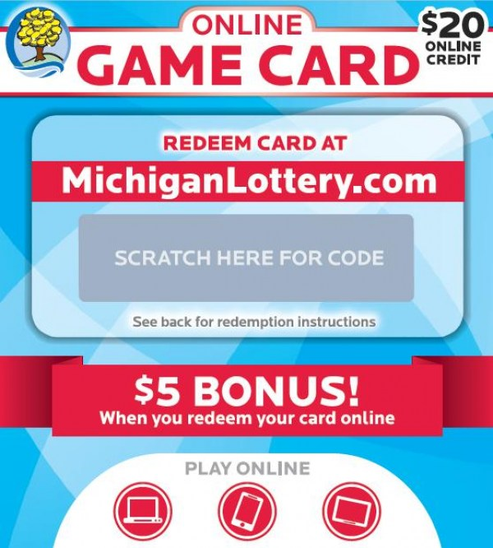
innovative payments
used exclusively by 20% of players
Notes:
If you haven’t seen it before, this is a picture of our Online Game Card produced with Pollard
It was quite simple, it takes the form of an instant ticket and is merchandised in the same bins
Players scratch to reveal a code they can enter online for $20 in credits plus a $5 bonus
A key insight that we learned was that 20% of players were exclusive to this form of funding for their iLottery play
As a result, we are looking to expand retail payment programs for iLottery in the coming year

Slide 21


MARKETING
player funnel
Notes:
Marketing Department
Primary Purpose
To acquire new players and to maximize the retention of current players.

Slide 22





acquisition sources
38%
28%
1%
3%
7%
display
paid
search
direct
mail
online
game card
database
Notes:
This slide illustrates the acquisition source of new players in the first year
As you can see, most players came from our Player’s Club database that we had been building over the past several years
We used our marketing database, and other tools, to activate these players

Slide 23
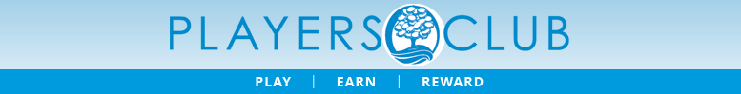
E-COMMERCE VALUE OF DATABASE
64% DEPOSITORS
$86.4
MILLION IN SALES
Notes:
Key Insight
The Player’s Club is an early-adopter base of iLottery players
In fact, they represent roughly 2/3 of all new depositors in the first year
If you’re investing into a loyalty program and looking for ROI justifications, we generated $86 million in first-year bets from this group
That’s about $12 million in net before operating expenses this year

Slide 24

ANALYSIS
Notes:
Analysis Department
Primary Purpose
To improve decision making of all departments by informing with data-driven insights.

Slide 25

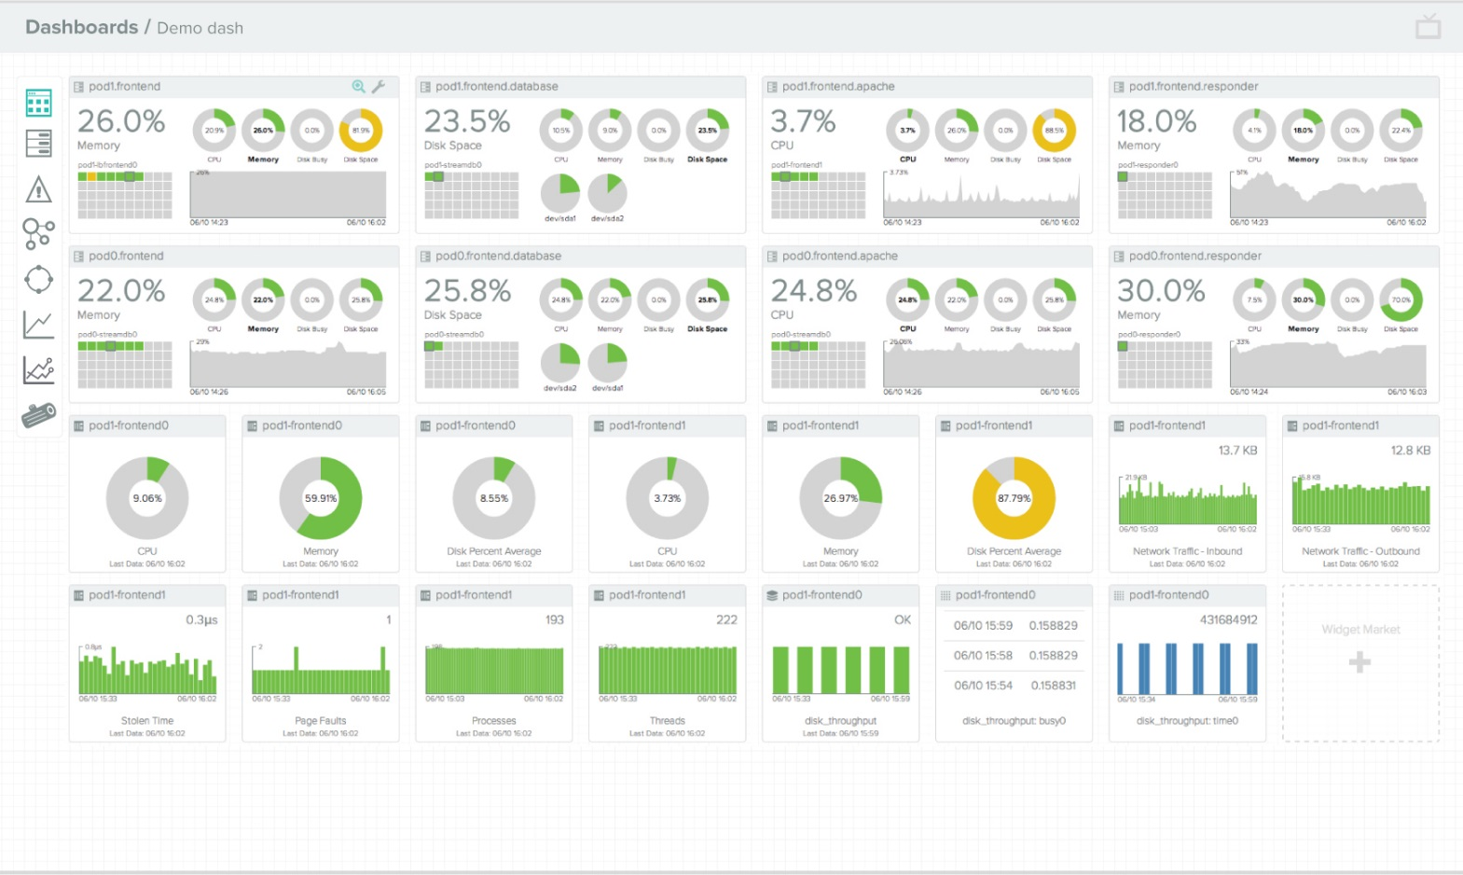
games
retention
payments
site traffic & advertising
Notes:
The team underpins all other departments and produces weekly dashboards for nearly everything; site traffic, advertising, retention, games, payments, etc.

Slide 26

PEAK
4 PM
5 PM
6 PM
7 PM
8 PM
9 PM
10 PM
11 PM
PEAK
5 TIMES
PEAK
PEAK
PEAK
Notes:
Key Insight
This is actually a quite simple example, but illustrates the interaction between the departments very well
After analyzing peak play times on the sites, there was an insight formed around the best times to acquire new players
The Analysis team informed the Marketing team to concentrate digital budget spend between 4pm and 11pm
Conversion rates for Paid Search have been 5X more effective since adopting this change (among other optimizations)

Slide 27

Notes:
It’s been a very successful year, and as Scott stated there are many more exciting things to come in the future
Each of the teams are helping to drive the business forward each day
Last week, we broke a new record in sales with roughly $4.4 million in bets

Slide 28

thanks
questions?
SCOTT BOWEN
DANNY BOGUS
Notes:
- Thank you, Scott and I are happy to take any questions

