Slide 1

Panel Discussion: Retail Optimization:
The Outside-The-Store Consumer Experience
April 6, 2016
Notes:
Earlier today, we listened to a panel talk about Lottery retail optimization practices and technology that can turn retail customers into Lottery players inside-the-store.
This panel will discuss the out-side the store experience, and how Lotteries can leverage our online connection to millions of consumers to ultimately drive them to retail.
We will explore how we can further optimize the Lottery’s eco-system of consumer touch-points to improve the customer experience and create a relationship with consumers.
Panel Introductions:
Panelists:
David Barden, Chief Executive Officer, New Mexico Lottery
Kevin Gass, Vice President, Lottery Gaming, BCLC (British Columbia)
Bill Thorburn, Group Executive – Lotteries (International), Tatts Group Limited
This PGRI conference is a reminder of how much the retail market place has changed over the past few years. We live in an increasingly cashless society where much of our communication happens through social media and the digital channel. Furthermore, the competition for our customer’s attention and loyalty is fiercer than ever.
Most of our competition is significantly ahead in using digital, social media, loyalty and CRM (Customer Relationship Management) to help deliver marketing, sales and business goals; and a more positive customer experience.
In order to improve the customer experience, Lotteries must be even more customer-focused. We must be dedicated to meeting and exceeding the needs, expectations and requirements of our customers at every step of their customer journey. To do that, we must seek first-hand customer information and use it to develop and improve our products and services.
Consumers are on the move and eager to engage with brands that provide seamless interactions across channels and devices, but often the experience they encounter is fragmented.
Successful brands realize the buyer journey must be better integrated, but as channels continue to proliferate, it’s challenging to get the full picture of what the customer experience looks like.
In this age of interactive and social media, it’s not just about targeting and segmenting customers. It’s really about engaging with people one-on-one.
To personalize the digital experience and gain competitive advantage - many brands have completed a detailed customer journey mapping exercise to help get closer to their customers.
Our brand can’t rise above the noise if we aren’t relevant or don’t serve an important purpose in our customers’ lives. Mapping the customer journey can help determine the purpose of our digital marketing efforts.

Slide 2
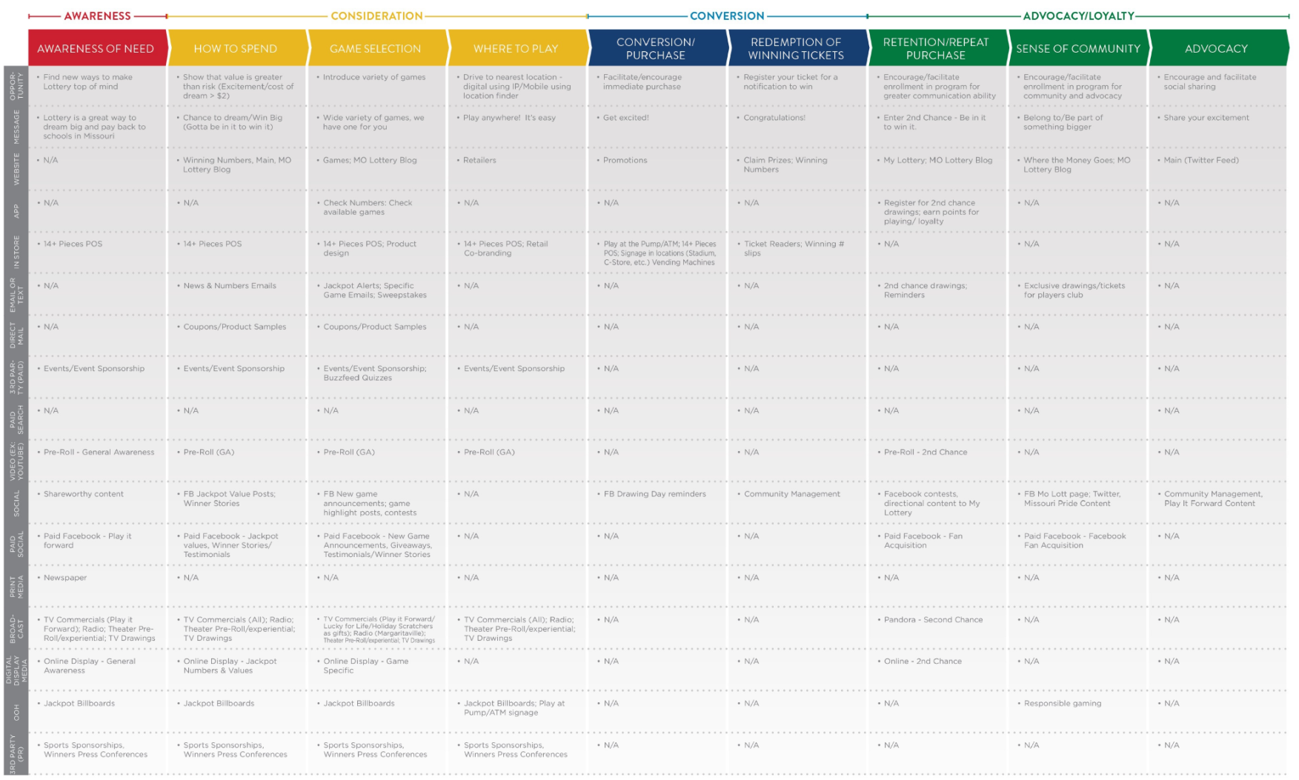
Missouri Lottery:
Mapping the Customer Journey
Notes:
Missouri Lottery has attempted to map the Lottery customer’s digital journey. We identified the opportunity, the key messages, and 16 potential mediums to reach customers on their journey from Lottery awareness of need to Lottery advocacy.

Slide 3
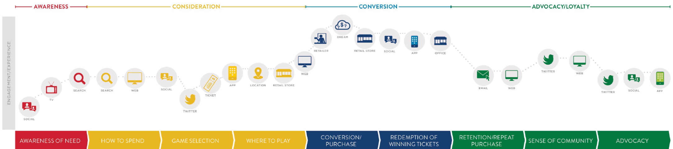
Customers Move Through A Continuum From Awareness, Consideration,
Conversion and Loyalty
Notes:
All customers move through a continuum from awareness of need, consideration, conversion and loyalty.
Panel Question:
How valuable is the customer journey mapping in helping raise awareness for Lottery and converting consumers into loyal Lottery players?
How can Lottery’s use customer journey information to more effectively engage with millions of consumers outside-the-store and ultimately drive them back to retail.

Slide 4
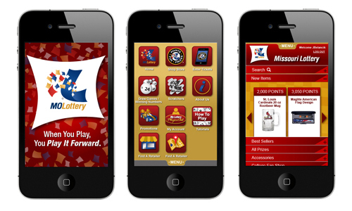
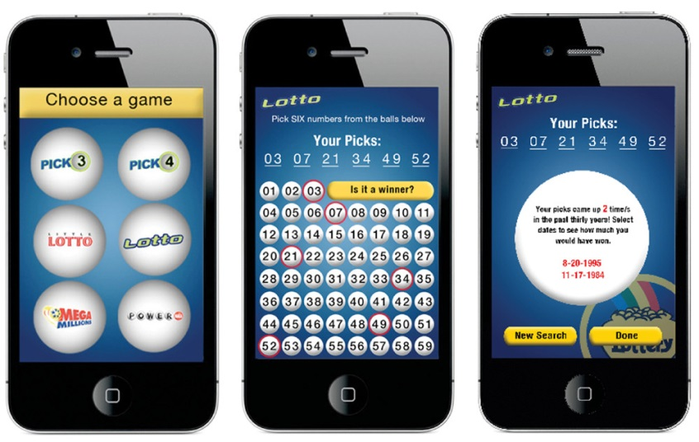
How Can Lotteries Leverage Mobile Apps?
Notes:
One tool an increasing number of Lotteries are using today to create Lottery product awareness, encourage consideration, build loyalty and improve the overall customer journey is mobile apps.
More than two-thirds of the U.S. population owns a smartphone, and people are using it for everything from buying products to banking. Many retail brands are having success using mobile apps for proximity marketing and sales.
Panel Question:
Several lotteries are active in the mobile space but still many are not. Can Lotteries really afford to neglect the need to connect with the consumer through the digital channel even though most can’t currently sell lottery products on-line?

Slide 5
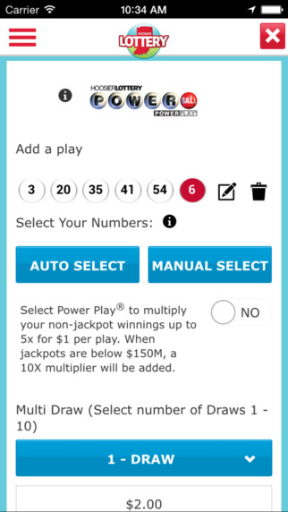
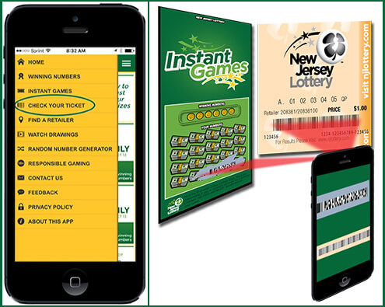
Mobile App Customer Engagement =
Customer Retention
Notes:
How many here have apps on their phone they have used only once?
The customers who are the most likely to keep using an app are the ones who establish a consistent pattern of engagement. And because even small lulls in customer engagement levels can result in significantly lower retention, it's essential for brands to create experiences and messaging campaigns that make interacting with their app consistently valuable for their audience.
Recent research conducted by Appboy* has found that levels of customer engagement have a direct correlation with levels of customer retention.
Only 55% of individuals who use an app in the first week after download will be retained (or will show further activity over the next three months)
90% of the people who engage weekly for the first month after download are retained, compared to only 23% of people who don't engage in the second, third and fourth week
Panel Question:
How are some Lotteries leveraging mobile to improve the overall Lottery experience, encourage relevant interaction, increase consistent player engagement and ultimately direct them back to retail?
What are some additional utilities and functionality Lotteries could add to their mobile Apps?
Retailer locator
Digital Play Slips
RNG (shake the phone)
Check a Ticket
Scan tickets for entry into promotions and loyalty program
Free play games for points or product
Jackpot Alerts
Purchase tickets
Push notifications (using instore - beacon technology)

Slide 6
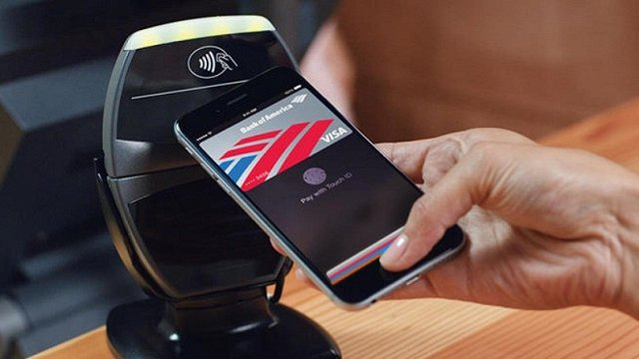
Mobile App Wallet
1 in 5 smartphone users will use mobile payment by end of 2016.
Notes:
Despite early security concerns by some, nearly 1 in 5 smartphone users (37.5 million) will use proximity mobile payments by the end of 2016.
Total mobile payment transactions are estimated to reach $27 billion, with users spending an average of $721 annually by the end of 2016.
Apple Pay, Android Pay and Samsung Pay will soon be a standard feature on new smartphones.
And more retailers will adopt point-of-sale systems that can accept mobile payments; and incentives like promotions and loyalty programs will be integrated to attract new users.

Slide 7
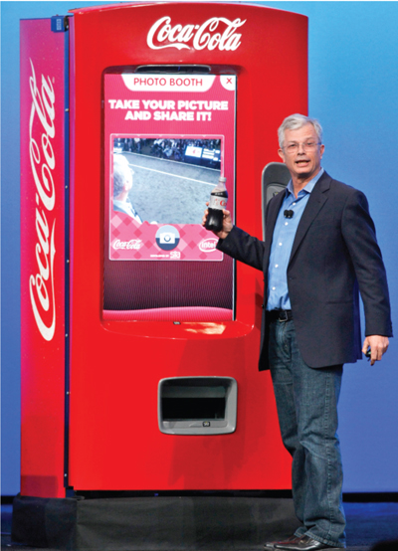
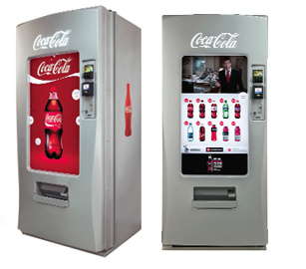
Notes:
Coca-Cola is releasing an app that enables consumers to get reward points for free sodas and other treats by using its vending machines. Consumers will be able to buy drinks without cash using the app, giving the brand a huge amount of data.
The mobile wallet is also provides the digital equivalent of everything you carry in your physical wallet, including coupons and loyalty cards. Having these items on your customers’ mobile phones creates an opportunity to increase your brand’s exposure, and loyalty.
Panel Question:
How can Lotteries and their retail partners use mobile wallet to add value for the brand and consumer?

Slide 8
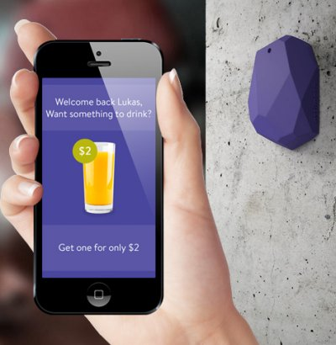
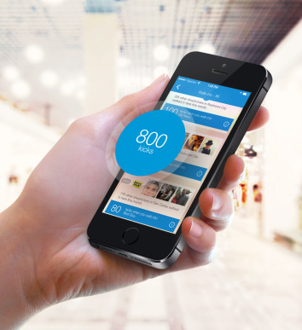
Beacon Technology =
Proximity Marketing At Retail
Notes:
Beacon technology first hit the public consciousness in late 2013. With the release of iOS 7, these small blue tooth devices can wake up closed apps on an iPhone. Thanks to beacon technology, a whole new world of place-based experiences are now possible.
Many national brands are already using proximity marketing to interact with their shoppers in the store including some existing Lottery retail chains (Shopkick i.e. you can receive offers in the stores, receive points from walking in, scanning items and purchasing).
Panel Question:
How could Lotteries use the power of Beacon Technology and proximity marketing to engage customers at retail via their mobile devices?
How could Lotteries deliver targeted campaigns to mobile devices within proximity of a retail location without seeming spammy?

Slide 9
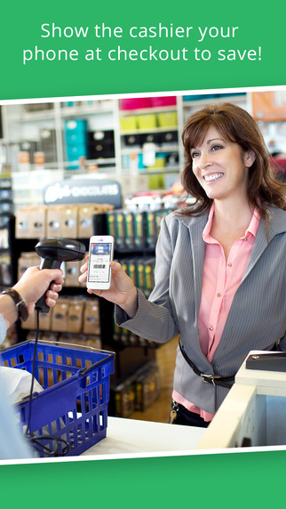
How Can Lottery Loyalty Programs
Increase Traffic At Retail?
Notes:
Today, several Lotteries are proactively focusing on loyalty in the customer journey, but do these programs help increase traffic at retail?
A recent survey conducted by Maritz Motivation Solutions and published in NACS online newsletter says “it’s more about the reward than loyalty.”
45% who are loyalty program members only purchase specific brands or shop in certain stores to earn rewards.
17% of loyalty program members joined because they love the products or the brand identity.
43% of consumers in loyalty programs want to earn rewards tied to the brand. But 60% of such consumers viewed the brands as offering loyalty programs only as a way to spur more sales, instead of cultivating more connections with customers.
Panel Question:
How can Lottery build brand loyalty and increase engagement by getting players to register for Loyalty programs and drive traffic to Retail?
Make enrollment into your loyalty program easier with fewer barriers (i.e. SS #)
Create more automatic participation in second chance drawings.
And how can Lottery leverage loyalty into heightened Retailer motivation and Lottery sales?
Allow loyalty points to be earned as tickets are being purchased at retail or checked through the Check-A-Ticket devices.
Include Lottery product coupons as rewards that must be redeemed at retail.
Allow players to earn points to buy retail-specific branded gift cards for food, beverage or gas.
Several retail chains have their own loyalty cards where they can earn points for gas discounts. Why not integrate with retailer loyalty programs. allow these same customers to earn points for free Lottery plays?
How can Lottery loyalty programs aim for "affiliation" and “cult loyalty” from members, which means they share identification with the brand and want to interact with similar customers? Like Starbucks patrons or Prius owners or even devotees to charitable causes and celebrities.
Use your sports sponsorships and other relationships to attract their loyal fans to Lottery through contests on social media.
Reward contest winners for sharing their winning moment’s photos, videos and stories on social media.
Play in groups?
Gamification?

Slide 10
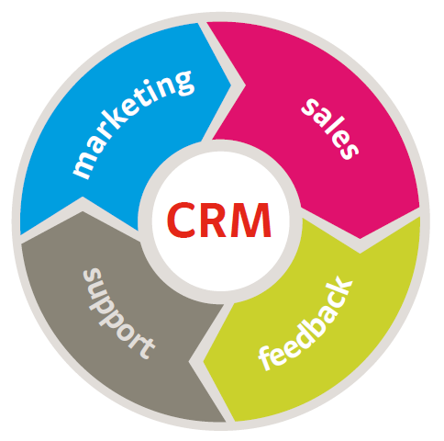
Customer Relationship Management Strategy CRM
Notes:
Many successful brands use Customer Relationship Management (or CRM) to increase incremental revenue by discovering and utilizing insights unique to their customers and business. Most Lottery play in North America today is still largely anonymous.
Identify precisely who our customers really are and tracking their behavior is impossible unless your Lottery captures player data through internet sales, loyalty, social or mobile engagement.
CRM Question:
What would it take to deploy a CRM strategy in the current Lottery environment?

Slide 11
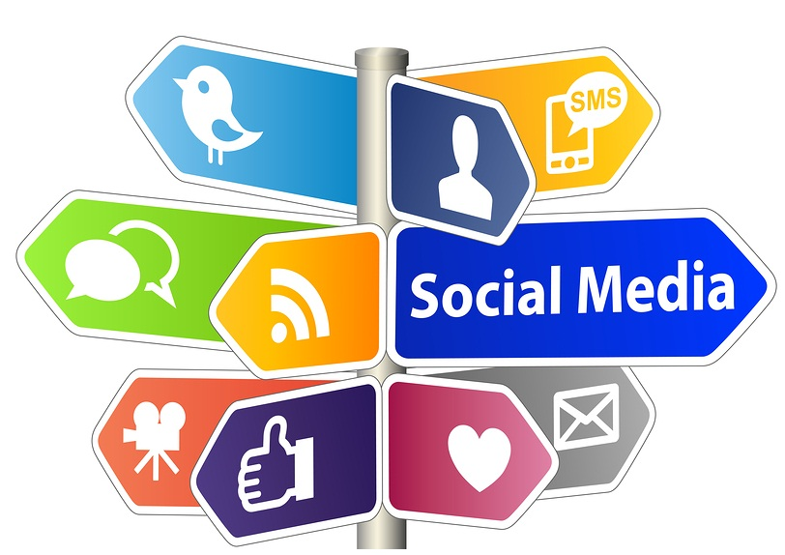
Social Strategy
Notes:
A successful social media strategy requires the deliberate integration of social media into a comprehensive Omni-channel, loyalty and CRM strategy. As a channel, social media presents unique opportunities and advantages for a brand’s loyalty initiatives with near real-time immediacy and the ability to enable two-way conversation. By engaging with customers, leveraging promoters and intercepting detractors, Lotteries can improve the customer experience.
Panel Question:
How can Lotteries harness the power of social to drive loyalty and improve the customer experience?

Slide 12
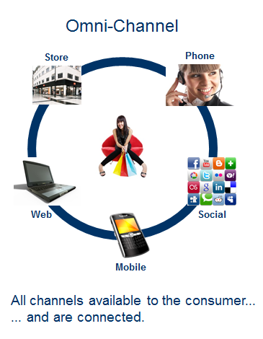
Lottery Omni-Channel
Notes:
There has been a convergence between brick and mortar retail and the digital channels.
Many national brands have adapted an Omni-channel approach to reach consumers where they are (whether that be at their brick and mortar locations, online or mobile). Because Lotteries don’t own their retail locations and most don’t sell on the internet yet, Lottery retailers have not yet adopted an Omni-channel model for Lottery.
Panel Question:
What would convergence (or Omni channel) look like for lotteries?

Slide 13
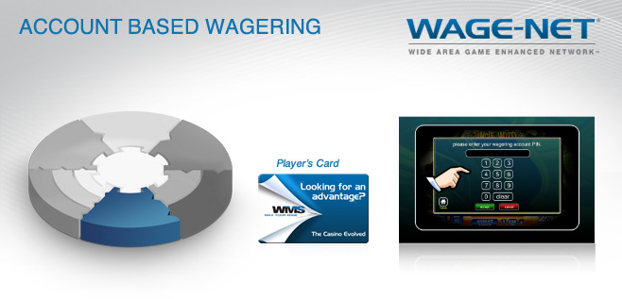
Account-Based Wagering (ABW)
Notes:
Account Based Wagering (or ABW) is an established and proven cashless solution used in the casino field for over 15 years, which utilizes existing player tracking cards to allow players to access their accounts and use their funds to wager at various gaming locations.
Players insert casino loyalty cards into the card reader, similar to an ATM card they log on with their PIN, and then transact with the server in real time as they play.
ABW provides many key benefits to operators and players.
Trusted and secure account (cash not on card)
Accounts can be anonymous or personalized
Personalization of messaging/promotions
Elimination of tickets and ticket-related costs
No forgotten, lost, damaged, or stolen tickets
100% patron tracking enabling more targeted real time interactions (rewards, communications).
Designed to enable responsible gaming initiatives of operators.
Panel Question:
ABW Sounds like a program that would offer retailers and players a lot of benefits? What is the appetite and potential role of Account Based Gaming at retail for North American lotteries?
Conclusion:
That’s all we have time for today. I want to thank our panel of experts for a very informative discussion on the various tools and strategies available to Lotteries today to improve the outside the store customer experience.

Slide 14
Thank You

